Slide 1
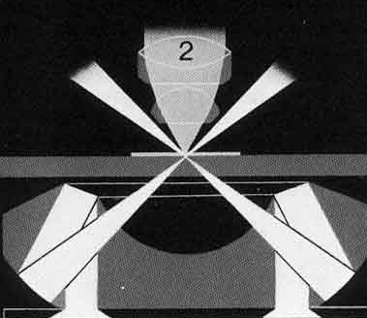
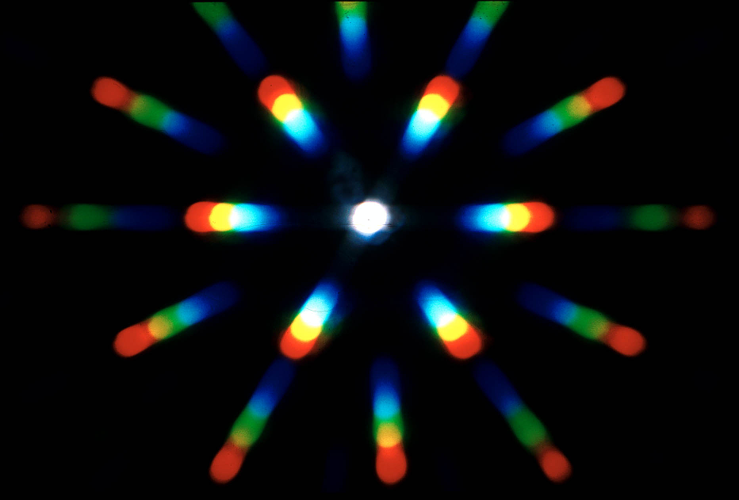
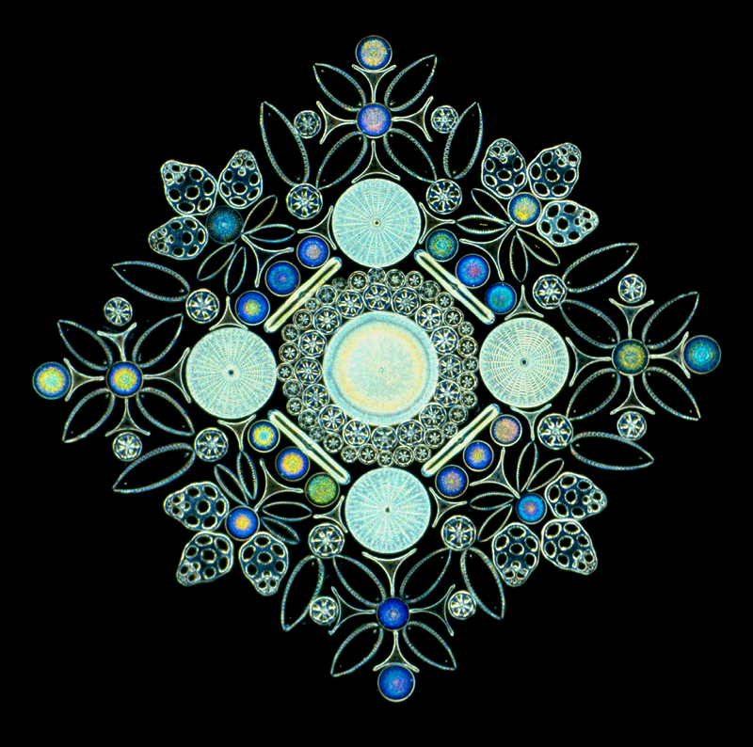
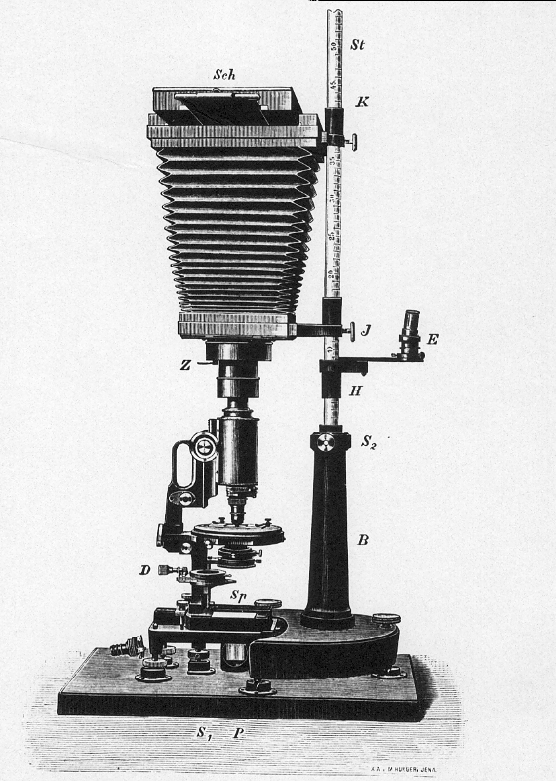
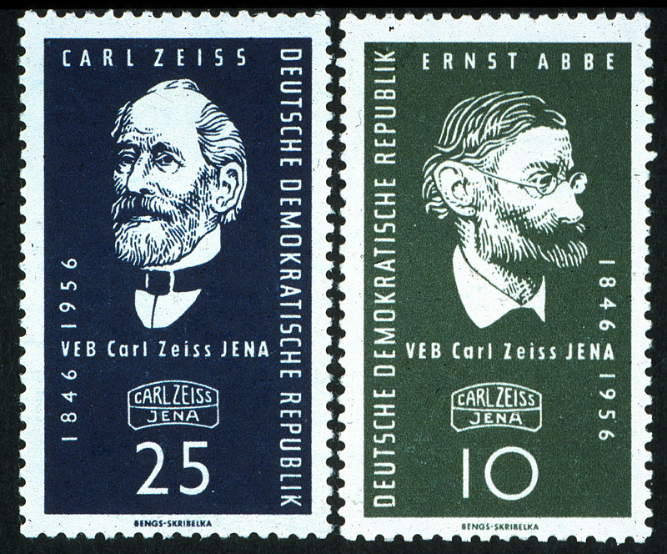
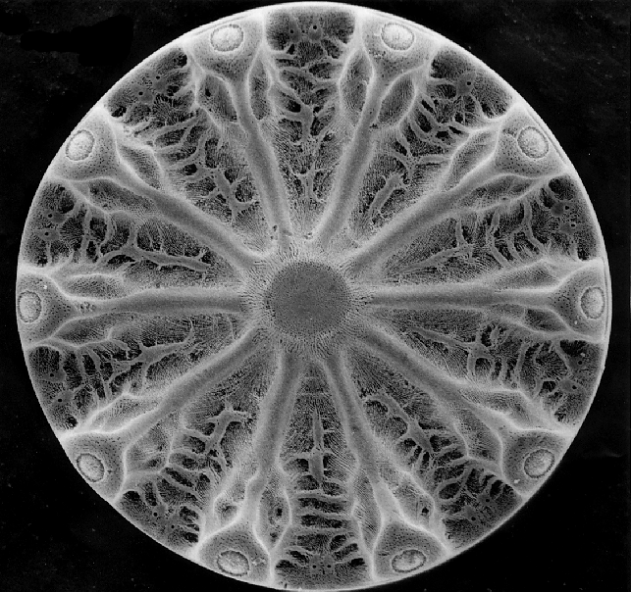
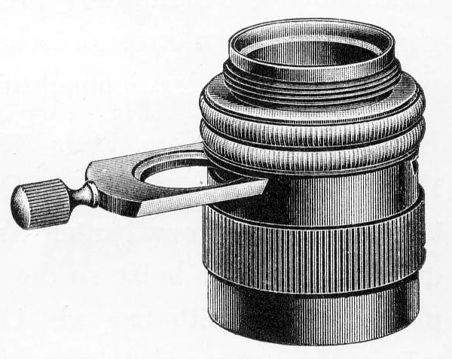
Introduction to Light Microscopy
Peter Evennett
peter@microscopical.co.uk

Slide 2
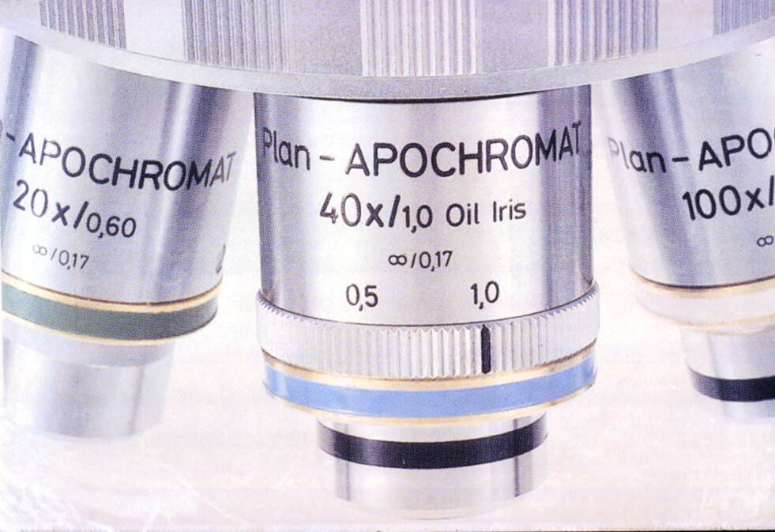
The Objective Lens
Modern microscope objective lenses are marked with several pieces of important information
The standard marking is
Magnification/Numerical Aperture
In the picture above: 20x/0.60 and 40x/1.0
Find the magnifications and apertures of your microscope lenses
The Aperture is the measure of the fineness of detail the lens is able to pick up – and is what you pay for!
It is the aperture that makes Magnification worthwhile

Slide 3
The importance of Objective Aperture
Every ray leaving the object carries some information about fine detail in the object
Objective
lens
Some of these rays
- and some information -
will be collected by the objective
Information
collected
Information
wasted
and some rays
– and some information –
will NOT be collected,
and will be wasted.
Resolution depends on angular aperture
of objective

Slide 4
Microscope Illumination
Once you have bought the objective lenses, there is little you can do to improve your microscope image…
…but it can easily be made worse by poor illumination of the specimen

Slide 5
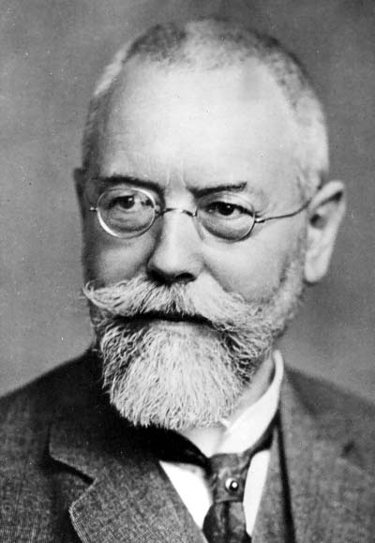
The standard method of microscope illumination is Köhler Illumination
devised by
August Köhler
in 1893

Slide 6
Köhler Illumination enables us to -
Light up the specimen uniformly
over an adjustable area
for objectives of different magnifications
And at the same time to
Illuminate the objective aperture uniformly
over an adjustable angle
for objectives of different apertures

Slide 7
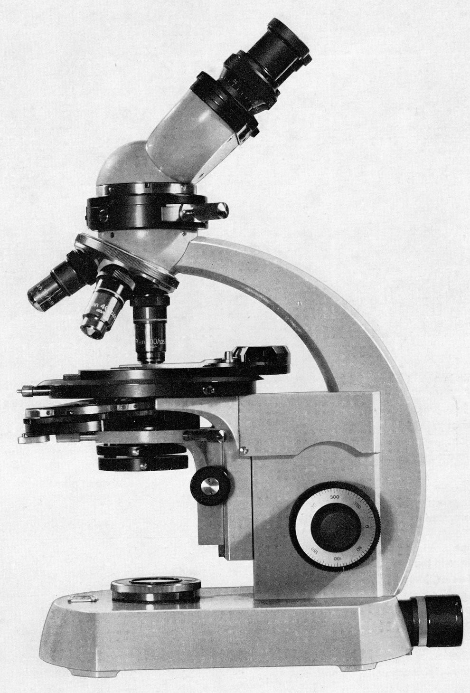
Parts of the microscope
Eyepiece
Identify these parts on your microscope
Objective lens
Stage
Condenser lens
Condenser Aperture diaphragm
Condenser Focus
Note: many of the microscopes in the lab do not have a Field Diaphragm
Field Diaphragm
Image focus knobs
Coarse & Fine

Slide 8
What are the diaphragms for?
The diaphragms are NOT intended for adjusting the brightness of the image
The
Condenser Aperture Diaphragm sets the angle of the cone of light illuminating the specimen, and is adjusted according to objective NA
The Field Diaphragm sets the area of specimen illuminated, and is adjusted according to magnification

Slide 9
Setting up Köhler Illumination
Start with both diaphragms (if you have two) wide open
Lamp turned on
Condenser lens raised to top
Lowest magnification objective in place
A stained slide on the stage
and get a focused image

Slide 10
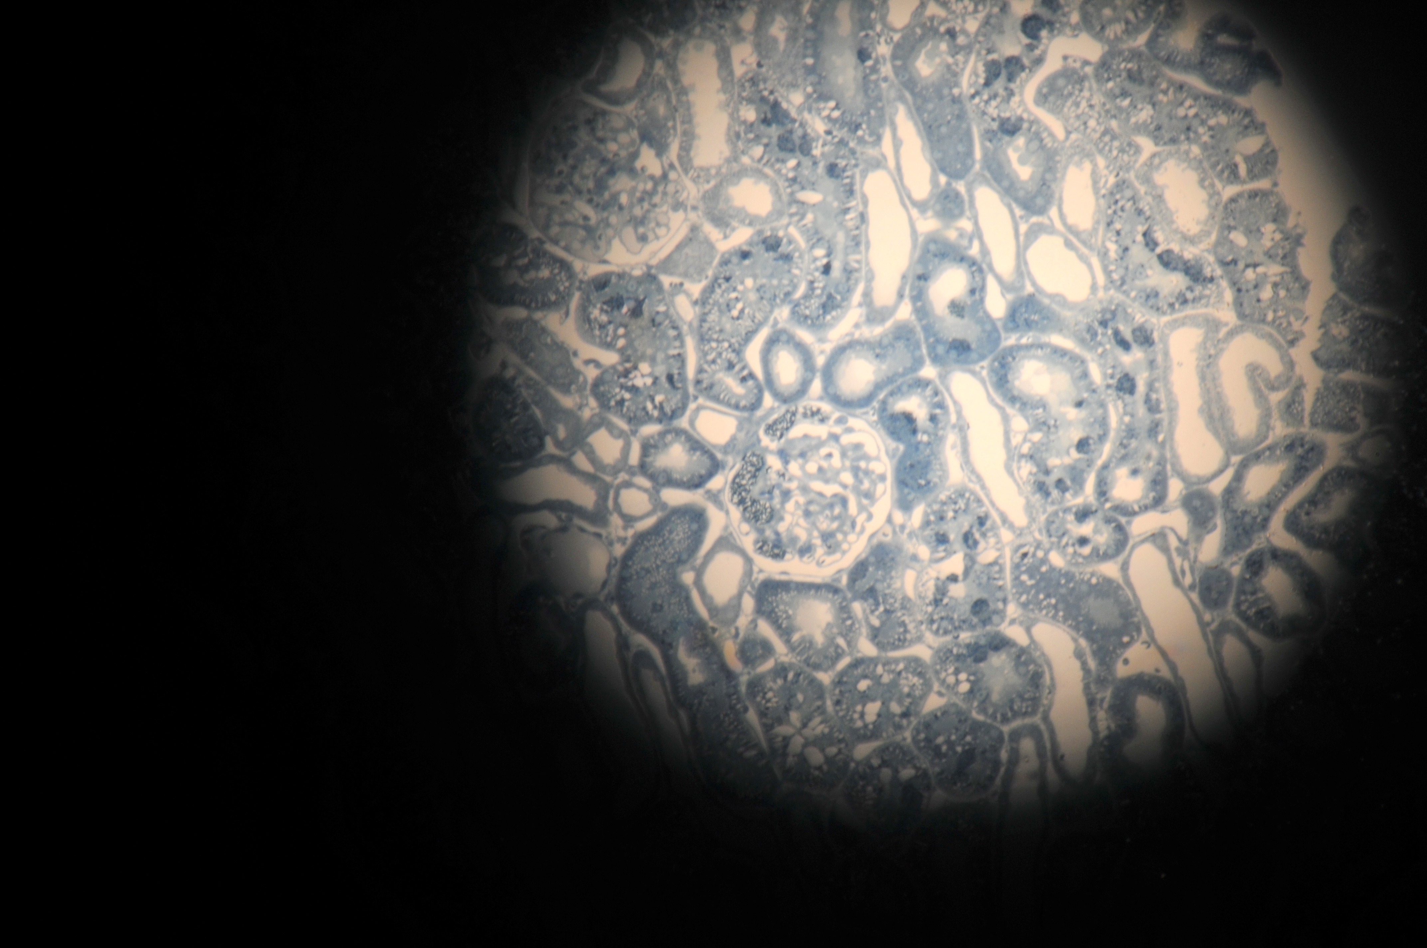
Stained slide on microscope, and image brought into focus

Slide 11
Partly close the Field Diaphragm
the one on the base of the microscope
(not all the microscopes
in the lab have one)
until area illuminated is reduced

Slide 12
You are now seeing the slide, together with an image of the field diaphragm at the edge, and which is probably
- not sharply focused on specimen
(has fuzzy edge)
- and not centred on field of view
Fuzzy edge

Slide 13
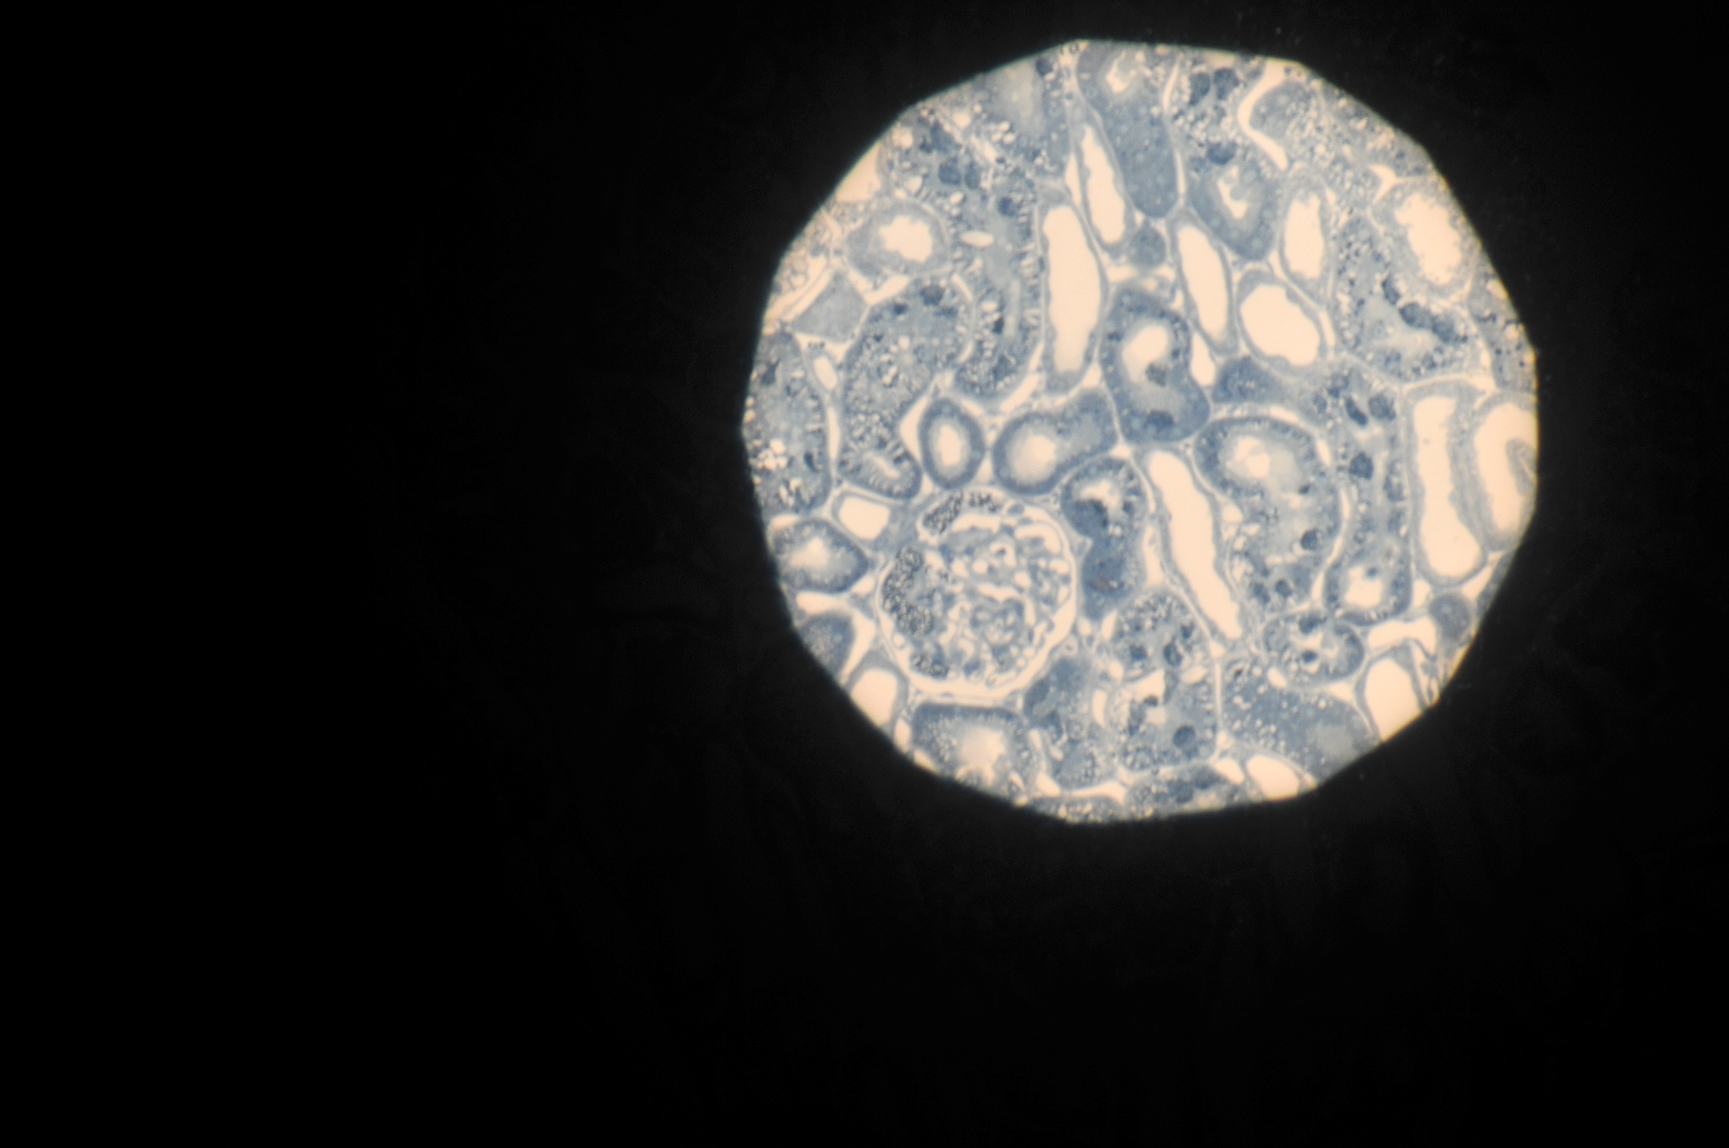
Adjust condenser focus (up and down) until image of Field Diaphragm is sharply focused on specimen
- but probably still not centred on field of view
Sharp edge
Field of view

Slide 14
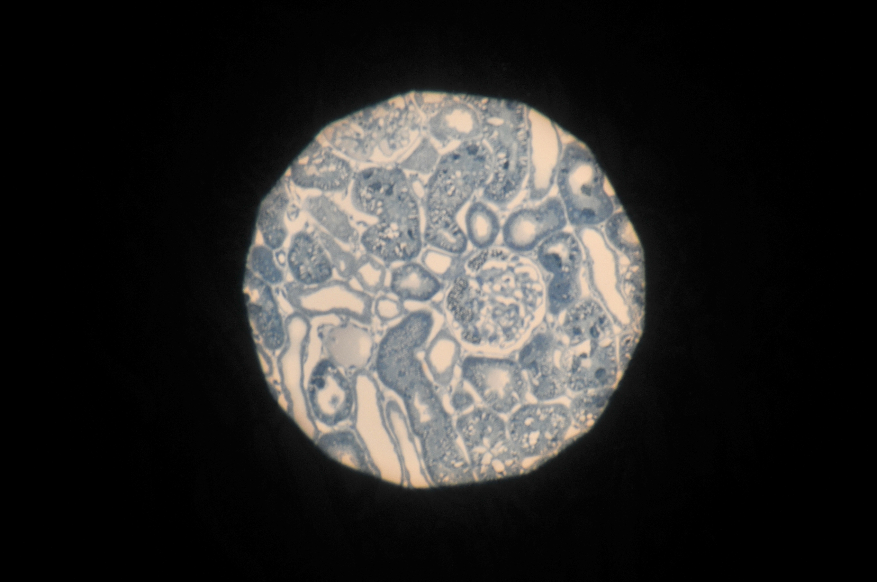
Adjust condenser centring screws until image of Field Diaphragm is centred on field of view.
Then open field diaphragm to illuminate full field

Slide 15
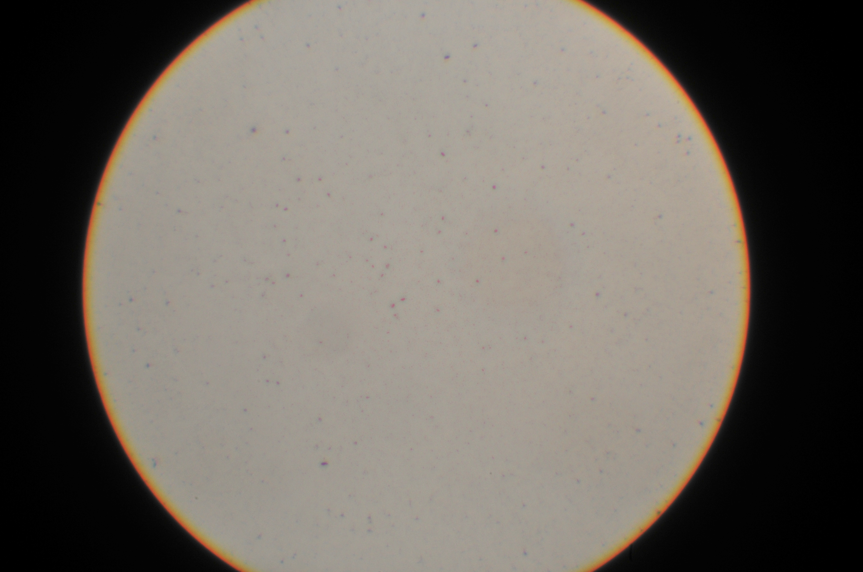
Take out an eyepiece and look down microscope tube
You are seeing the full aperture of objective
Full aperture of objective

Slide 16
Full aperture of objective

Slide 17
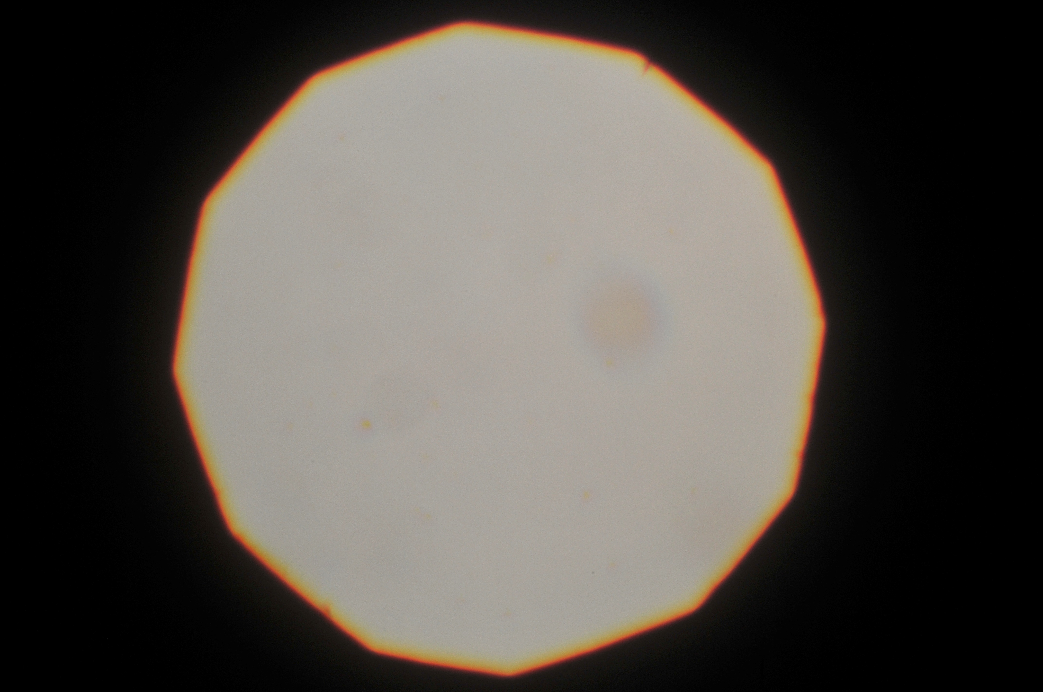
Close condenser aperture diaphragm until it is
Iluminating about 75% of the full aperture of objective
100%
75%

Slide 18
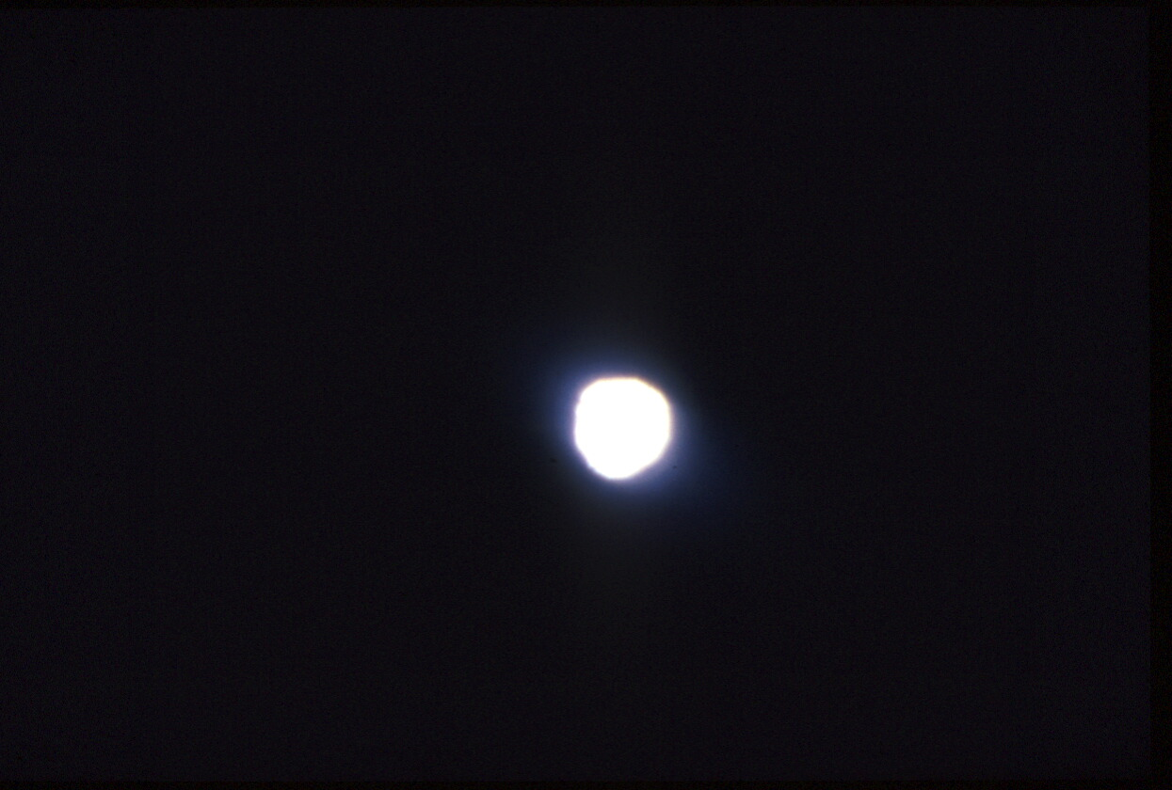
Do not close Illuminating Aperture too far
This will probably increase contrast
But this will be at the expense of resolving the fine detail
75% of
full aperture

Slide 19
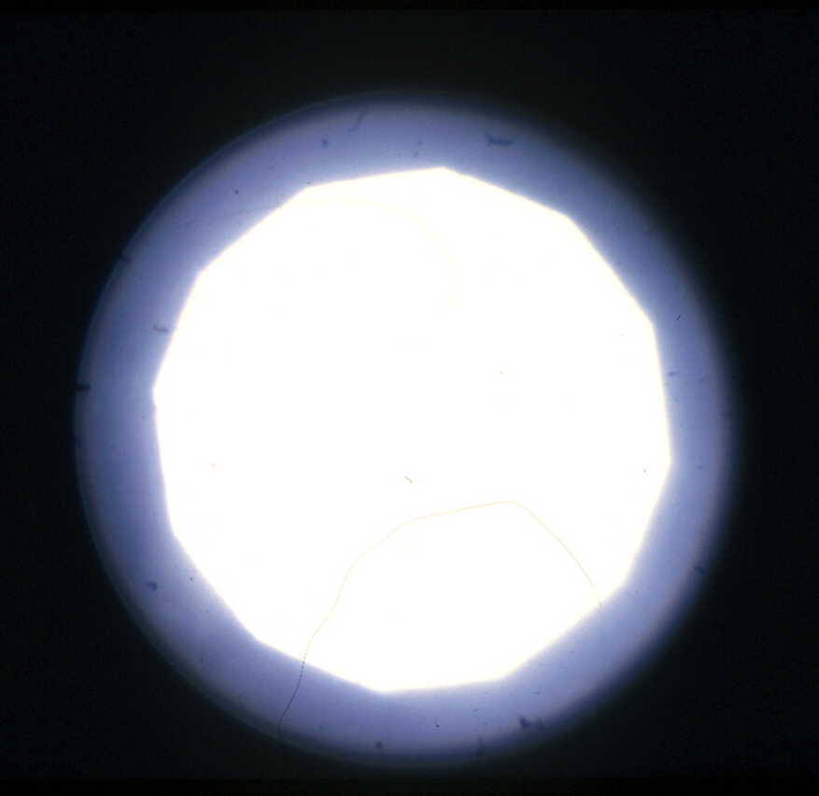
Illuminating Aperture
Correct
Too small

Slide 20
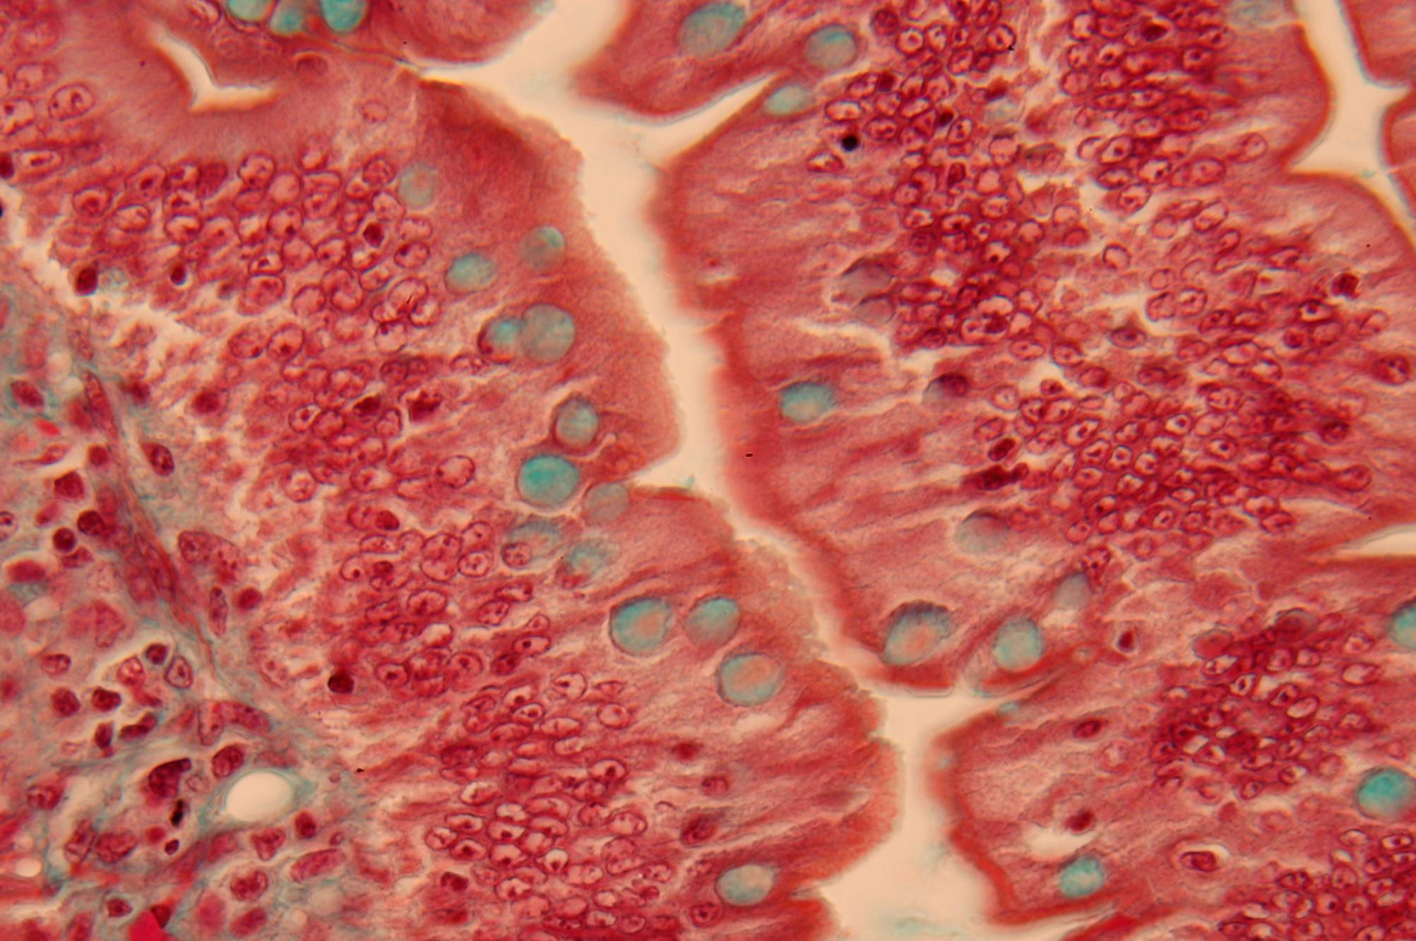
Illuminating aperture correct

Slide 21
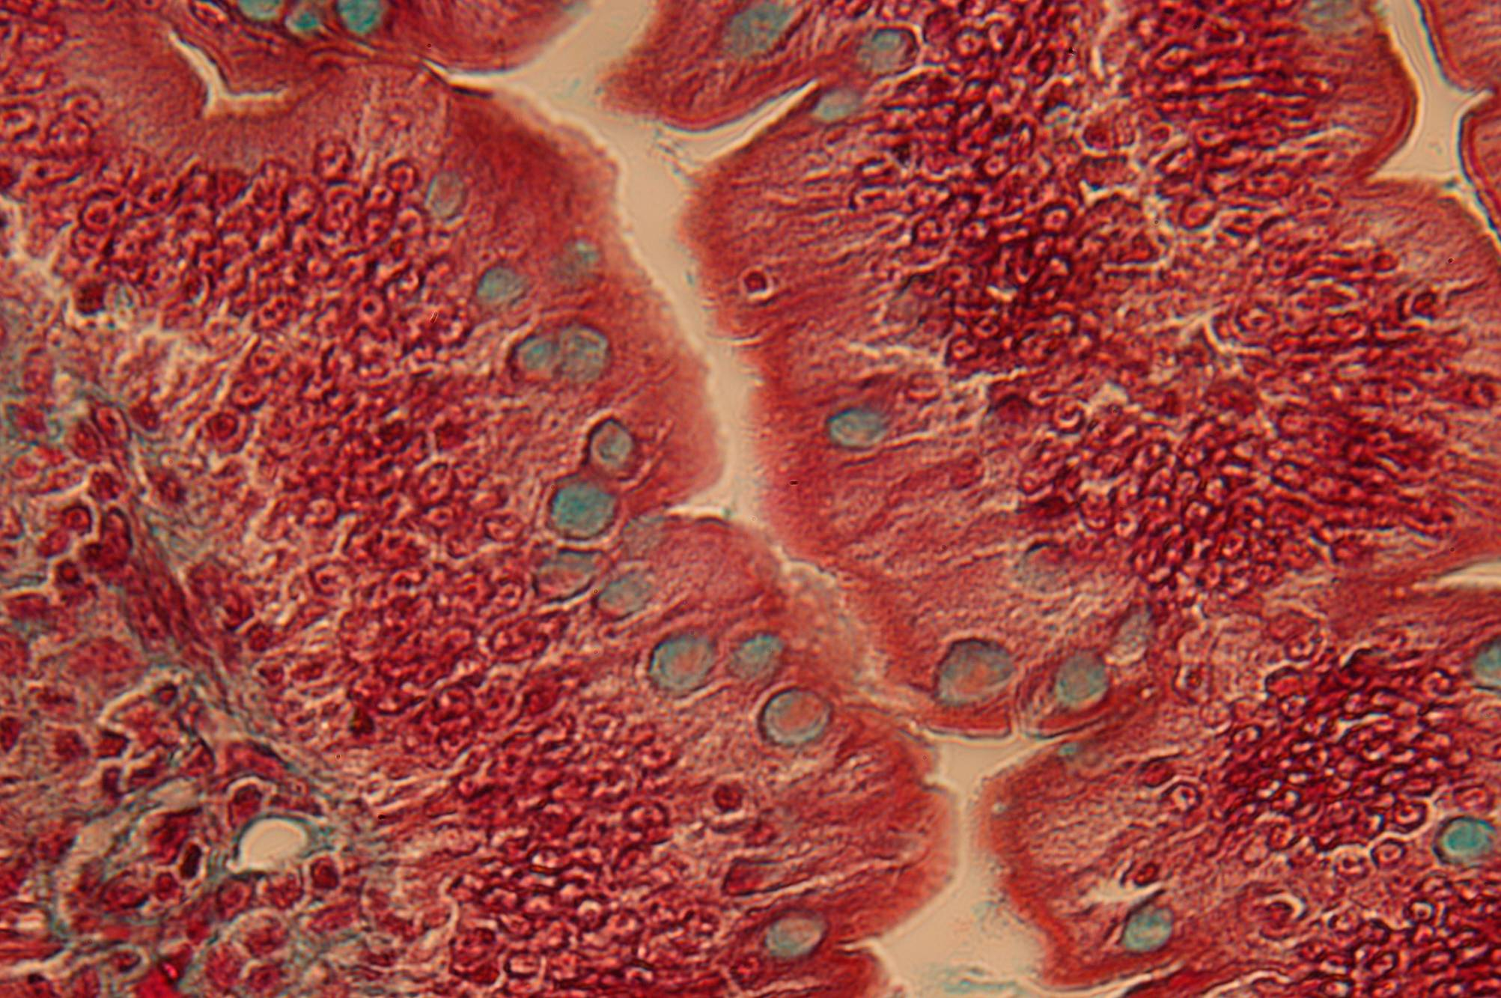
Illuminating aperture too small

Slide 22
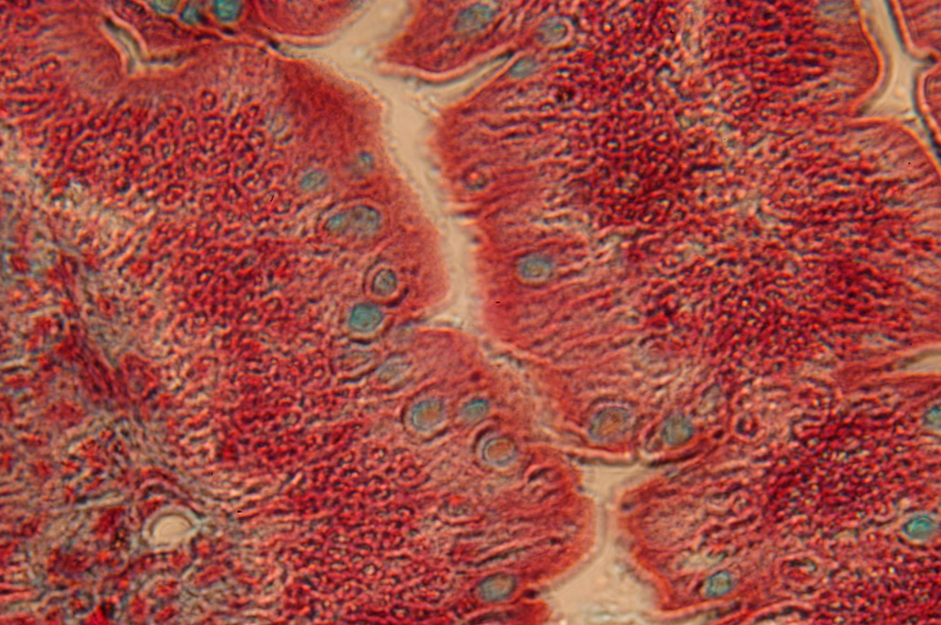
Illuminating aperture much too small

Slide 23
Köhler Illumination provides
Control of Area illuminated by the
Illuminated Field Diaphragm,
which is adjusted according to magnification.
Control of Angle of illumination by the
Illuminating Aperture Diaphragm
(the condenser diaphragm),
which is adjusted according to objective aperture.

Slide 24
A short cut when checking many slides
Set the field diaphragm so that the whole of the field of view is illuminated when using the low-power objective.
This is so that you can scan the slide and find the area of interest that you’ll want to study at higher power.
Then, having changed to the higher power objective, set the condenser aperture diaphragm correctly – c75% of objective NA
This is necessary to provide optimum illumination for the larger-aperture high-power objective which you’ll be using for detailed study of the slide. This is the most important factor.
This procedure will result in adequate (though not quite perfect) illuminating conditions for both low and high power images.
For maximum image quality when necessary (eg for photography), repeat all adjustments to recommended settings.

Slide 25
Gradually close illuminating aperture diaphragm.
Illuminating aperture now equal to
objective aperture
A short cut for setting the Illuminating aperture diaphragm
Illuminating aperture wide open:
much larger than
objective aperture
Optimum setting:
Stray light removed but
still have adequate
illuminating aperture
Removing stray light
X
Poor image!
Illuminating aperture
much smaller than
objective aperture
Image
brightness
Reducing illuminating aperture

Slide 26
For a simple demonstration and explanation of microscope optics
Go to https://www.youtube.com/watch?v=60_jgZtyR6U
Or Google
Understanding the light microscope Peter Evennett

Slide 27
Principles of Light Microscopy
Peter Evennett
peter@microscopical.co.uk

