Slide 1
Cervical Cytology
Dr Karin Denton
Consultant Pathologist
Southmead Hospital

Slide 2
Needs a new title…..

Slide 3
Cervical Screening Pathology

Slide 4
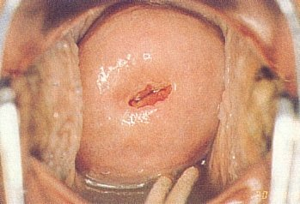
Normal Cervix

Slide 5
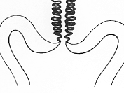
Squamo-columnar junction
-SCJ
Endocervical cells – delicate
columnar shaped cells
Squamous cells - protective
SCJ

Slide 6
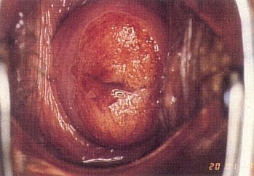
Wide Ectropion

Slide 7
Ectropion / Erosion
At puberty & in pregnancy the SCJ everts out beyond the cervical os.
Normal
Ectropion

Slide 8
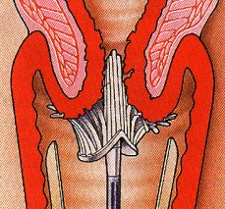
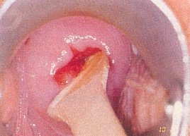
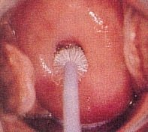

Taking the Sample

Slide 9


Slide 10


Slide 11
HPV Primary Screening Algorithm – Pilot Year 1
All women aged 25-64 on routine call/recall and early recall
HR-HPV Test
HR-HPV -ve
HR-HPV +ve
Routine recall 3y(25-49) 5y(≥50)*
Cytology triage
Cytology normal
Cytology abnormal – borderline or worse
Screen in 2 years#
Colposcopy referral
HR-HPV -ve
HR-HPV +ve
Routine recall 3y(25-49) 5y(≥50)*
Cytology normal
Cytology abnormal – borderline or worse
Screen in 2 years
Colposcopy referral
HR-HPV -ve
HR-HPV +ve
Routine recall 3y(25-49) 5y(≥50)*
Colposcopy referral
Notes
Inadequate tests at any screening episode in the pathway will be repeated in 3 months. Three inadequate tests in a row will lead to a colposcopy referral. *Routine recall to be extended to 6 years for all age groups from year 2 of the pilot - subject to approval based on women receiving their second pilot screening in year 4. #Consider HPV 16/18 typing (and referral on HPV 16/18 positive),or employing Norchip Proofer.
Version 1 May 2012

Slide 12
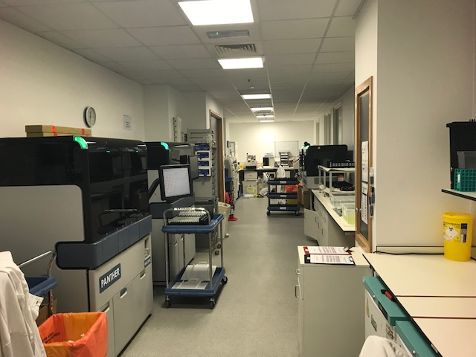

Slide 13
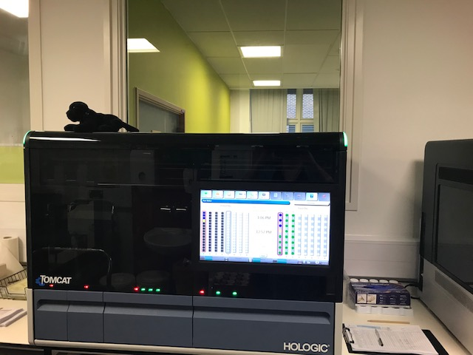

Slide 14
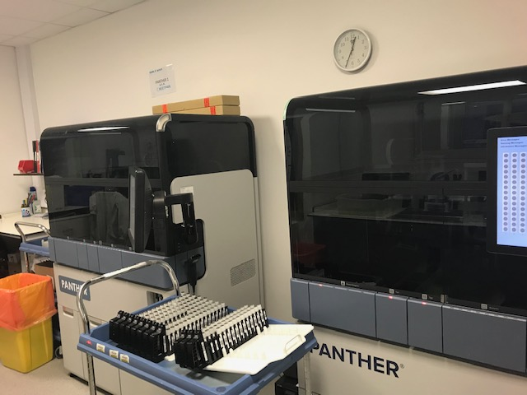

Slide 15
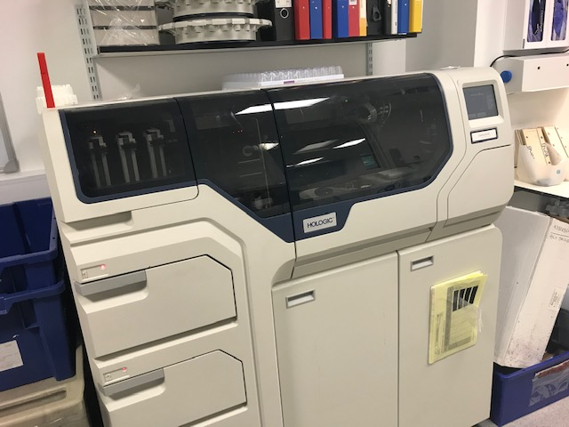

Slide 16
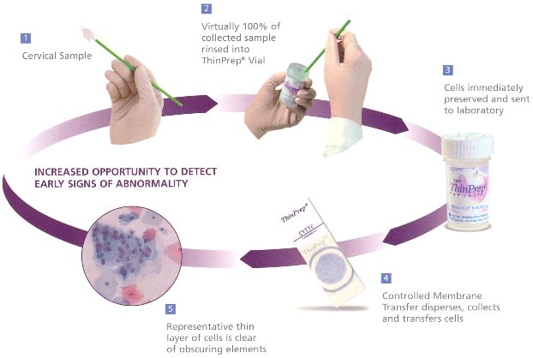

Slide 17
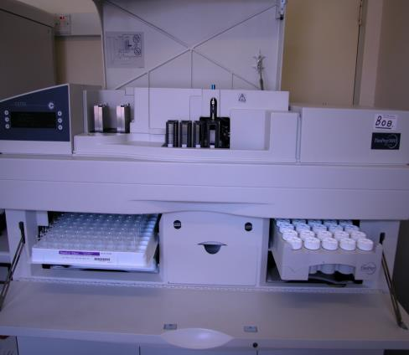
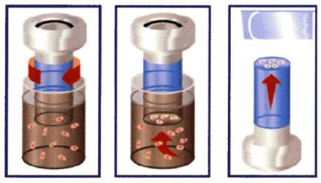
Liquid Based Cytology – lab processing

Slide 18
Jane Bloggs
06/12345
100% coverage
30% overlap of fields

Slide 19
Screening a cervical cytology sample
Need to look at all cells
  LBC sample 10 000-70 000
Abnormal cells can be very scanty

Slide 20
SCREENING PROCESS
 | PRIMARY SCREENER
NORMAL |  | ABNORMAL
RESCREEN |  | CHECKER
NEGATIVE REPORT |  | PATHOLOGIST
Notes:
20
20
20

Slide 21
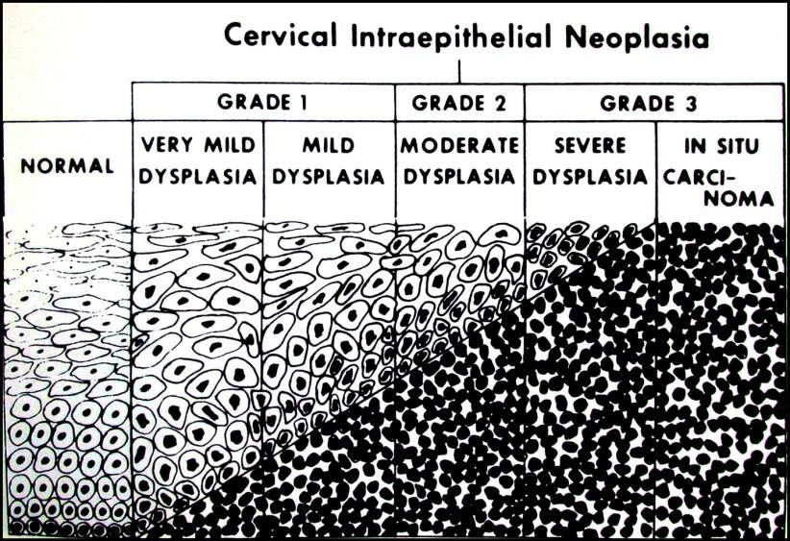

Slide 22
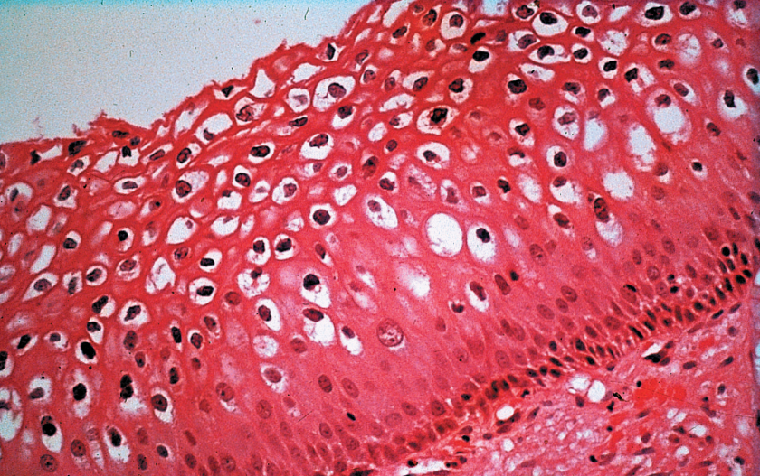
Koilocytosis
Notes:
22
22
22

Slide 23
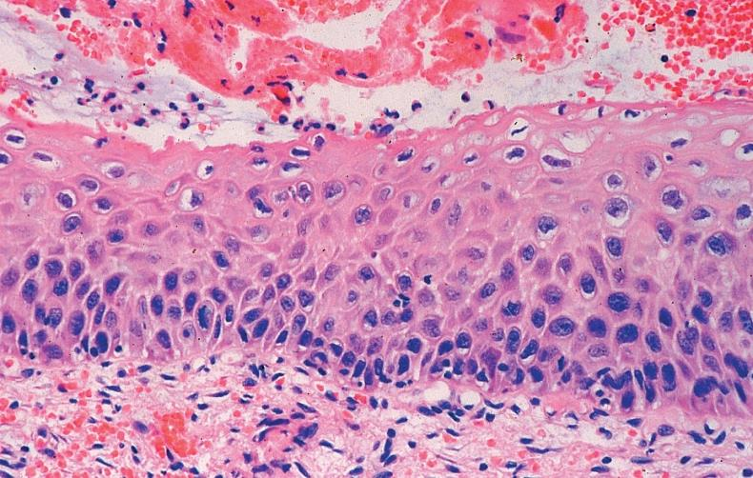
CIN 1
Notes:
23
23
23

Slide 24
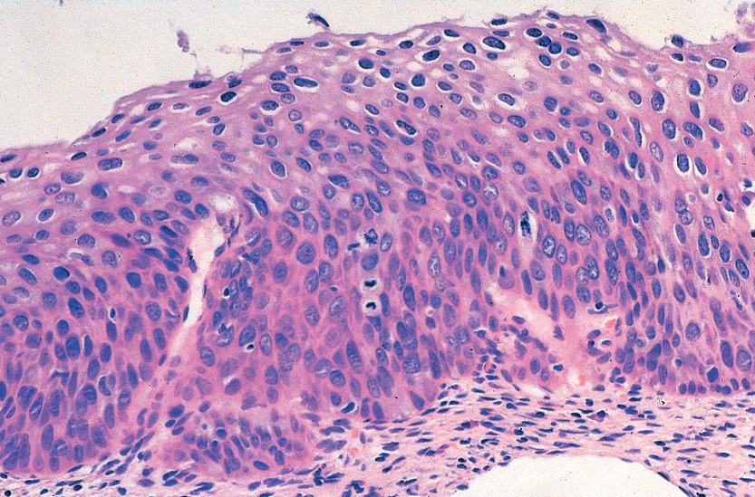
CIN2
Notes:
24
24
24

Slide 25
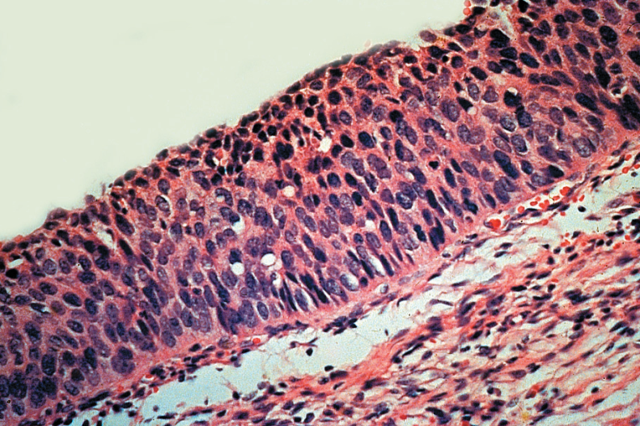
CIN3
Notes:
25
25
25

Slide 26
Morphology - terminology
  Inadequate
  Negative
  Borderline change in squamous cells
  Borderline change in endocervical cells
  Low grade dyskaryosis
  High grade dyskaryosis (moderate)
  High Grade Dyskaryosis (severe)
  ?Invasive squamous carcinoma
  Cervical glandular abnormality
  Non cervical glandular abnormality

Slide 27
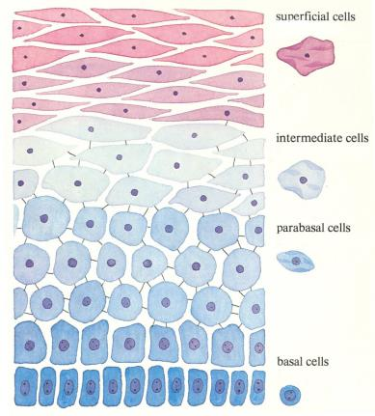
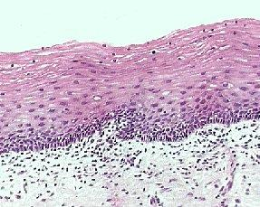
Squamous Epithelium

Slide 28
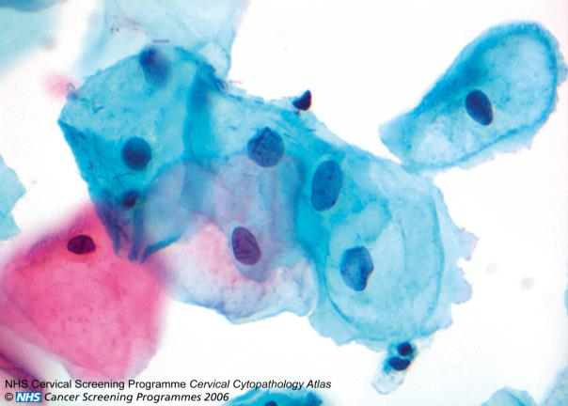
Notes:
28
28

Slide 29
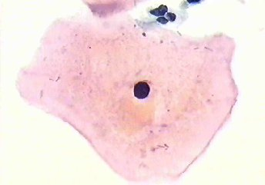
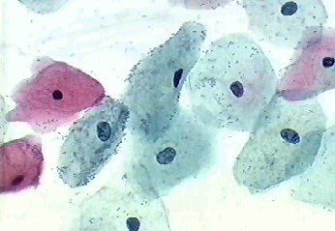
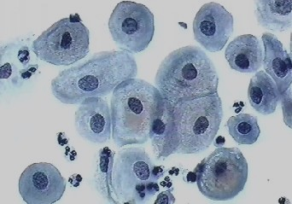
Normal squamous cells

Slide 30
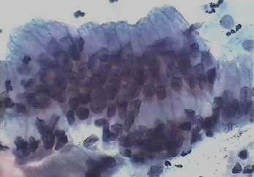
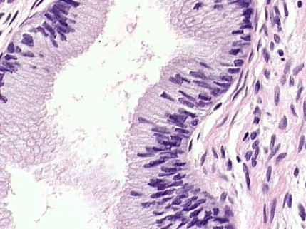
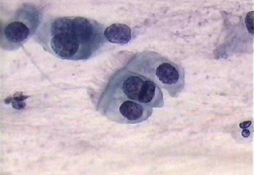
Endocervical
Cells

Slide 31
Transformation Zone
The area where metaplasia occurs is called the TRANSFORMATION ZONE
This is the area where CERVICAL INTRAEPITHELIAL NEOPLASIA may arise
The whole of the TZ must be sampled when a cervical smear is taken

Slide 32
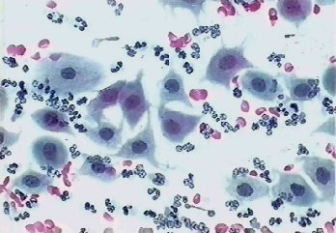
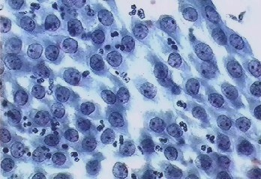
Metaplastic Cells

Slide 33
Non cervical cells

Slide 34
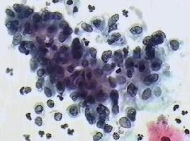
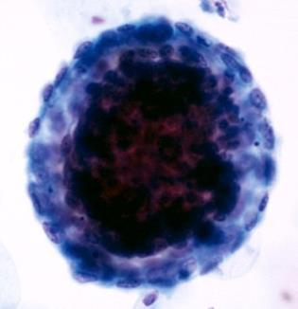
Endometrial Cells

Slide 35
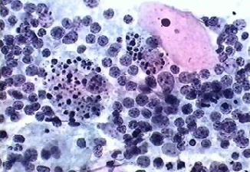
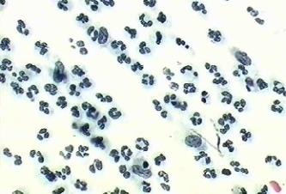
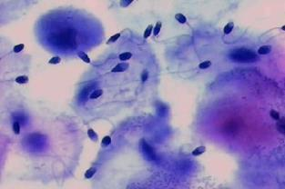
Non-Epithelial Cells
Lymphocytes
Polymorphs
Sperm

Slide 36
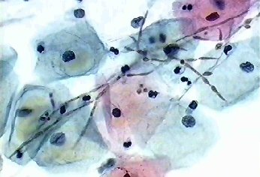
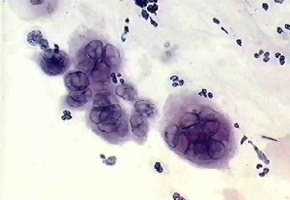
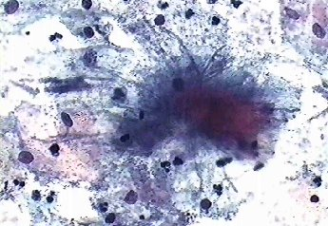
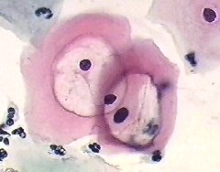
Infections –
Candida
Herpes simplex
HYPHAE
ALO
HPV

Slide 37
Management – all HPV positive
  Borderline/low grade
      Colposcopy
  HPV+, Cytology negative – repeat 12 months
  High grade dyskaryosis – Colposcopy
  Endocervical glandular abnormality – Urgent colposcopy
  ?Invasive squamous carcinoma- – Urgent colposcopy
  Non cervical glandular abnormality-gynae referral (2ww)

Slide 38
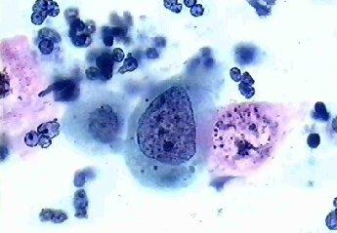
DYSKARYOSIS
Abnormal chromatin (always present)
Increased NC ratio
Irregular nuclear margin

Slide 39
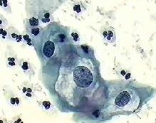
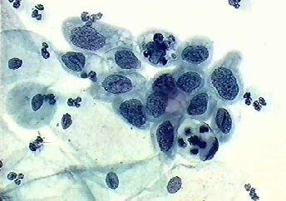
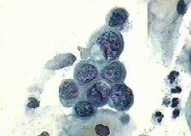
Grading Dyskaryosis
Low grade < 50%
High Grade ( moderate) 50-66%
High grade (Severe) >66%

Slide 40
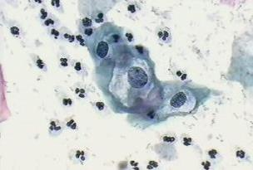
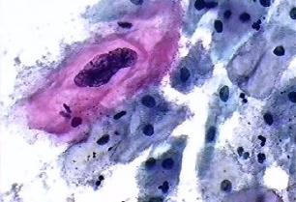
Low Grade Dyskaryosis

Slide 41
Koilocytes (HPV)
Nucleus
  Enlarged
  Irregular shape and membrane
Cytoplasm
  Sharp edged perinuclear halo
  Compressed cytoplasm
Need both cyto & nuclear features for diagnosis
Notes:
41
Koilocytes may be seen in pts with flat lesions but sometimes only anucleate squames and parakeratotic cells seen in pts with frank genital warts
Thus cytology sensitive test for flat condyloma but not for macroscopically visible lesions
Dd glycogen and perinuclear halo of inflam esp TV

Slide 42
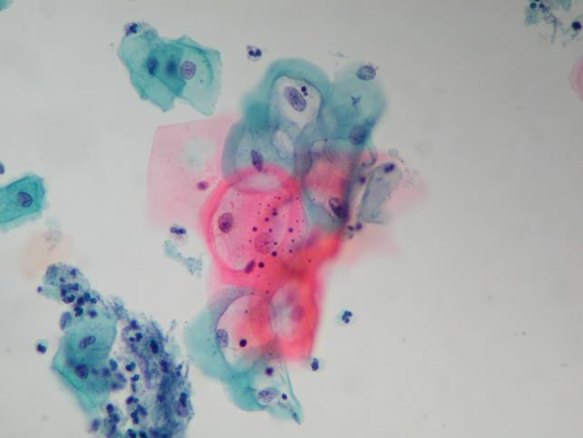
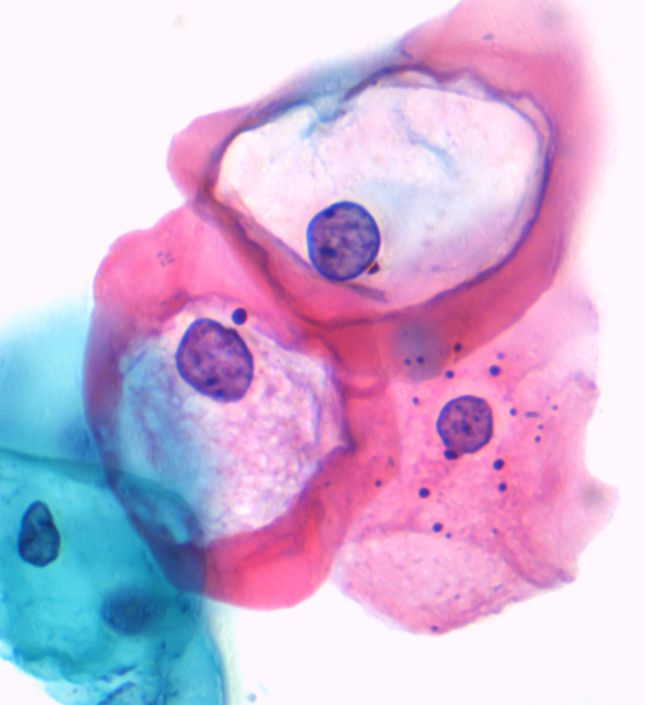
Low grade dyskaryosis ( koilocytes)
Notes:
42

Slide 43

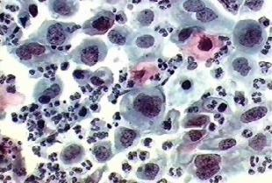
High grade Dyskaryosis (moderate)

Slide 44
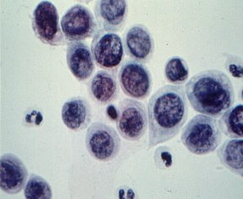
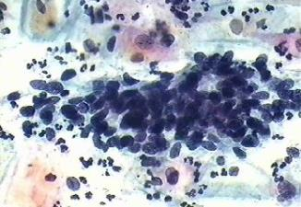
High Grade Dyskaryosis (severe)

Slide 45
Borderline Change in Squamous cells
Many samples contain features associated with HPV infection but without koilocytes
  Multinucleation
  Abnormal keratinisation
  Nuclear enlargement
  Slightly hyperchromatic chromatin

Slide 46
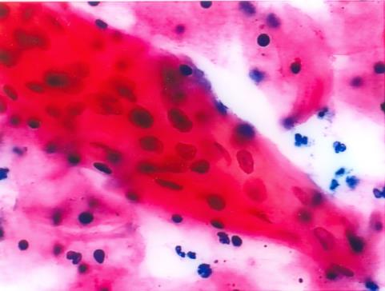



Slide 47
BCE
Typically have nuclear or architectural features of CGIN but not both
Only some endocervical cells will be affected, other groups normal or reactive
Management – HPV triage

Slide 48


BCE
Notes:
48
Worst group in smear –nothing definate for gn
Mt first case

Slide 49

Features of ? Endocervical glandular abnormality (6)
Nuclear
  Coarse irregular chromatin
  Raised NC ratio
Architectural
  Complex multilayered groups
  Radial arrangement
  Elongation of nuclei and cytoplasm
  Feathering and Tags

Slide 50

? Invasive Carcinoma
Cytological features can SUGGEST an abnormality may be worse than CIN3
Histological confirmation is essential

Slide 51




Cytology of Invasive Squamous Cell Carcinoma

Slide 52

Centres for HPV primary screening delivery
Bristol
HSL London
BSPS Chertsey
Derby
Manchester
Gateshead
Norwich
Wolverhampton

Slide 53



MDT meeting
NHS CSP standards have not changed
Depending on geography quite likely this will need to be converted to video conferencing
May need to be rescheduled
Your histology provider will remain responsible for the histology component
CSPL will have a key role

Slide 54
HPV Vaccine
2008 Cervarix introduced for 12-13 year old girls
2018 HPV vaccine for MSM
2019-20 HPV Vaccine for boys age 12-13
2010 Catch up completed for girls up to age 18
2012 Gardasil (HPV 6,11,16 and 18)
2014 Gardasil changed to 2 dose protocol

Slide 55


BMJ 2019; 365 doi: https://doi.org/10.1136/bmj.l1161

Slide 56
Cervical screening – a sales pitch
By far the biggest use of molecular testing in any branch of cellular pathology
Cutting edge changes, research opportunities
Making a really big difference to a large number of patients
High profile, well funded
Lots of opportunities for a keen young pathologist
Cervical cancer will become more rare but some form of screening likely to be needed for many years to come.

