Slide 1
Introduction to Surgical Pathology
Angus McGregor
Leicester Royal Infirmary
September 2019

Slide 2
CELLULAR PATHOLOGY
HISTOPATHOLOGY
Diagnostic biopsies
Resection specimens
CYTOPATHOLOGY
Cervical Screening Programme
Non-Gynaecological Cytology
AUTOPSY
Coroner’s cases (Forensic Pathology)
Consent cases

Slide 3
What is a Histopathologist
Doctor
Scientist
Student/Reader
Microscopist
Anatomist
Artist
Photographer
Detective
Communicator written and verbal
Team mate
Teacher
Collector
Colleague
Mentor
Technophile
Sceptic
Team Leader
Manager
Obsessive

Slide 4
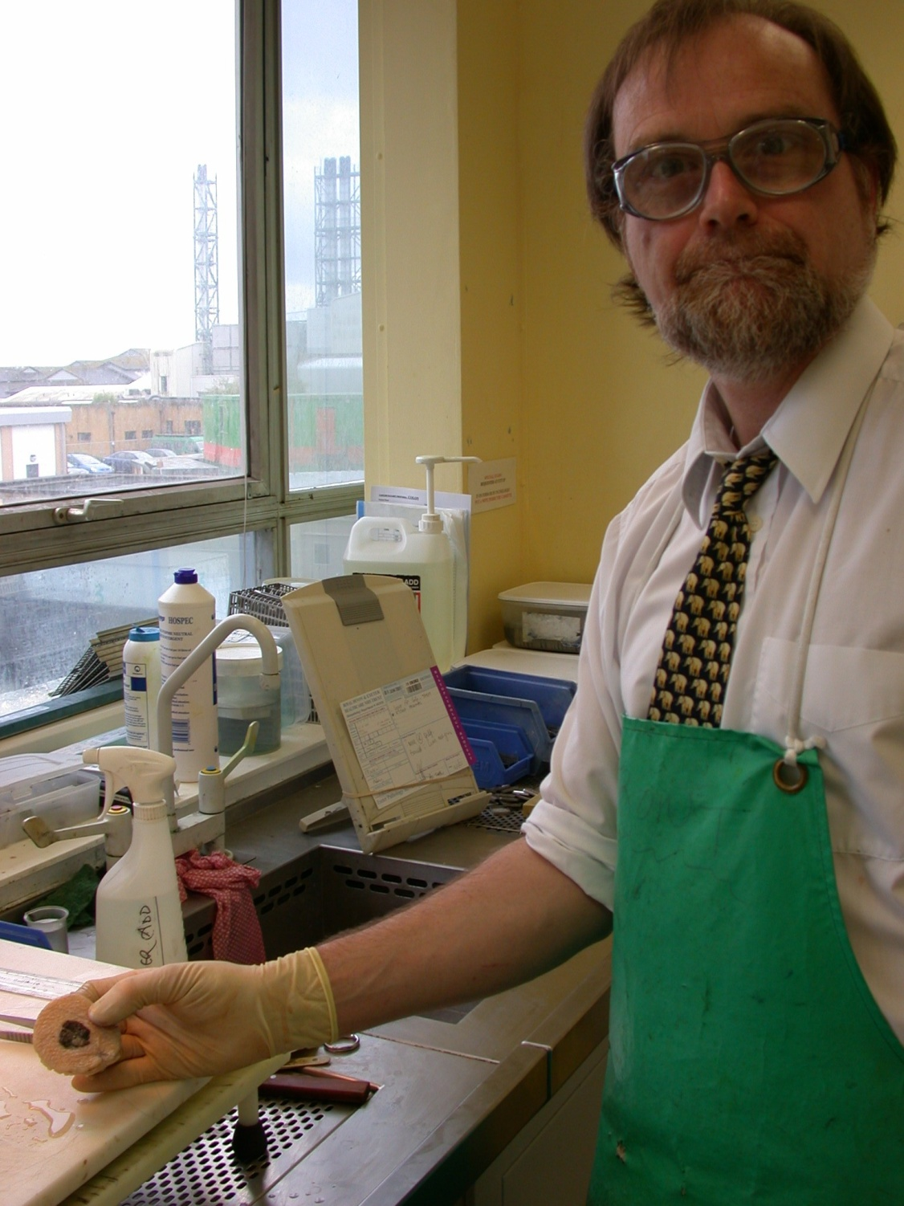
Charlie Keen

Slide 5
The job
Cutup
Is not a chore
Is easier the more you do
Good cutup makes tomorrow better
Bad cutup makes headaches
Reporting
Can be hard work
Is easier the more you do
Is where you can add most value
Is where you can make the worst mistakes

Slide 6
Approach to Cutup
Ensure sufficient formalin for fixation (incise to assist fixation)
2. DESCRIBE carefully
3. If in doubt use the largest knife you
have
4. Take sufficient and appropriate
blocks, each one for a reason

Slide 7
General Cutup
Know what to do before you start
Departmental SOPs and RCPath tissue pathways and datasets provide guidance
Some important items are not histological i.e. must be documented at cutup
Notes:
For cutup there is no evidence better than C (case control / cohort studies) or D (case study, expert opinion)

Slide 8
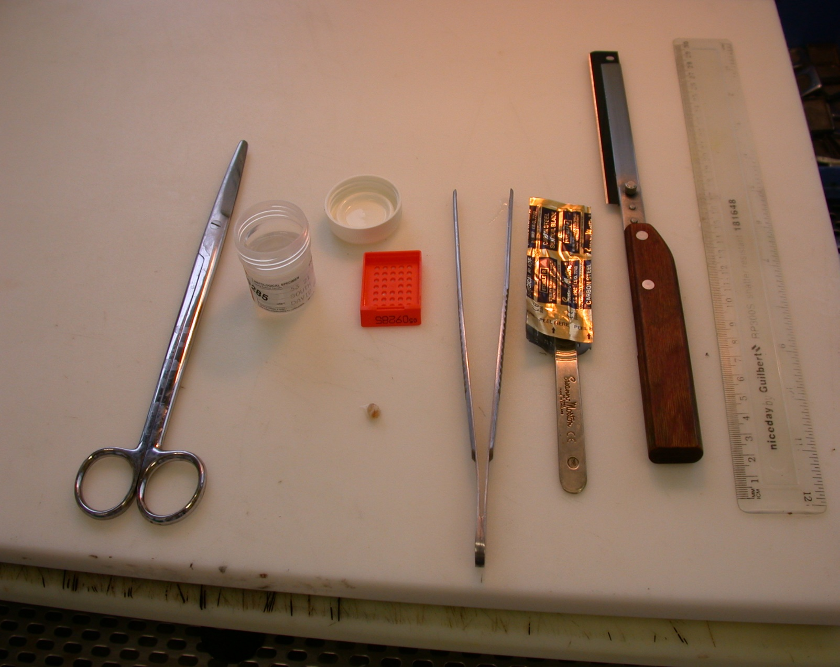
Choose the right tools
Very sharp!
Sharp
Keep your eye on the specimen!

Slide 9
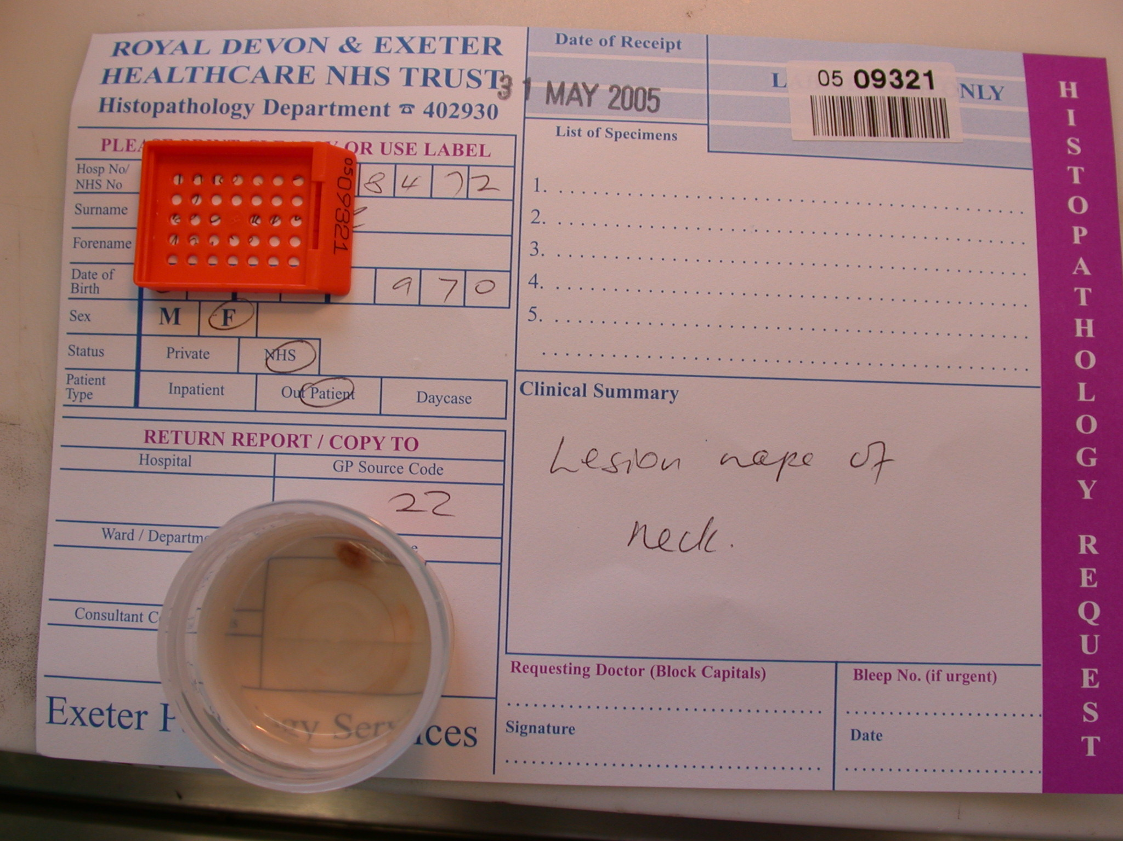
Check Number on
Form pot and cassette
Check ID on form and pot

Slide 10
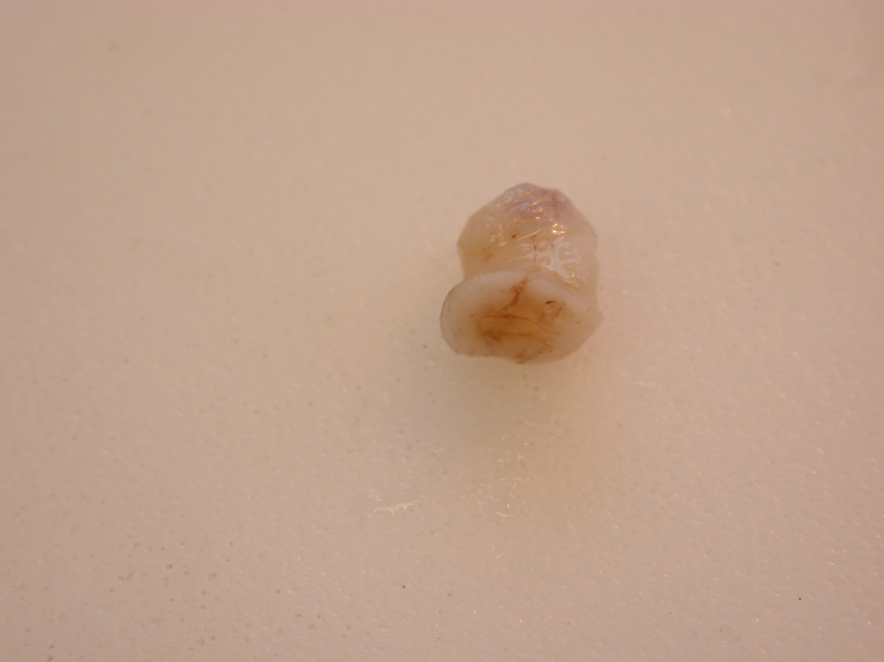

Slide 11
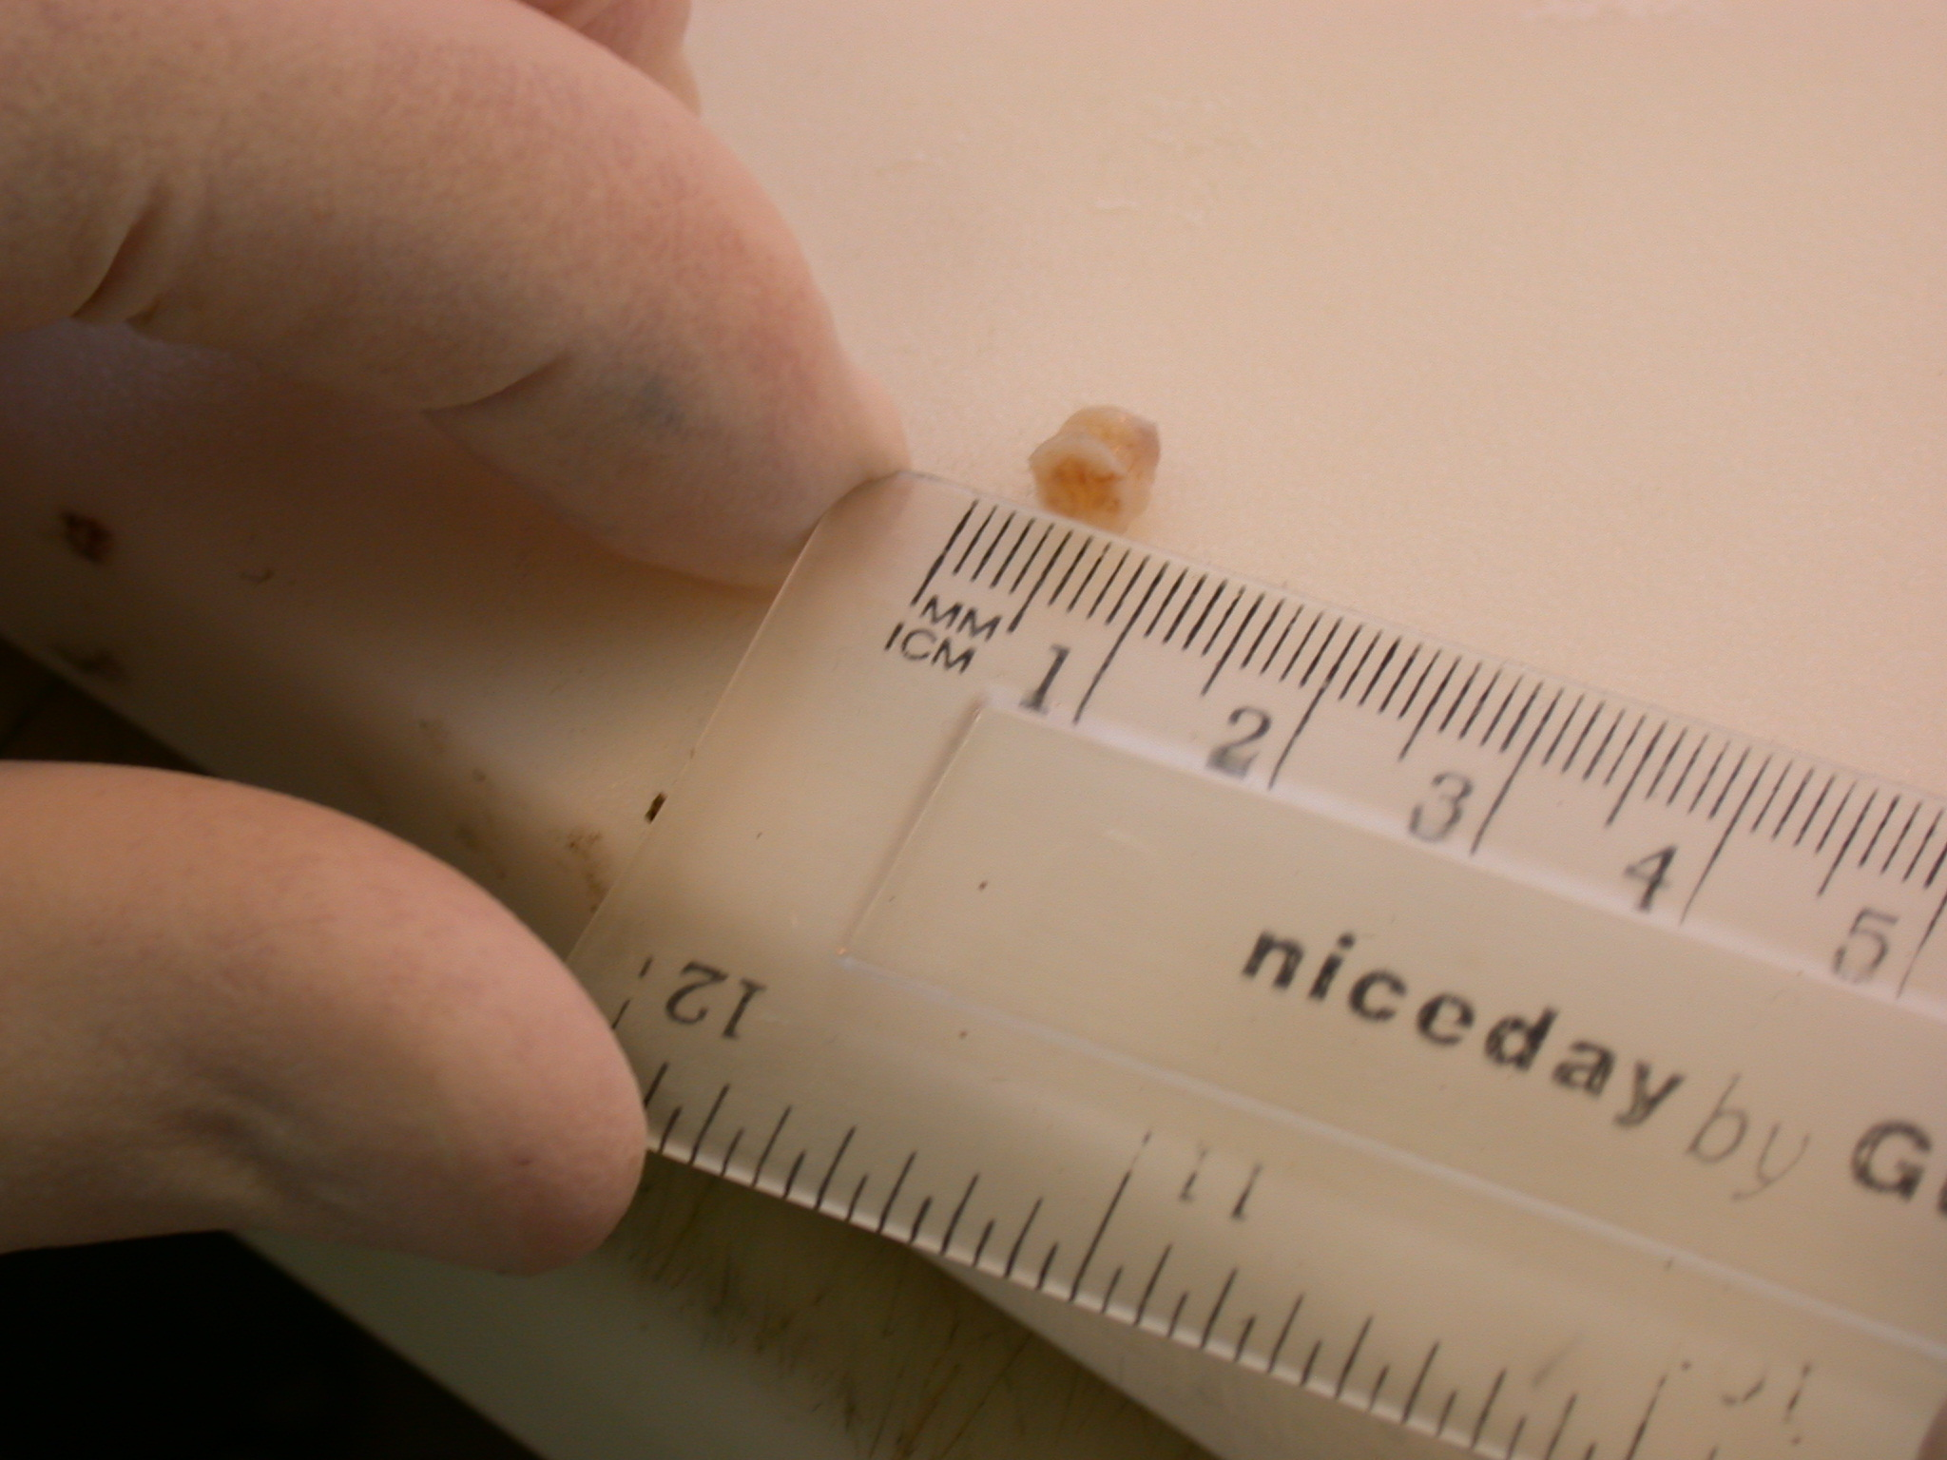
Use mm not cm

Slide 12
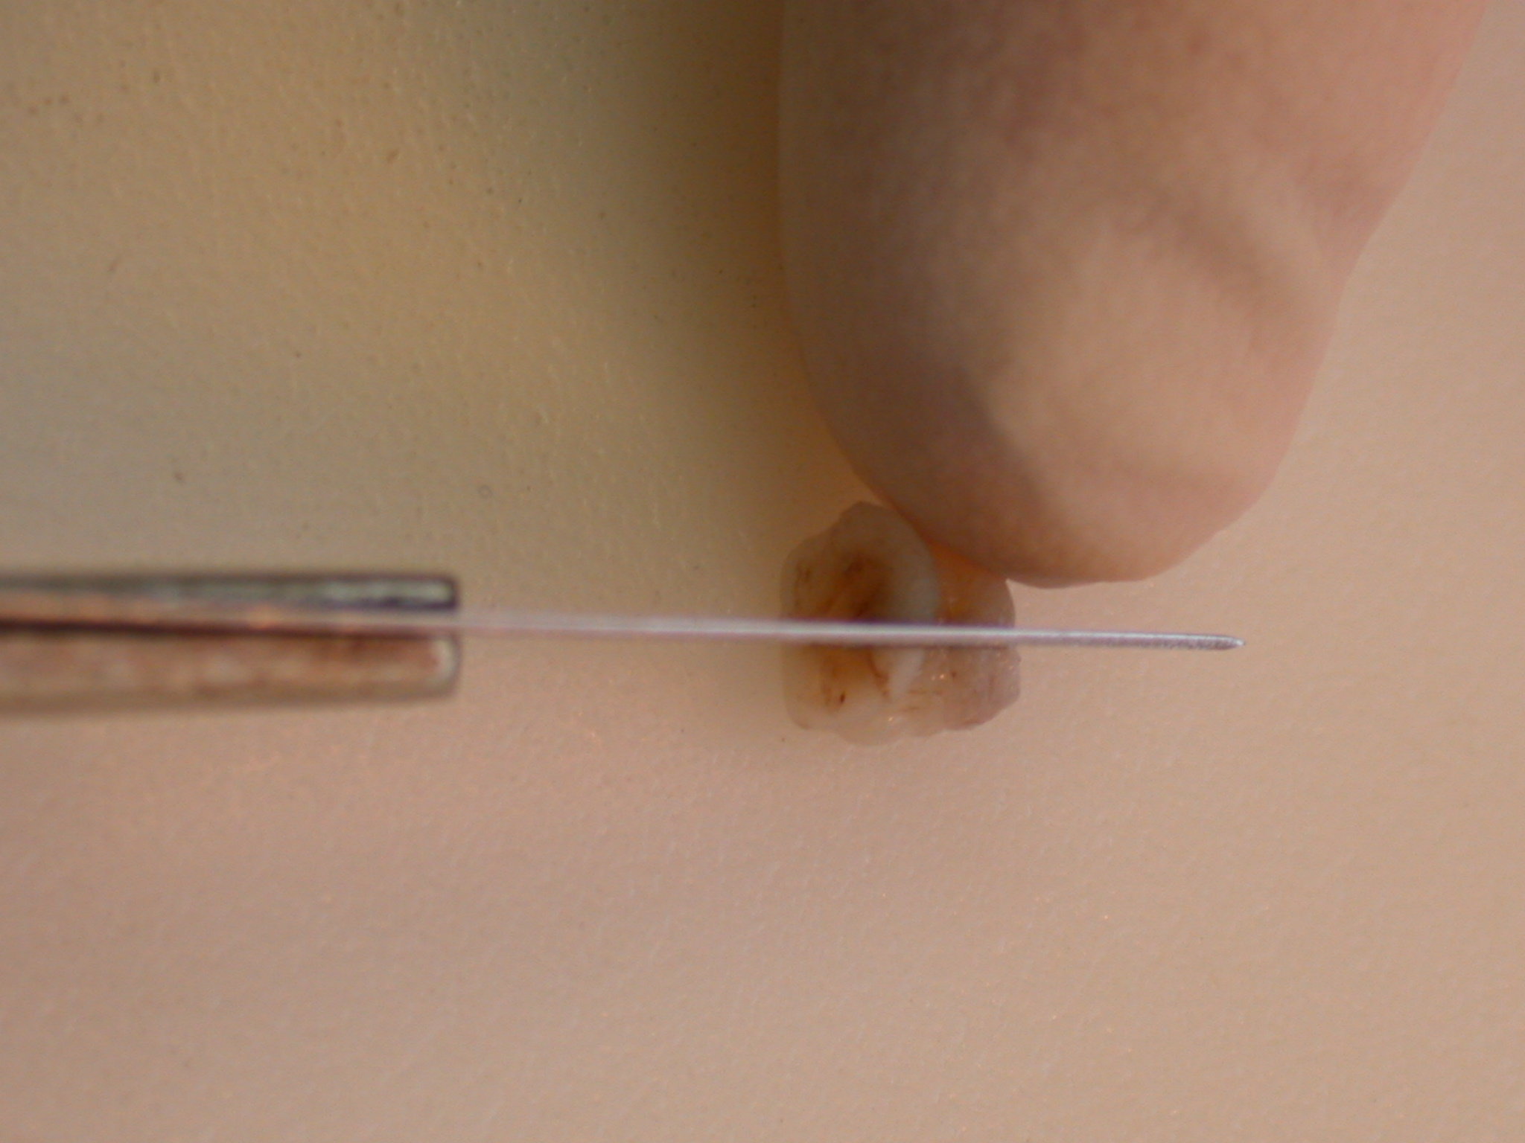

Slide 13
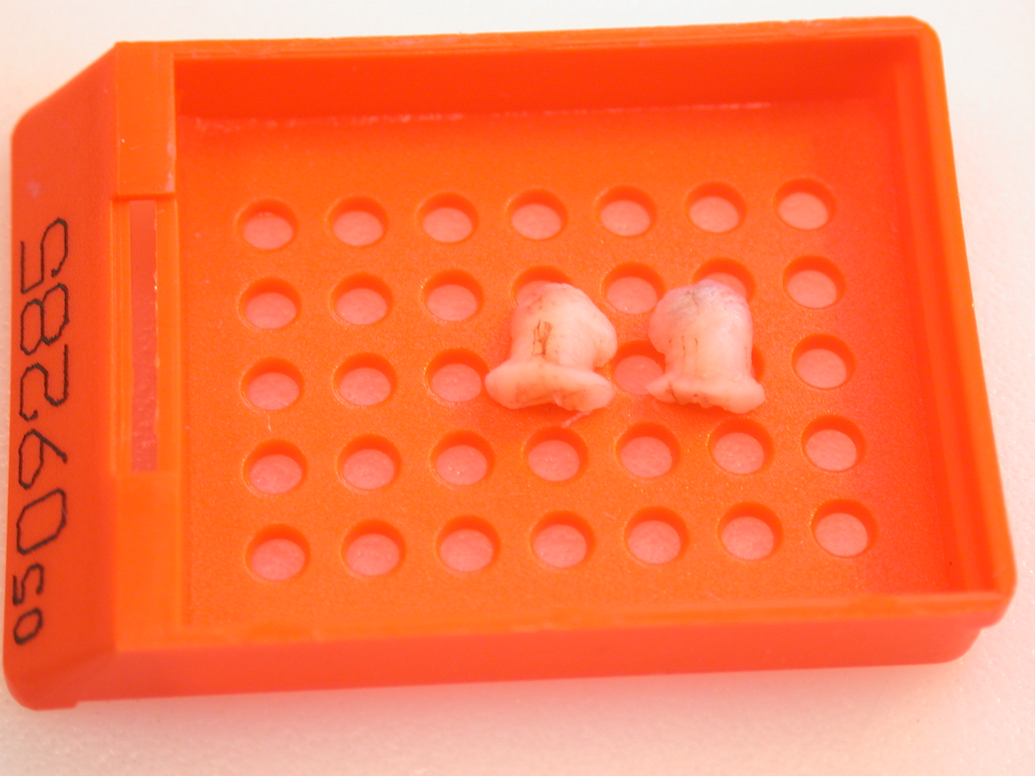
Face Down
The BOTTOM surface is the one the lab staff cut first
i.e. the surface you want to see first

Slide 14
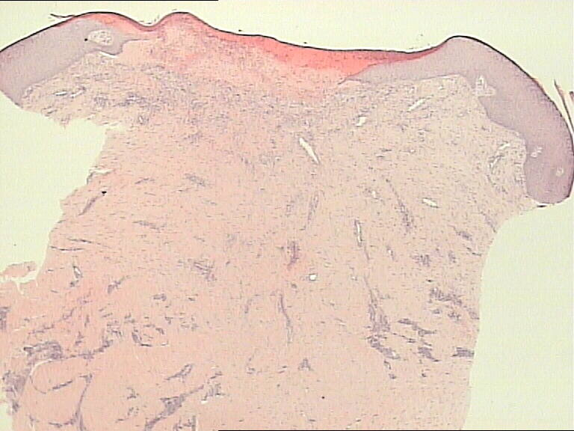

Slide 15
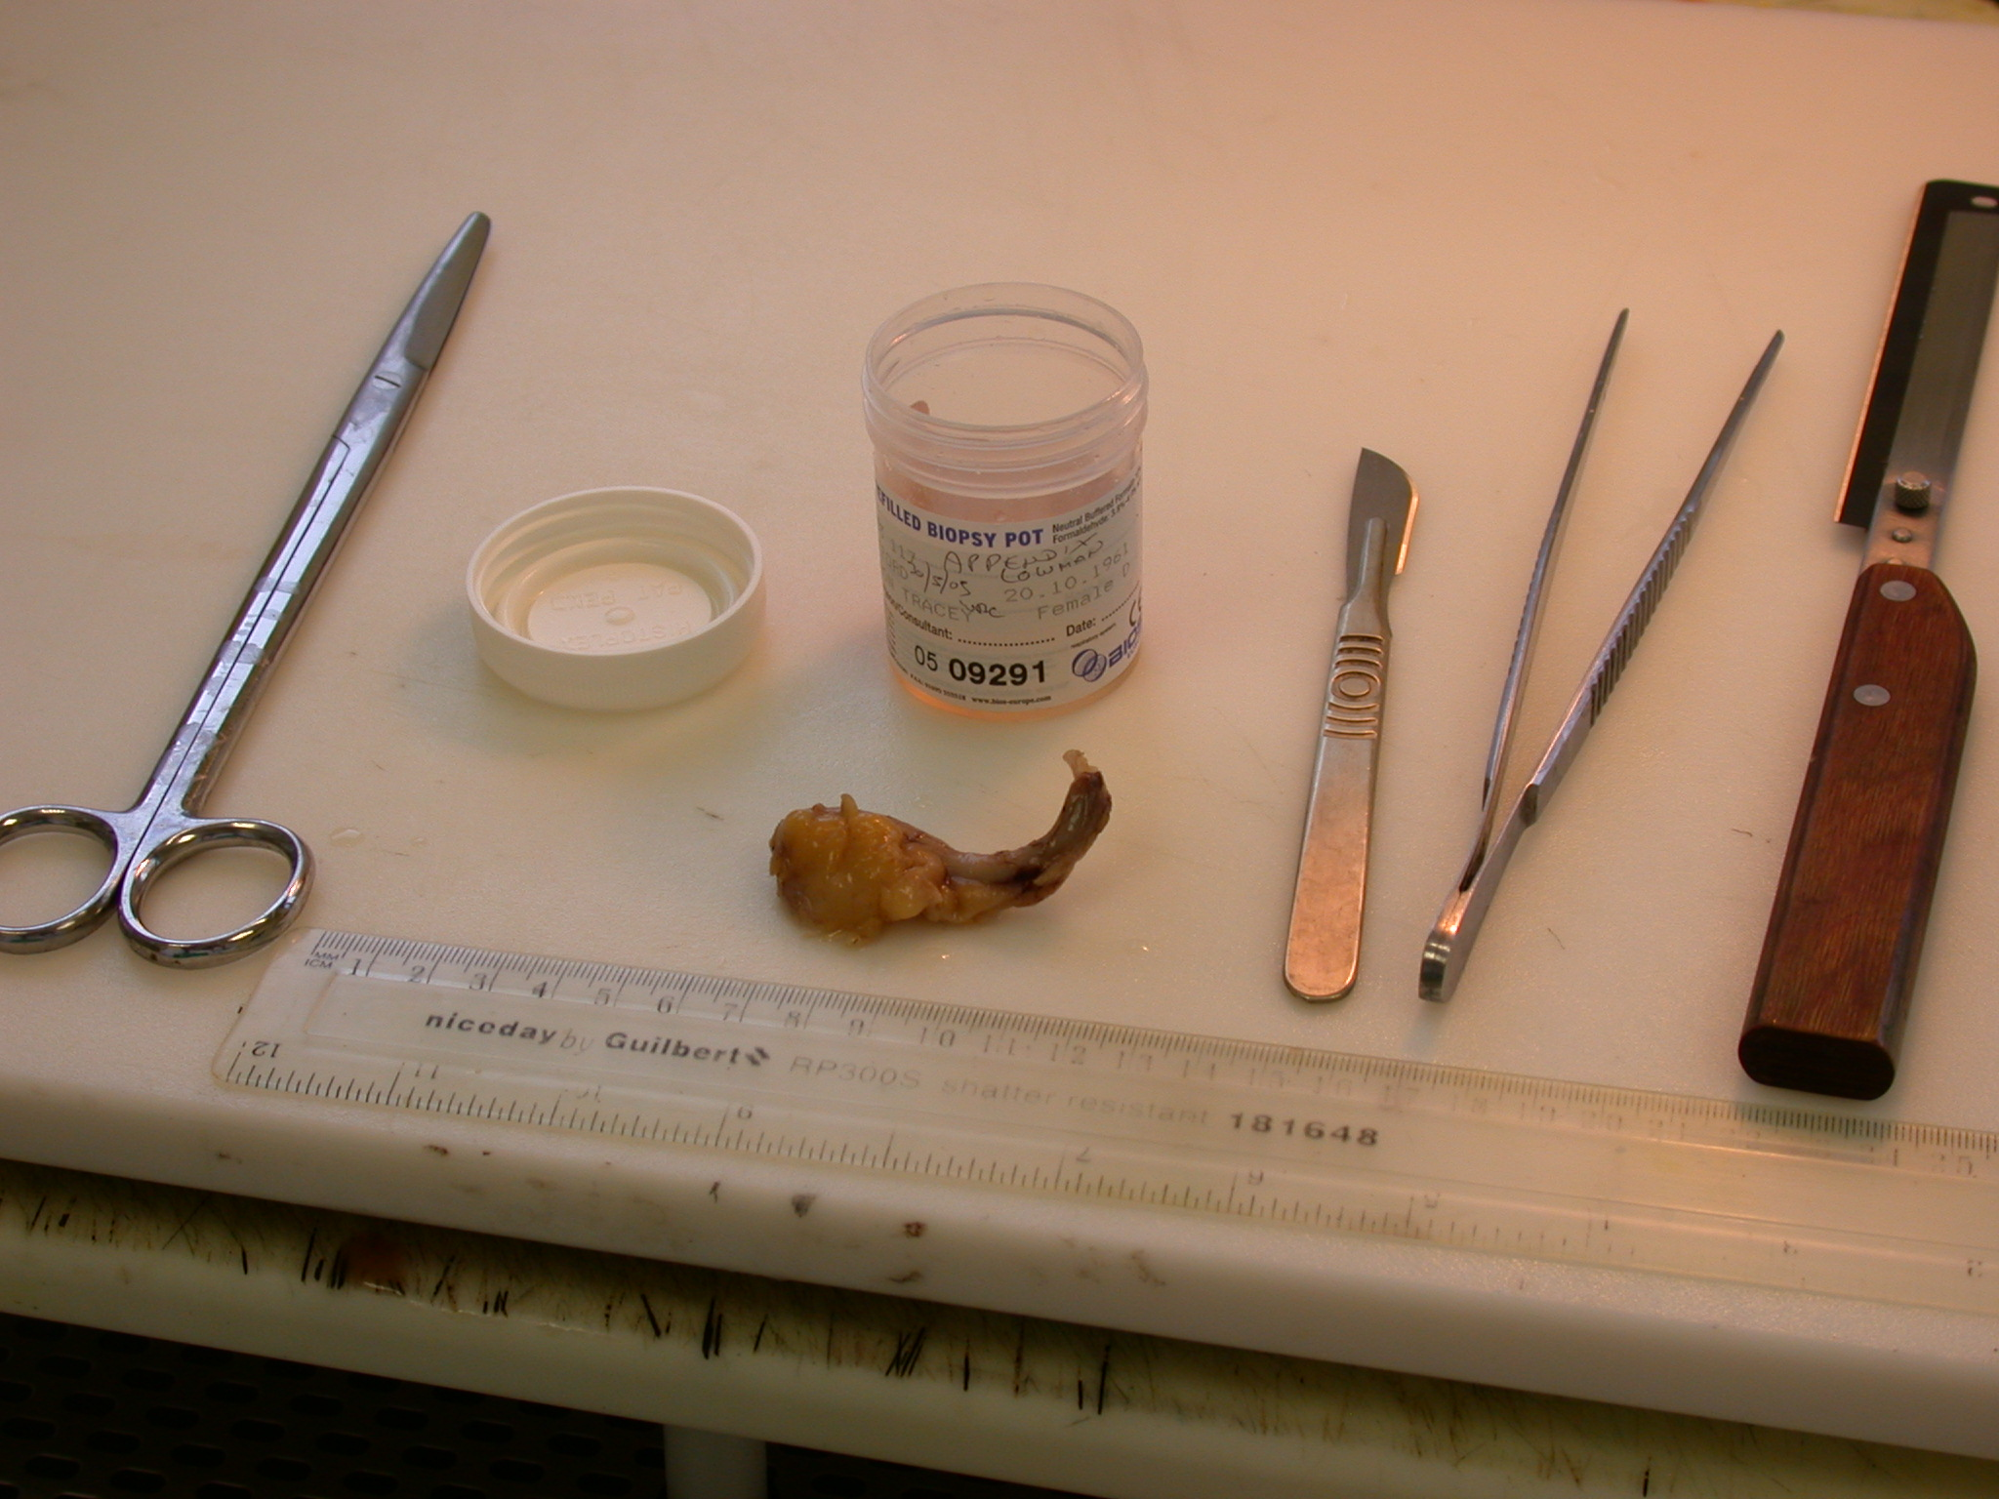

Slide 16
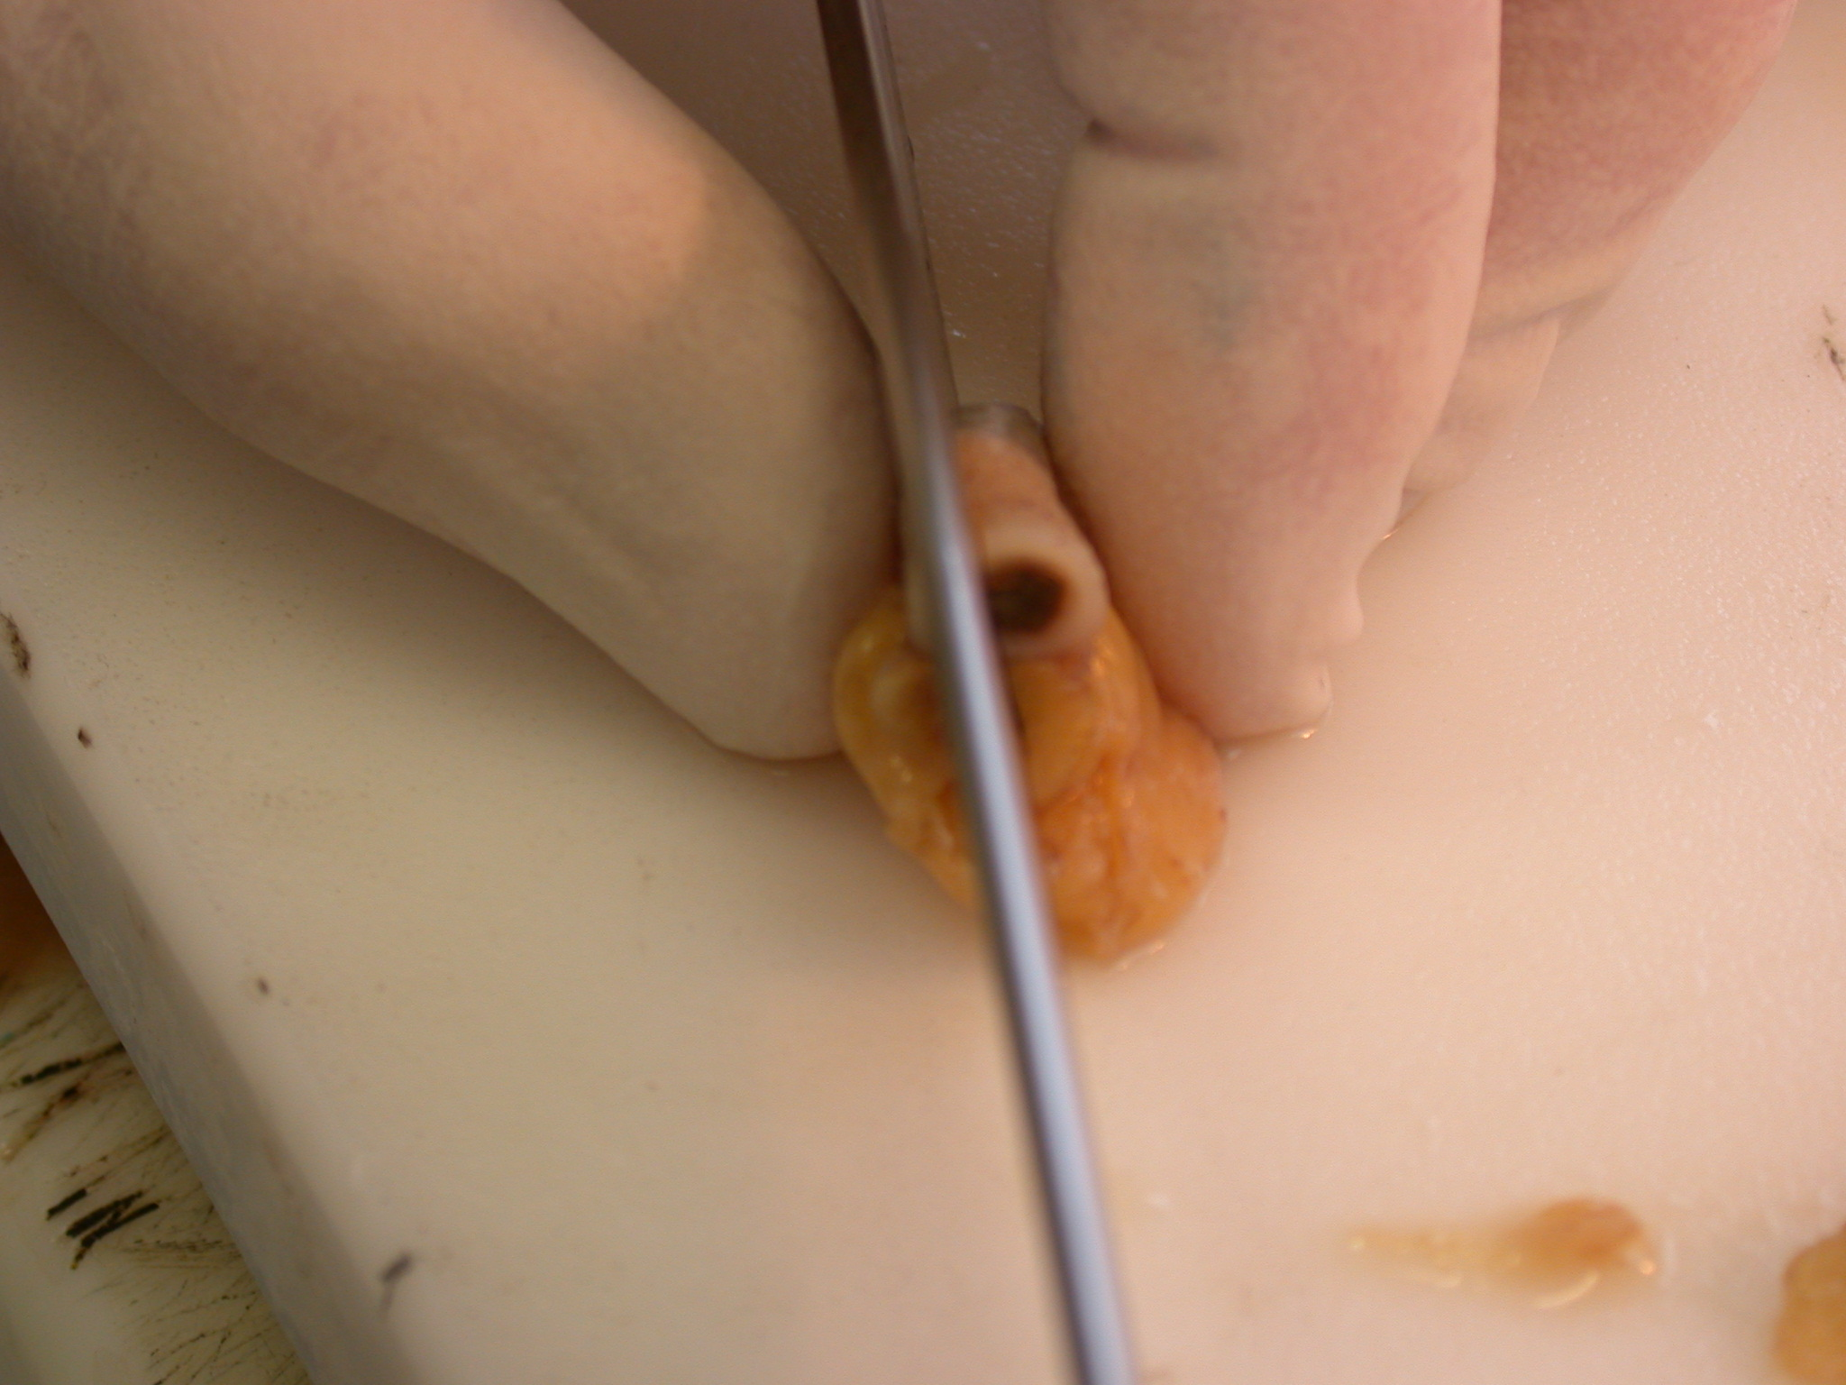

Slide 17
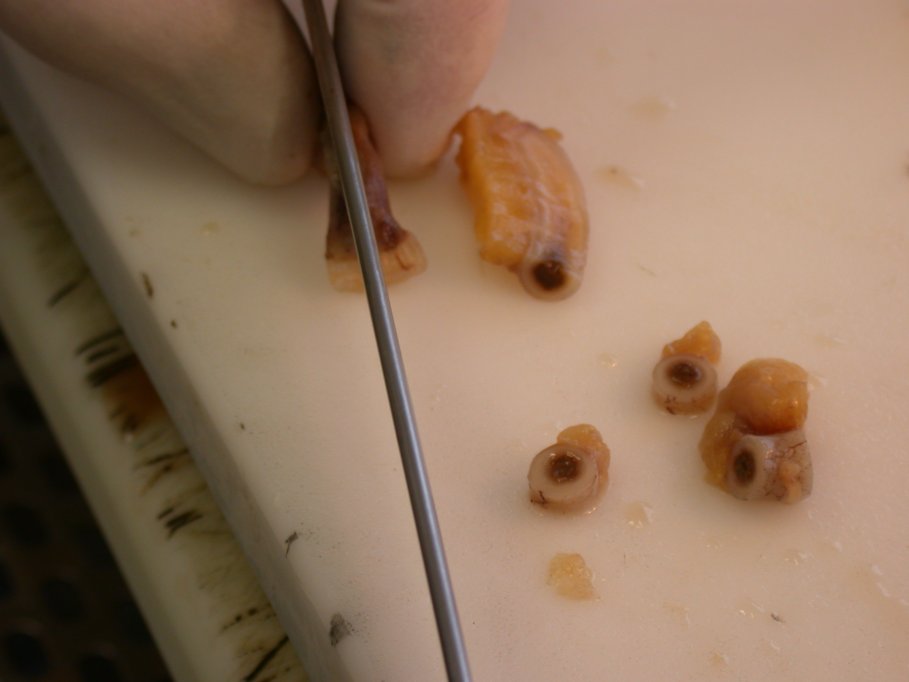

Slide 18
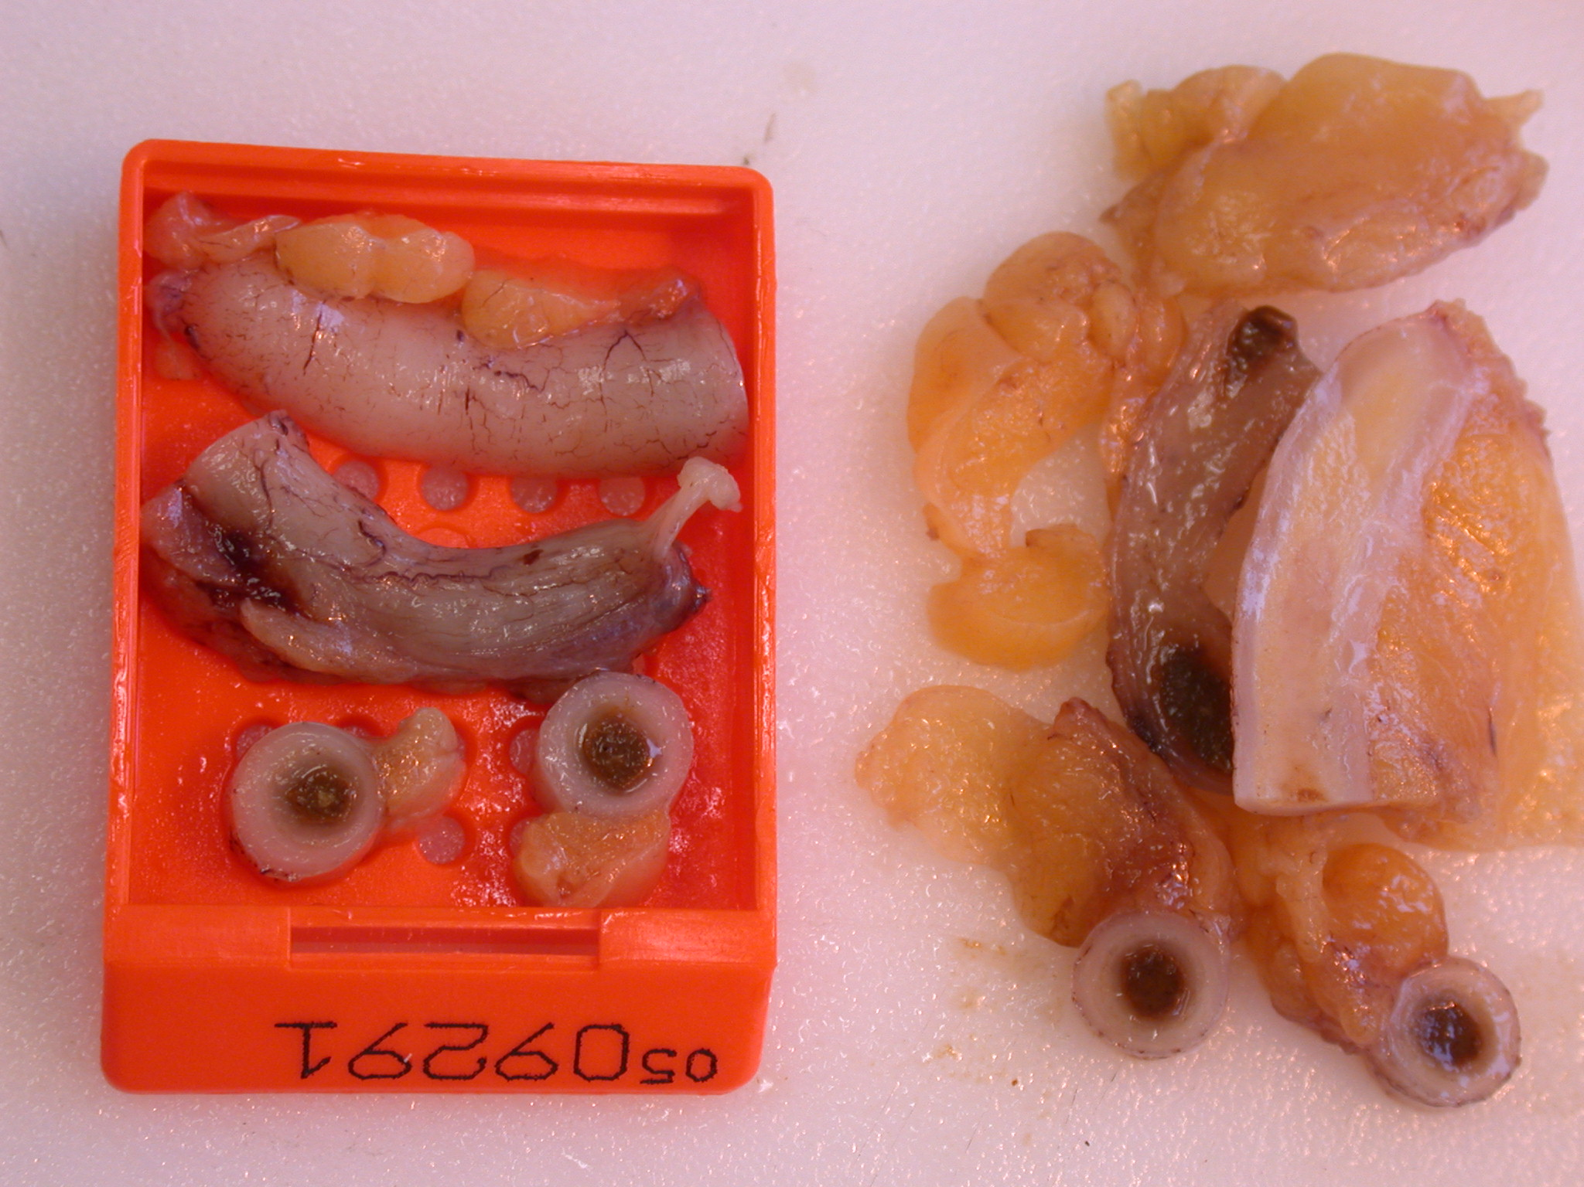
Use the space but don’t overfill the cassette
Extra stains?
CT/US guided Needle cores
1/cassette

Slide 19
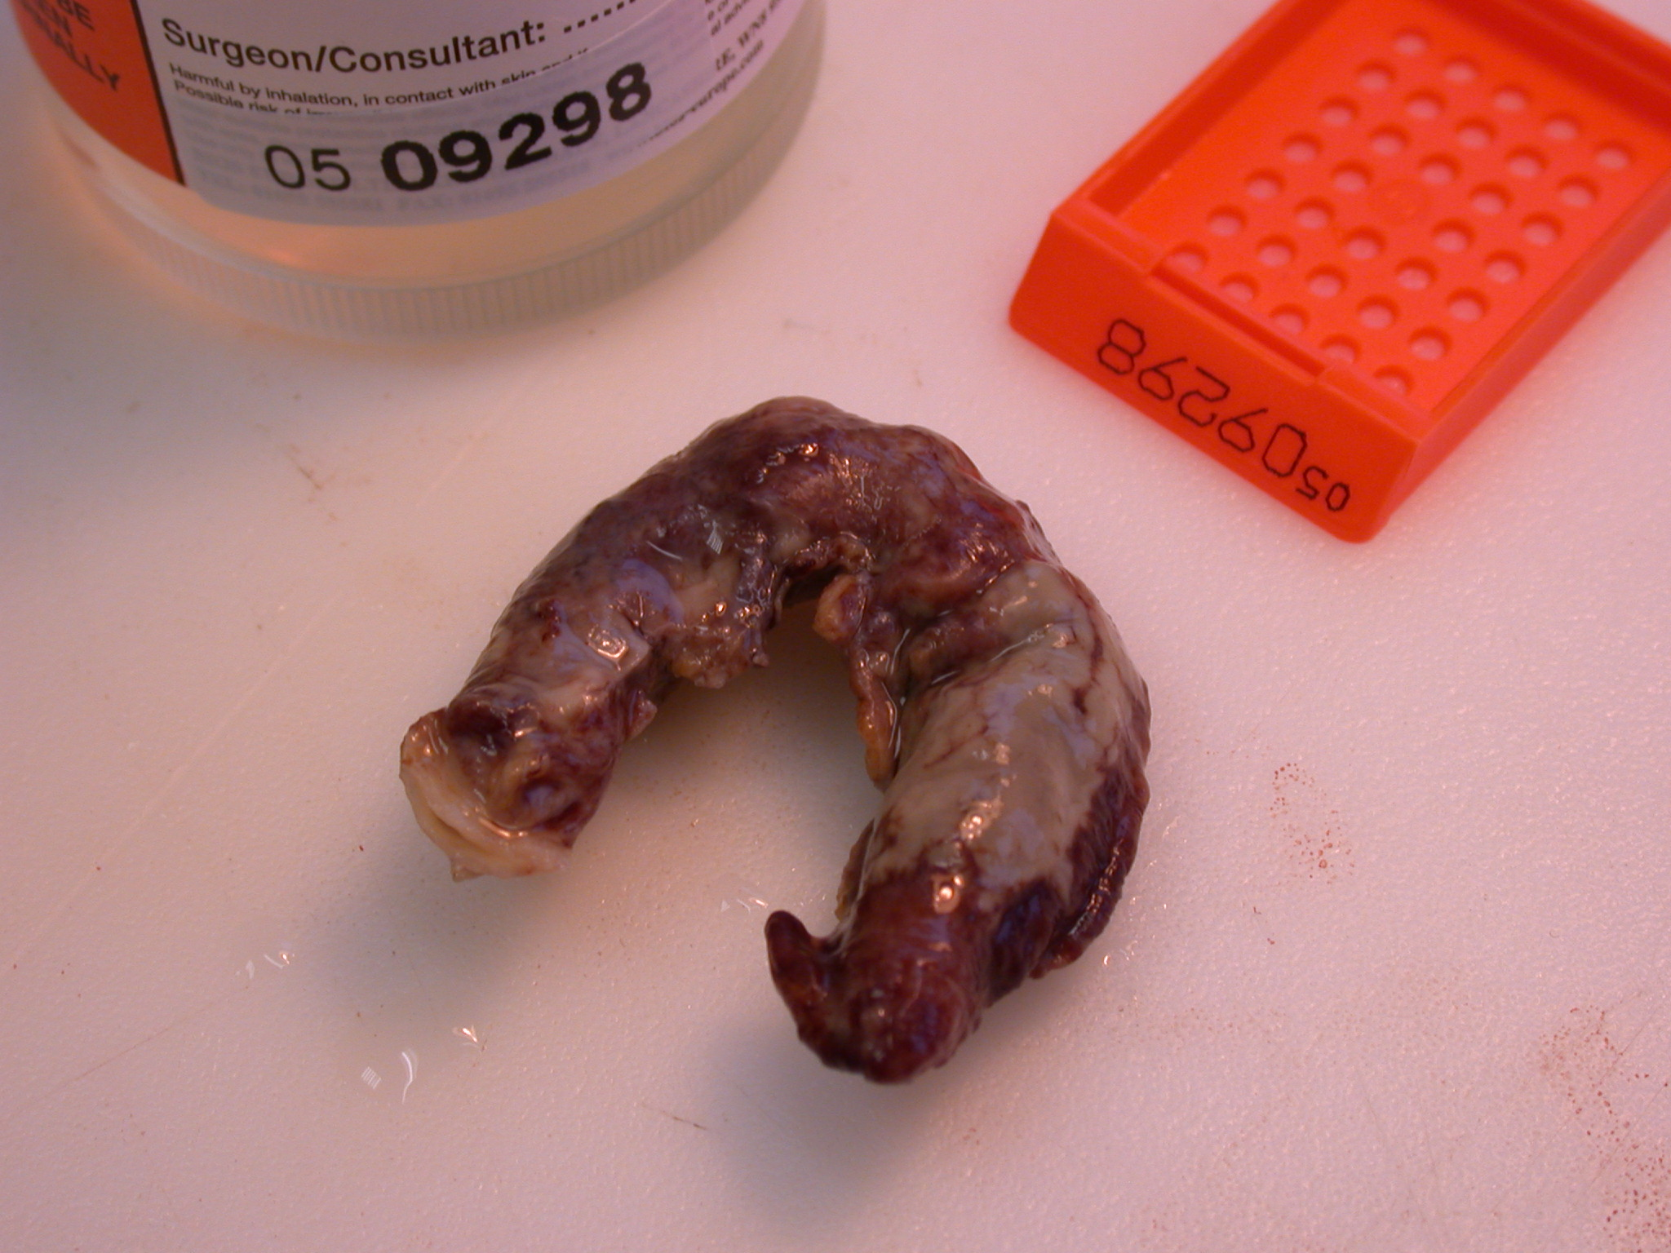

Slide 20
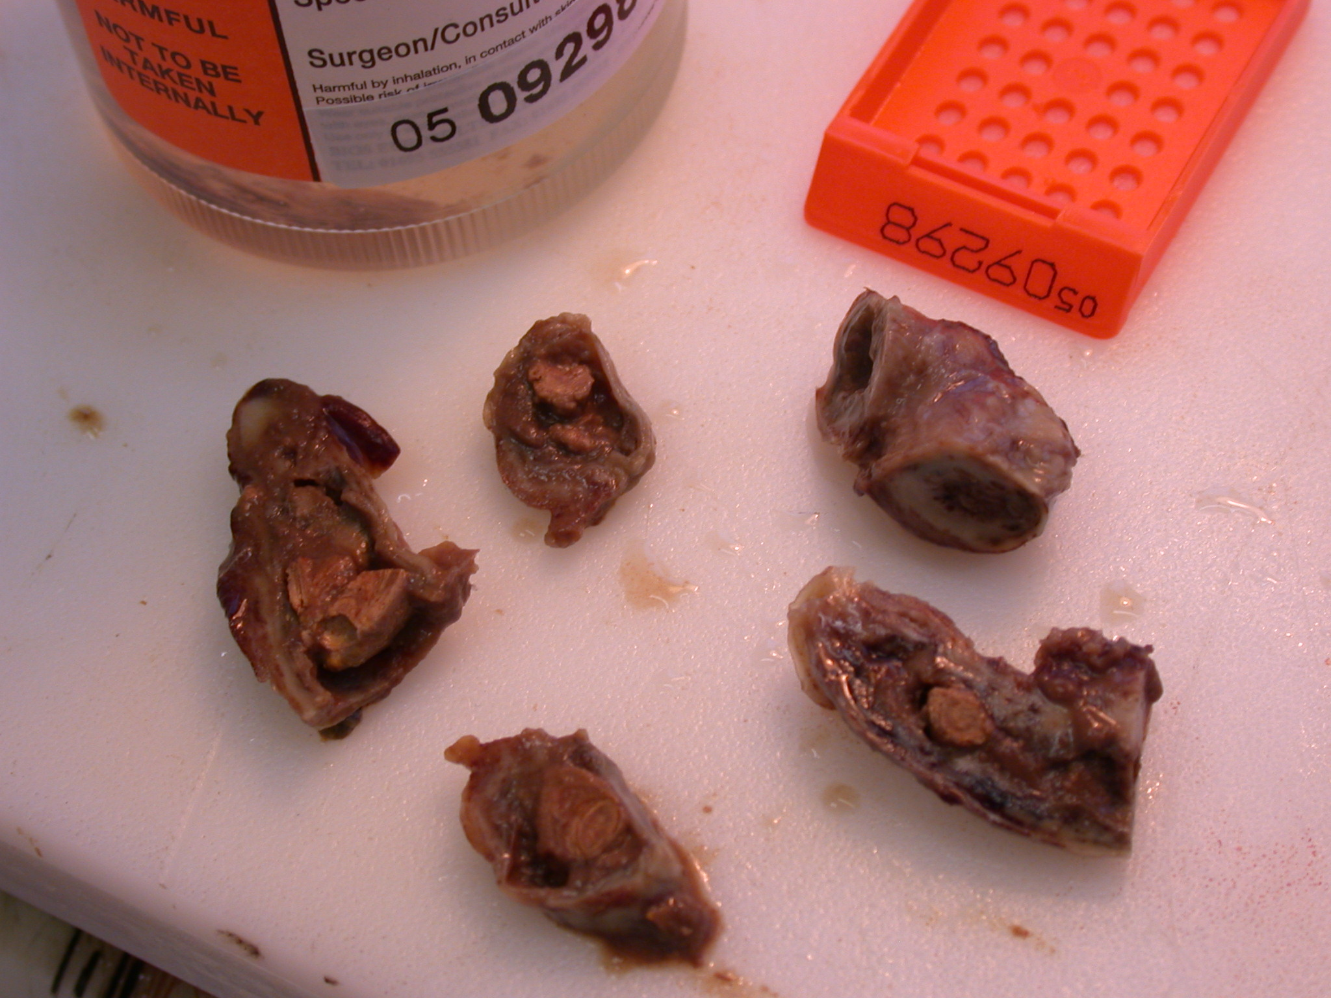

Slide 21
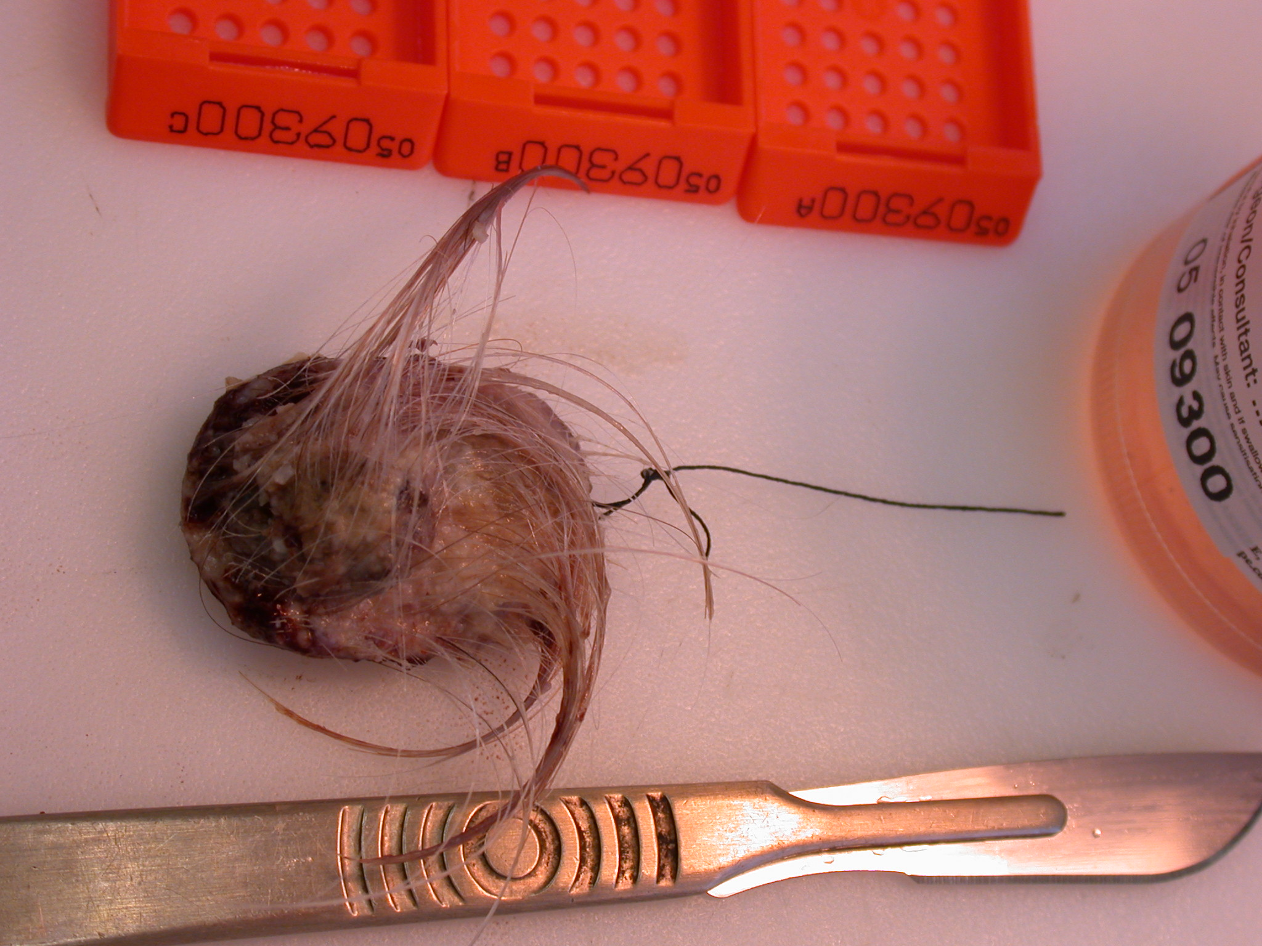

Slide 22
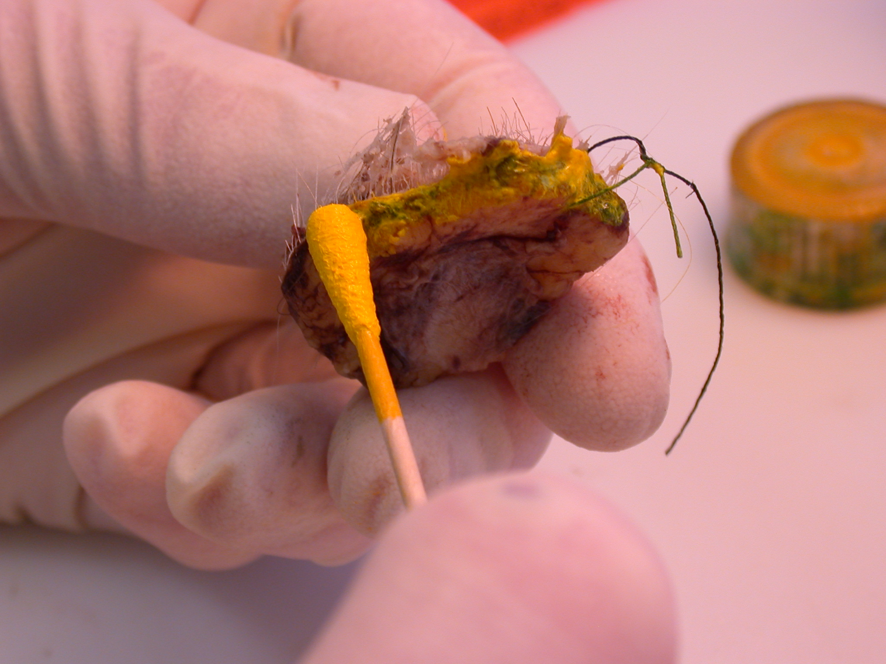

Slide 23
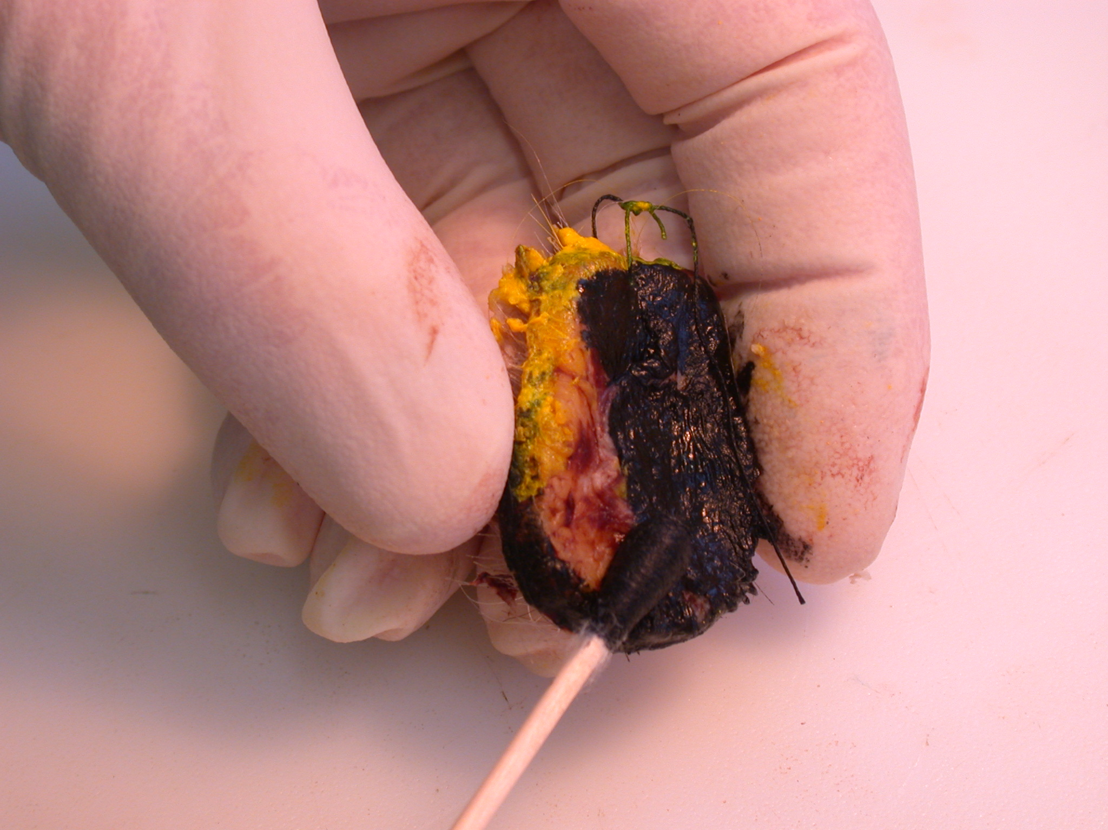

Slide 24
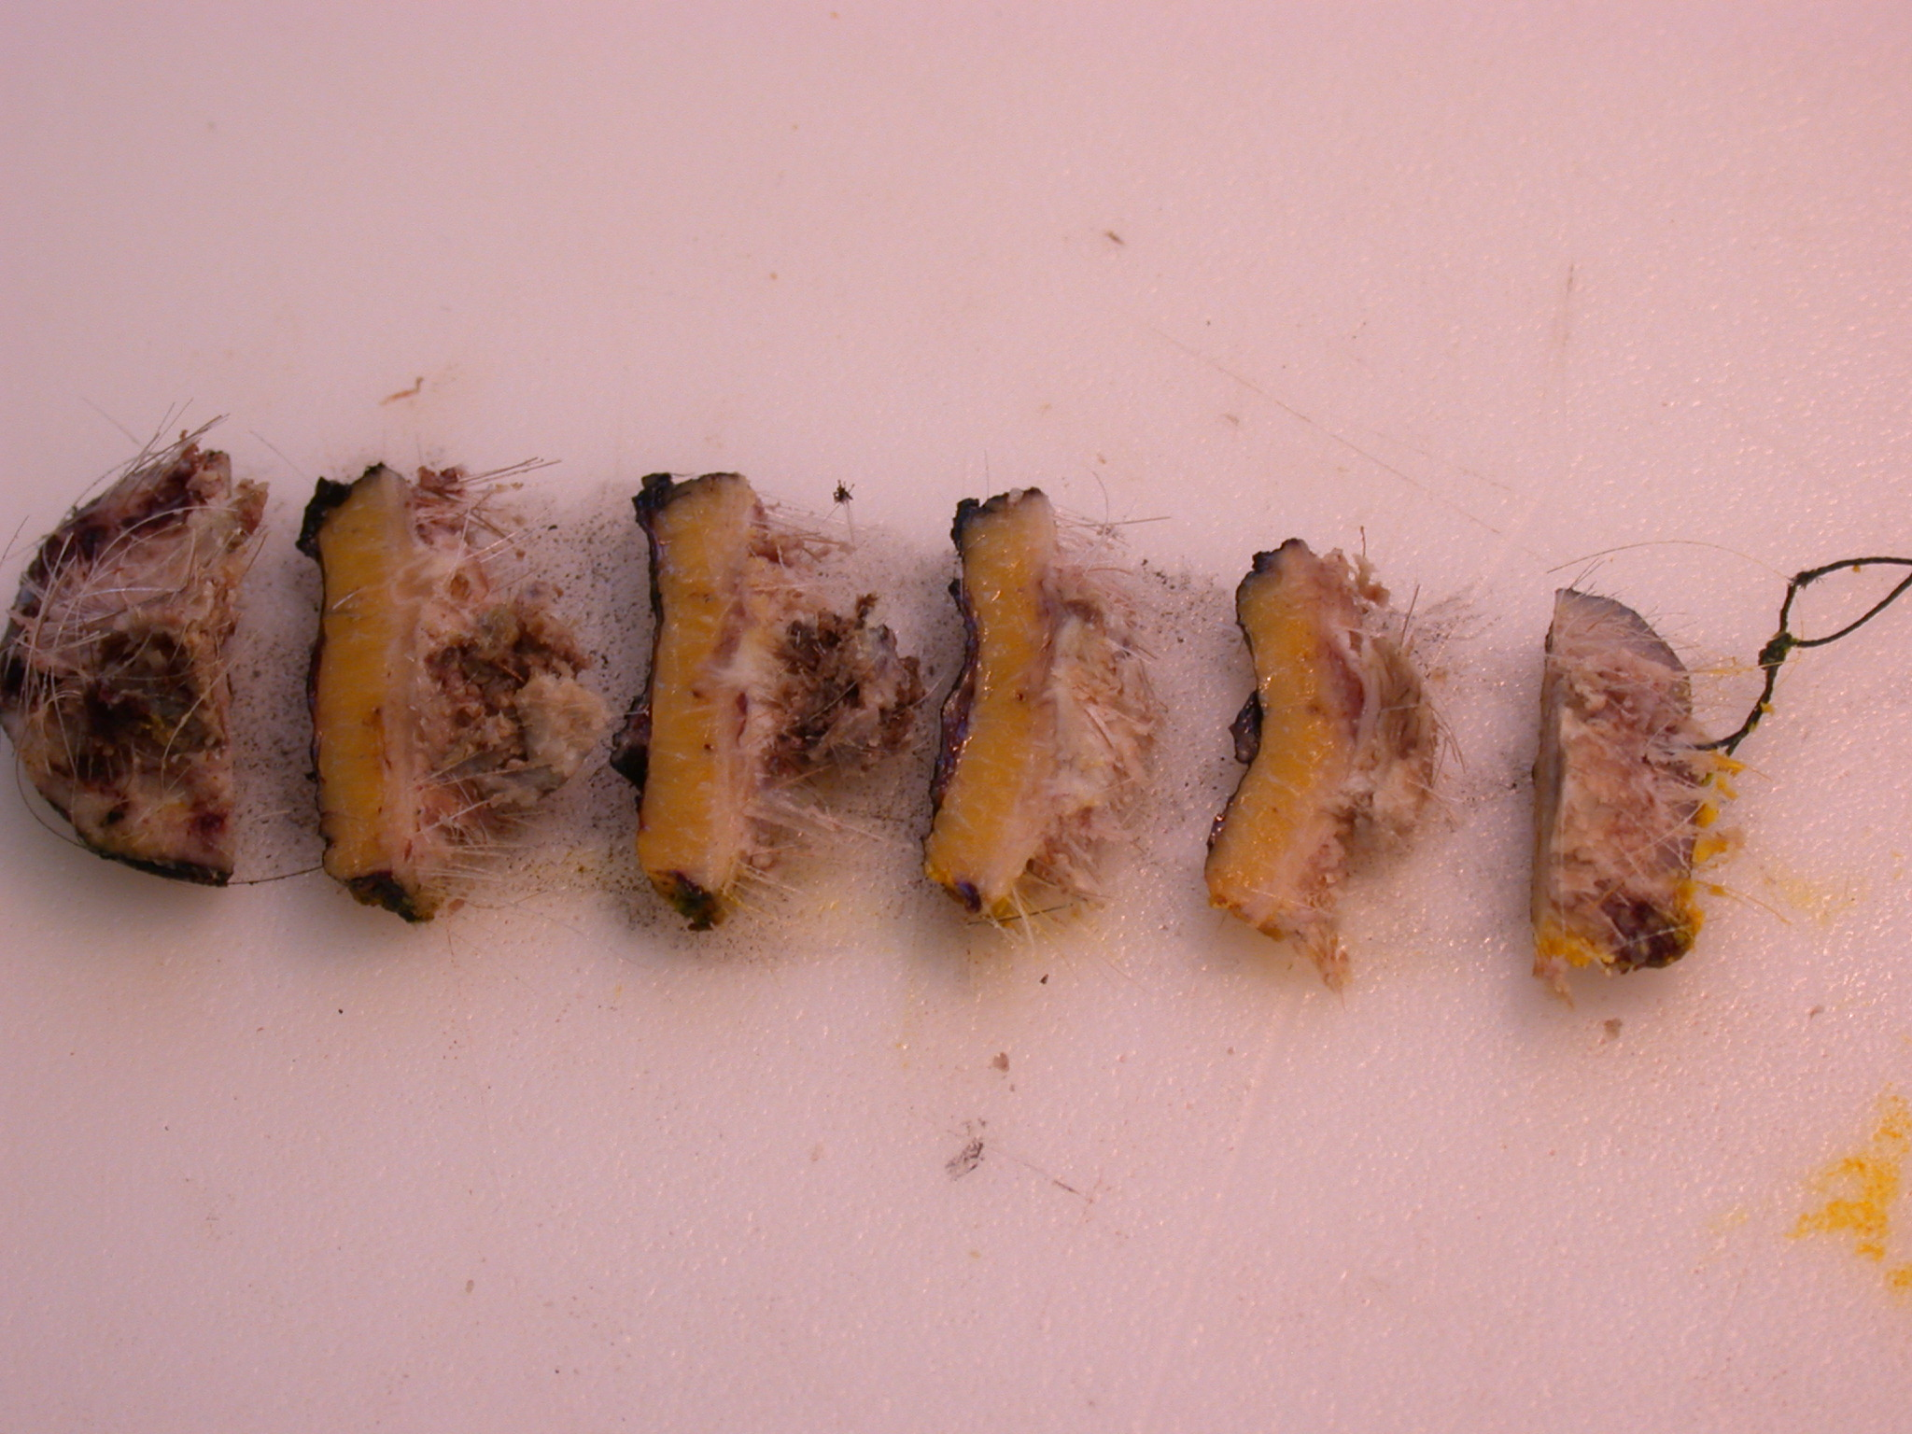

Slide 25
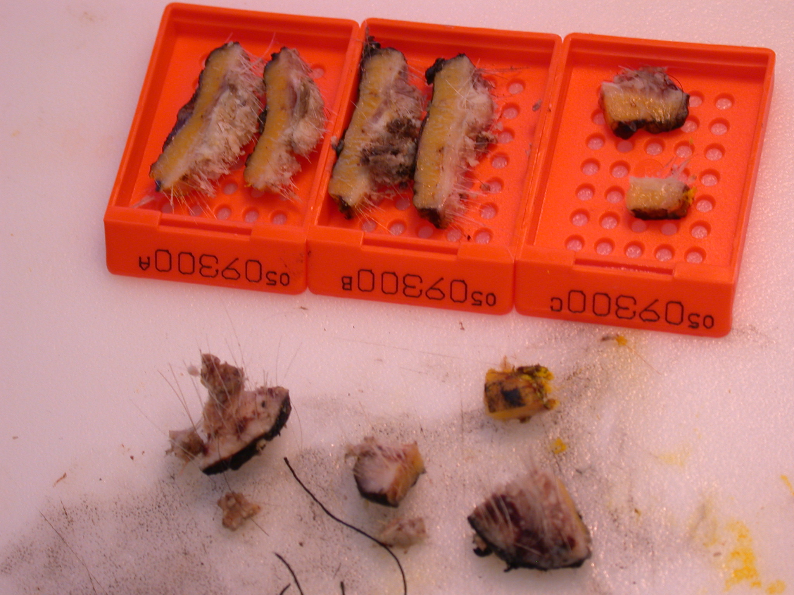

Slide 26
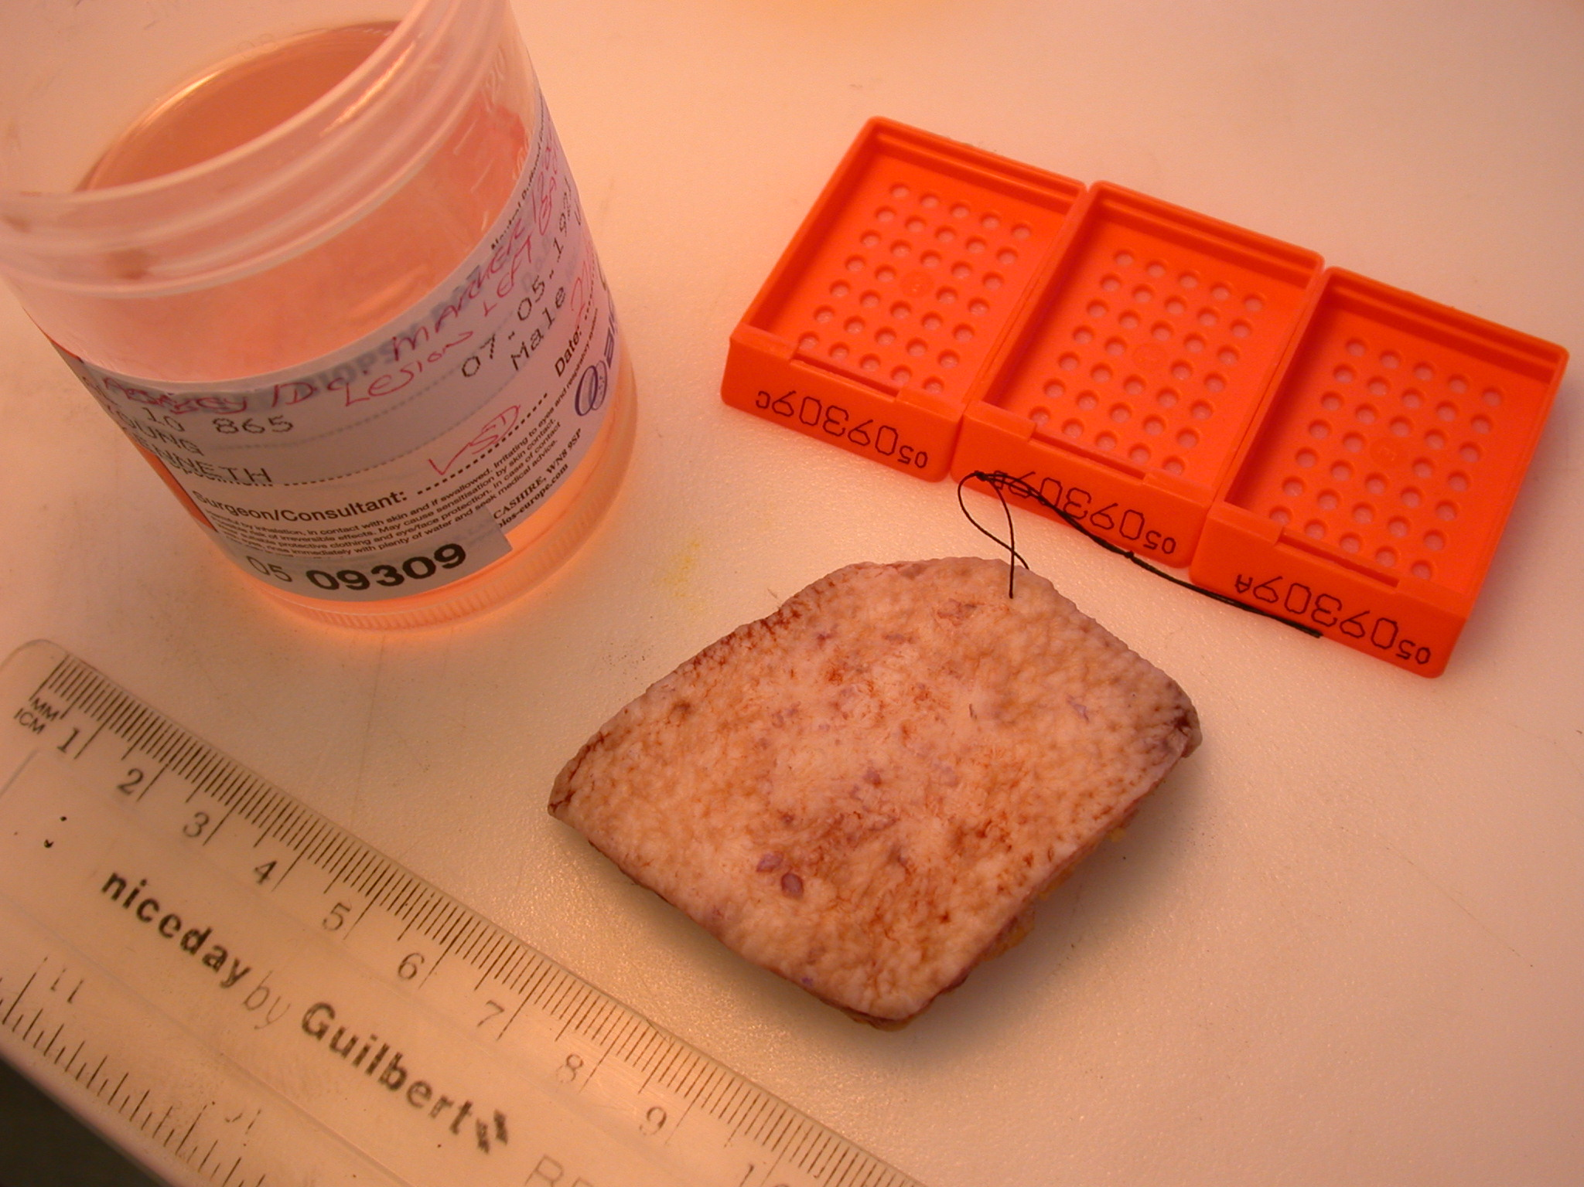
Superficial multifocal BCC

Slide 27
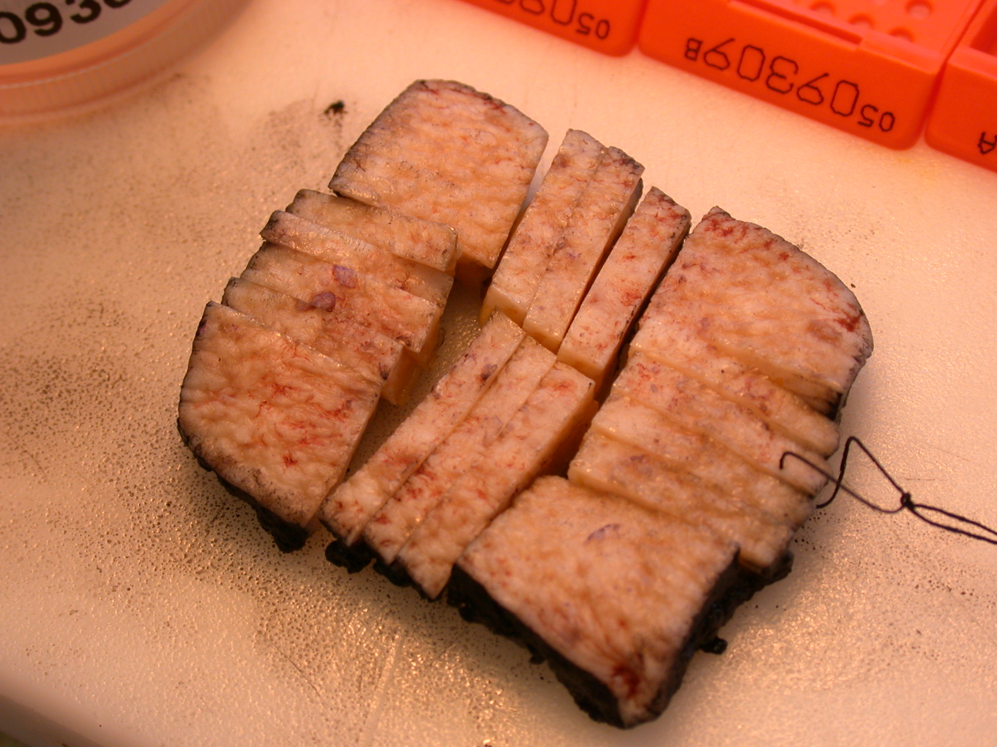

Slide 28
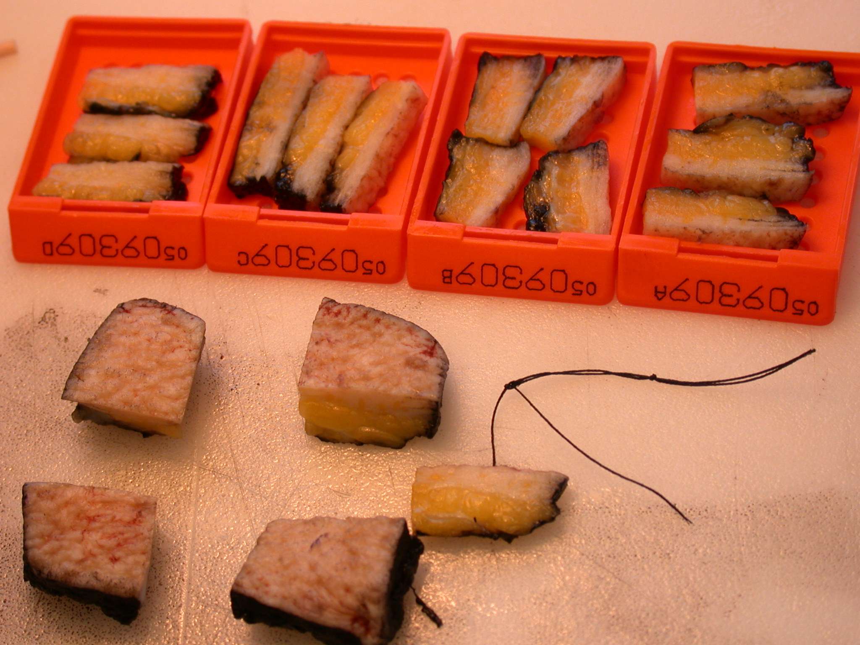

Slide 29
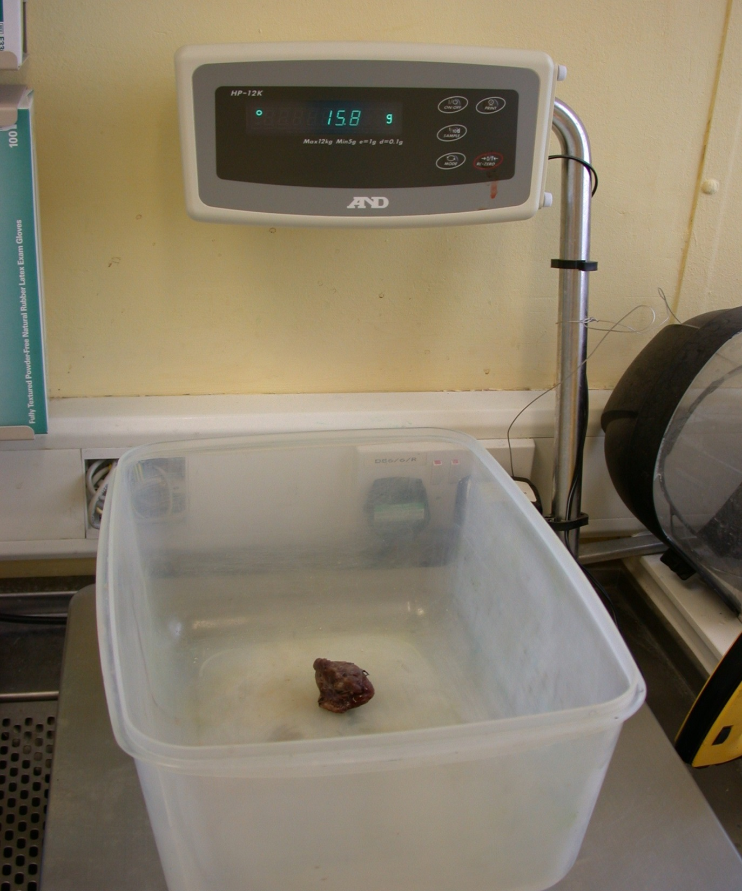

Slide 30
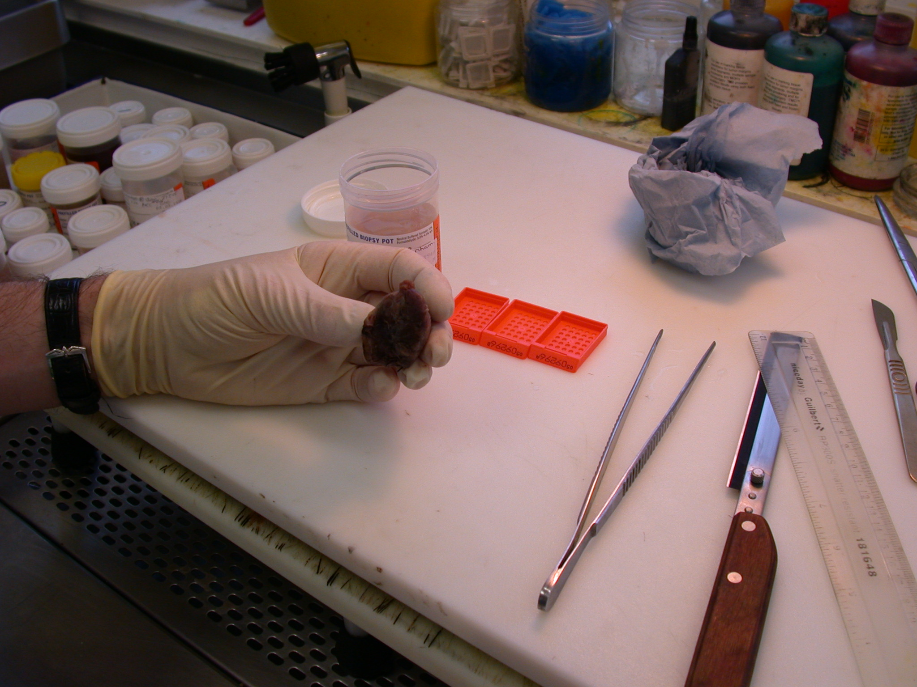
hemithyroidectomy

Slide 31
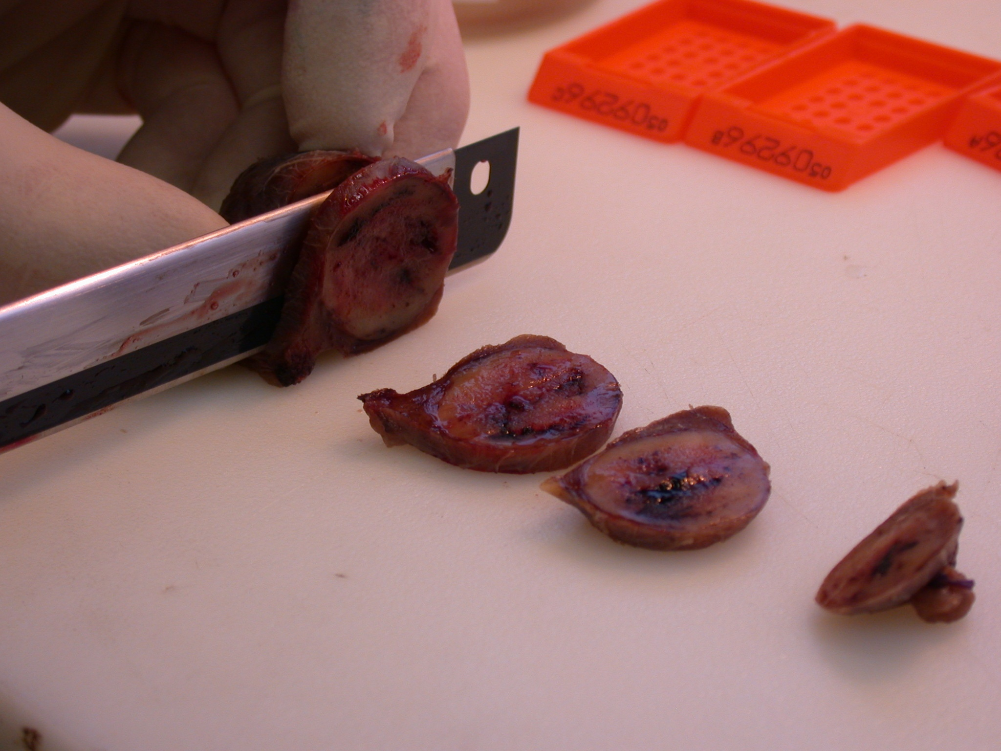

Slide 32
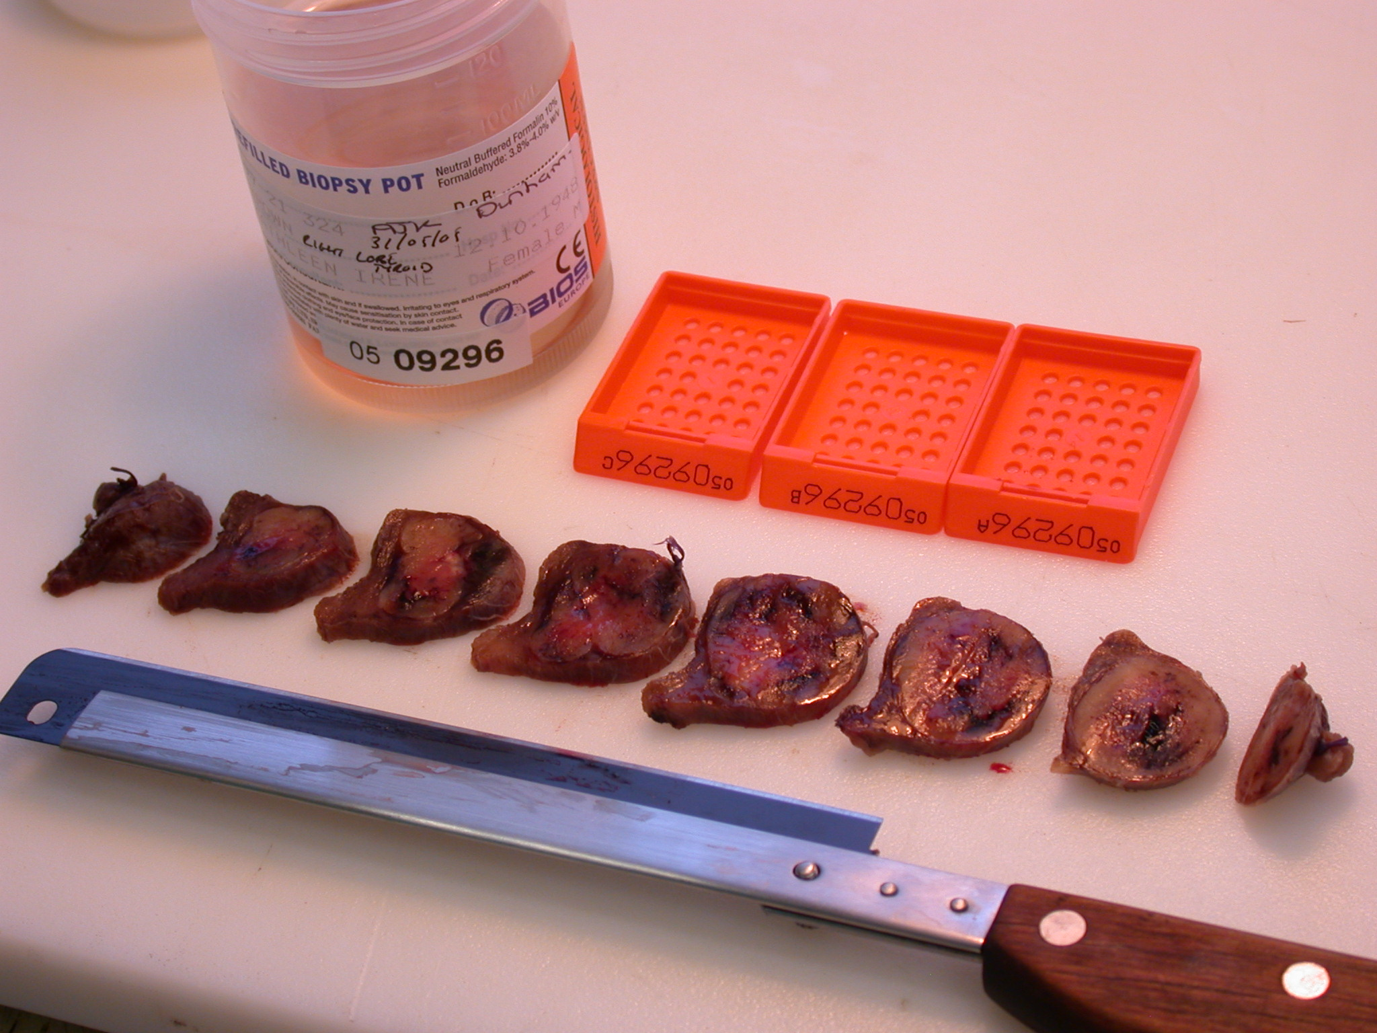

Slide 33
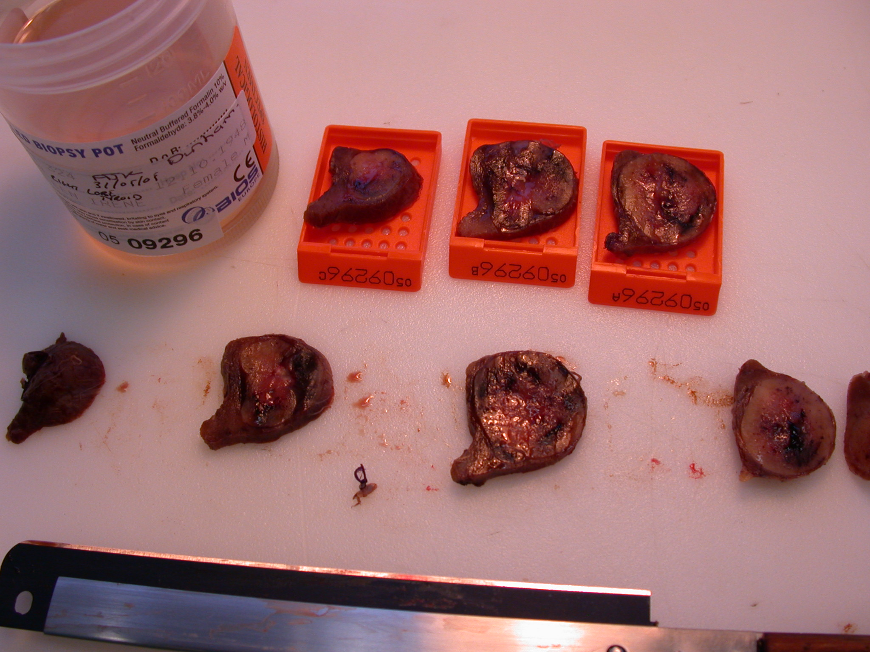

Slide 34
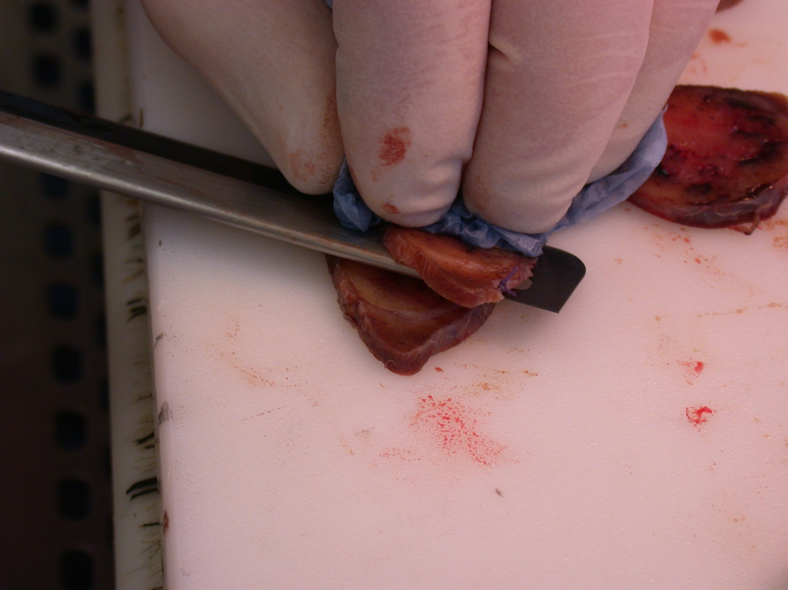

Slide 35
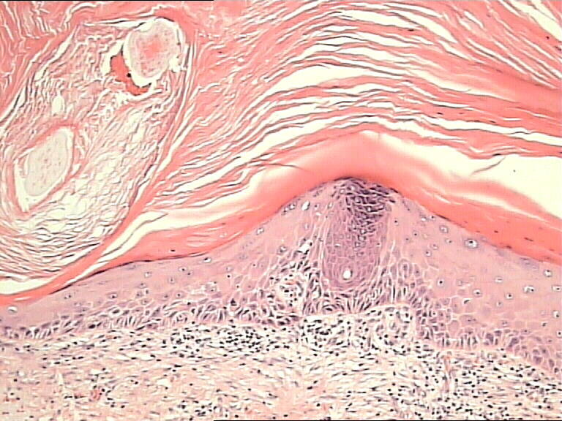

Slide 36
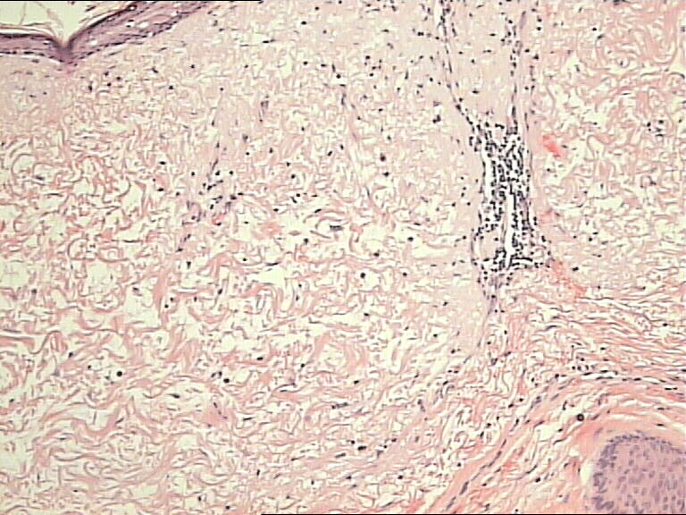

Slide 37
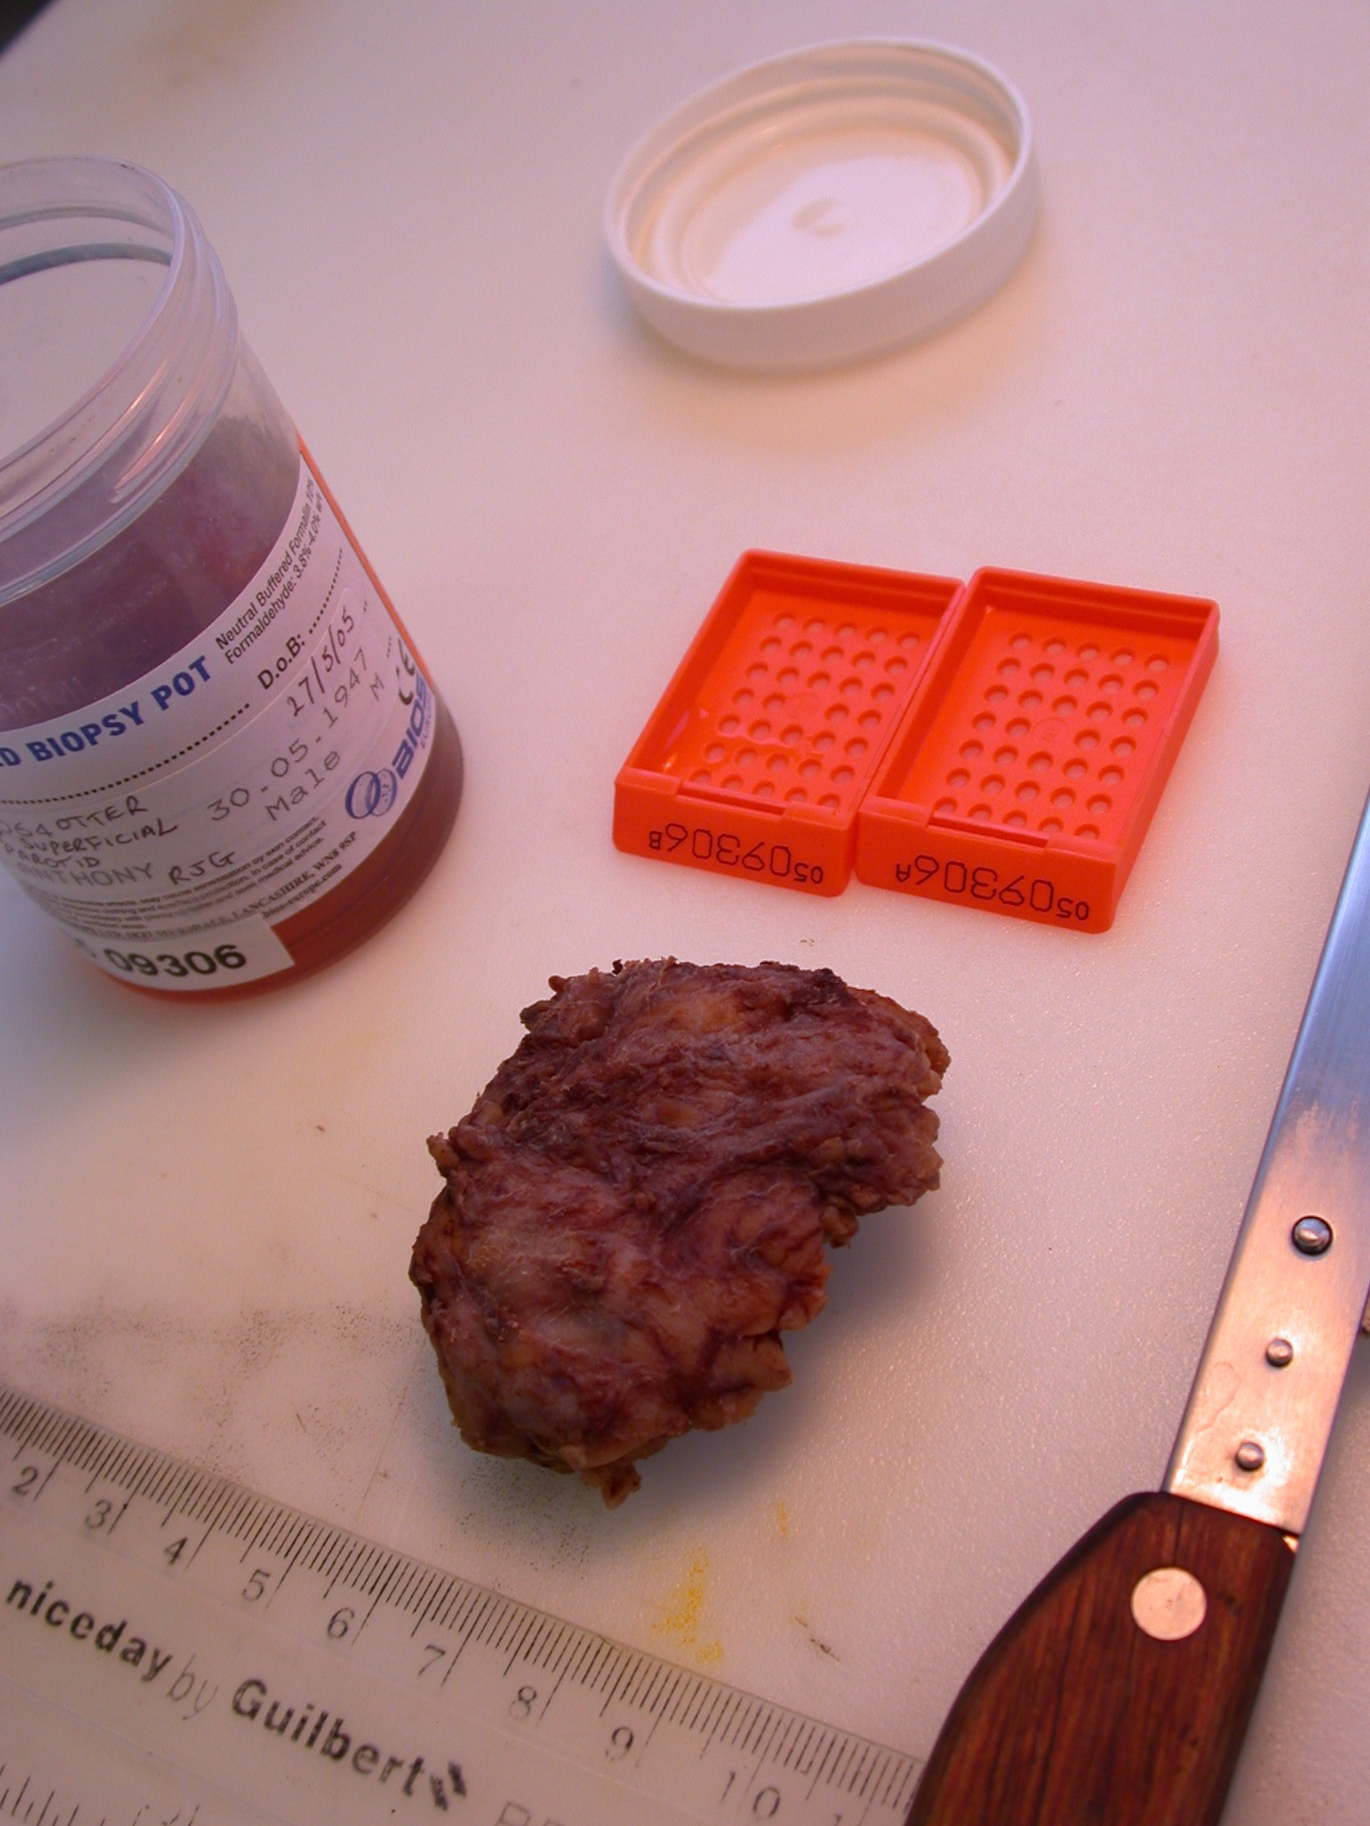
parotid adenoma

Slide 38
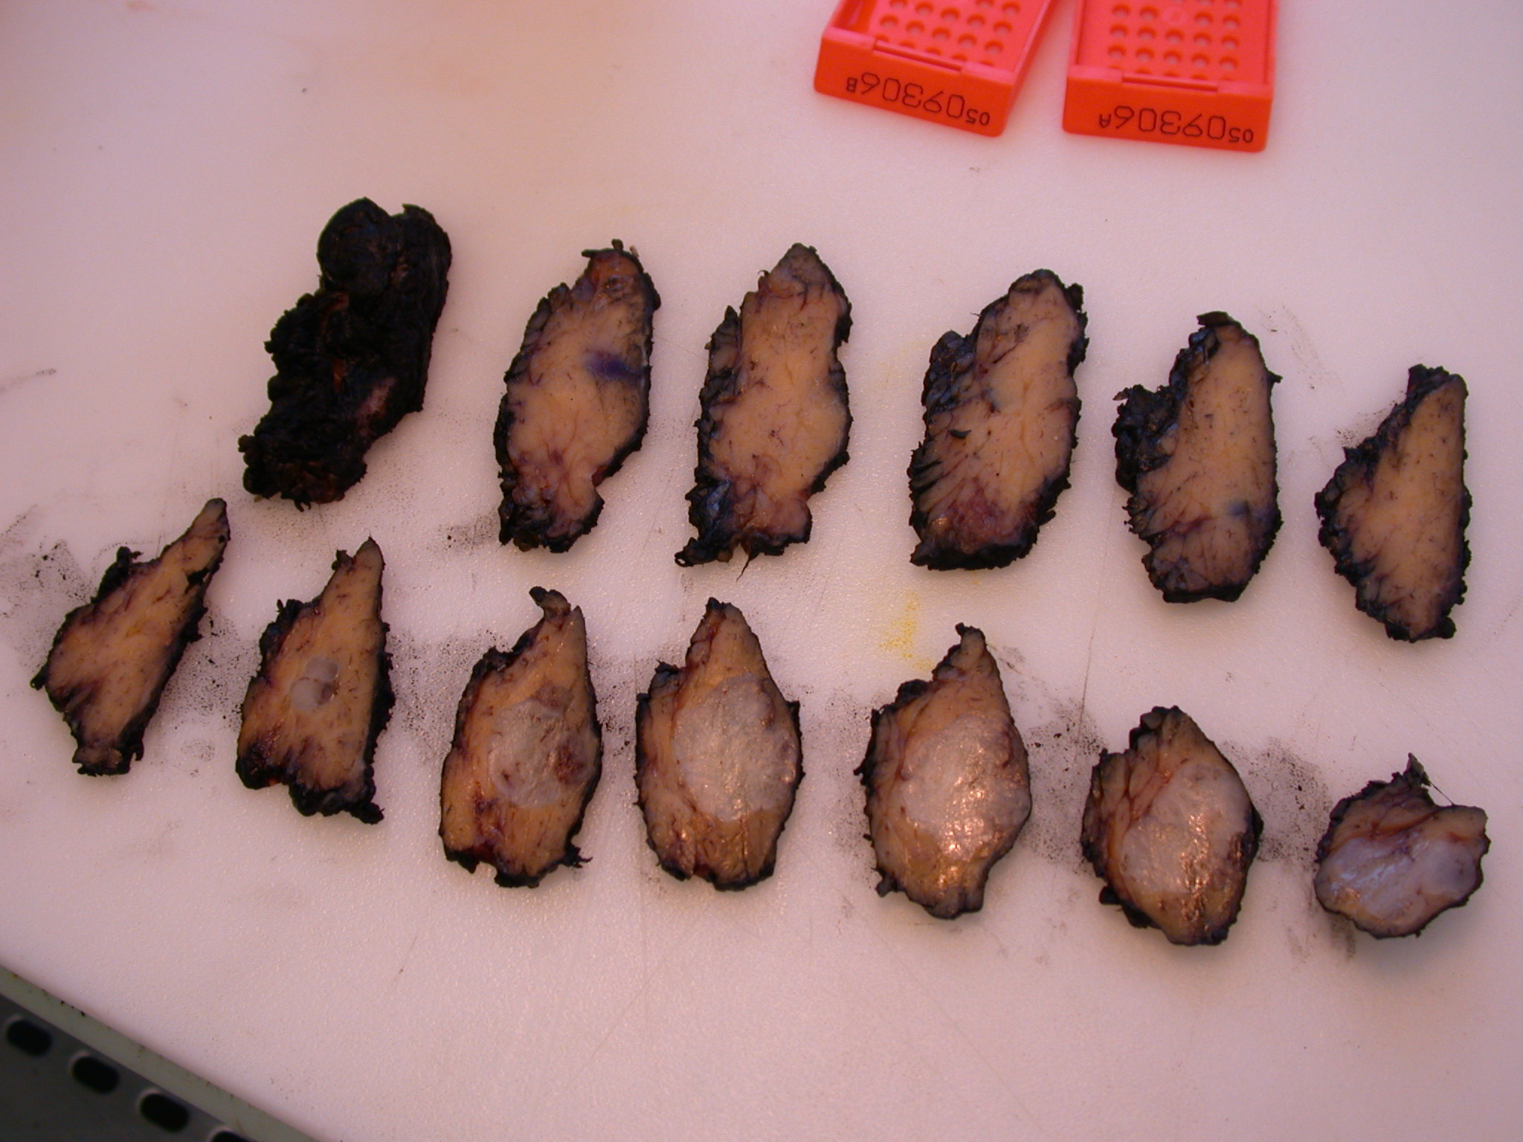

Slide 39
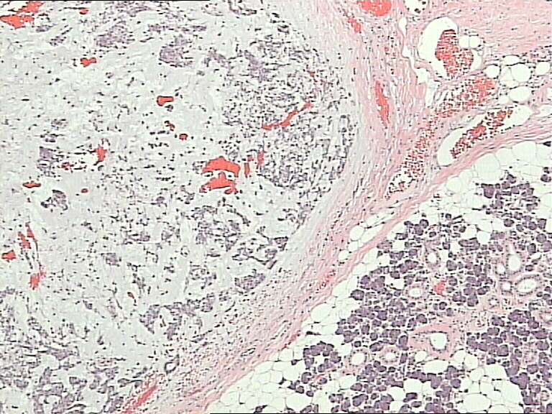

Slide 40
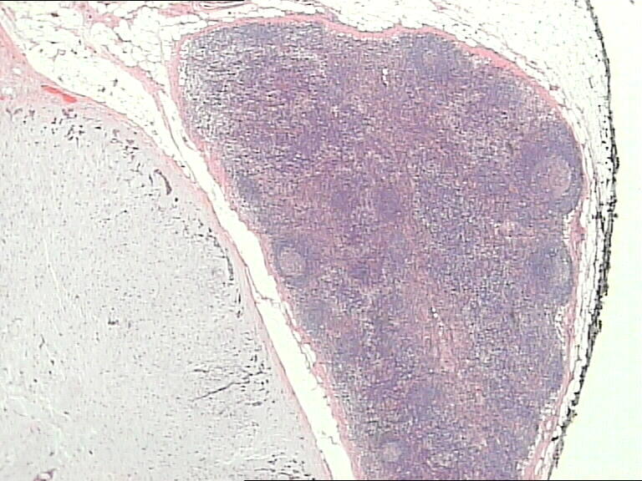

Slide 41
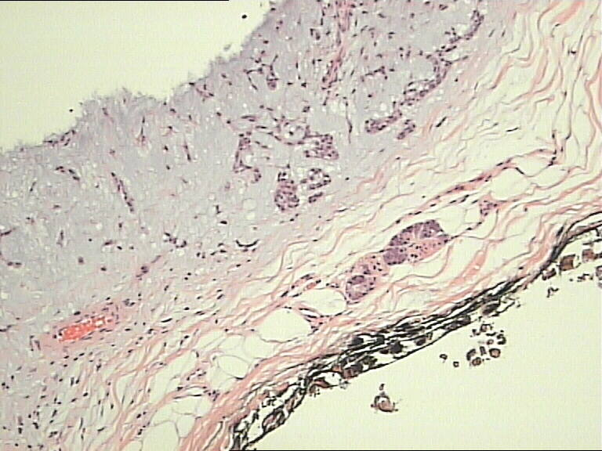

Slide 42
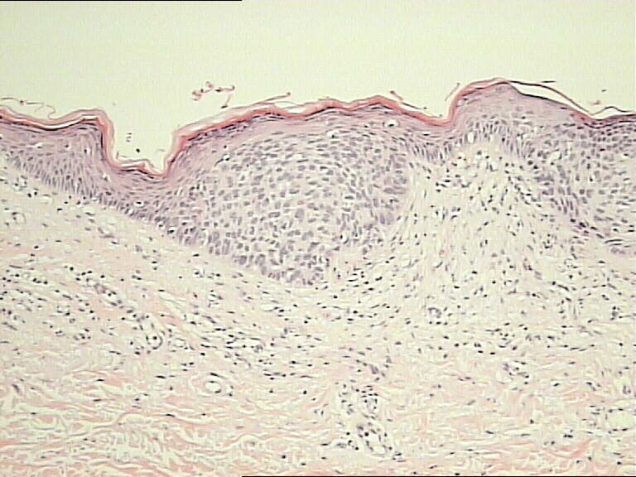

Slide 43
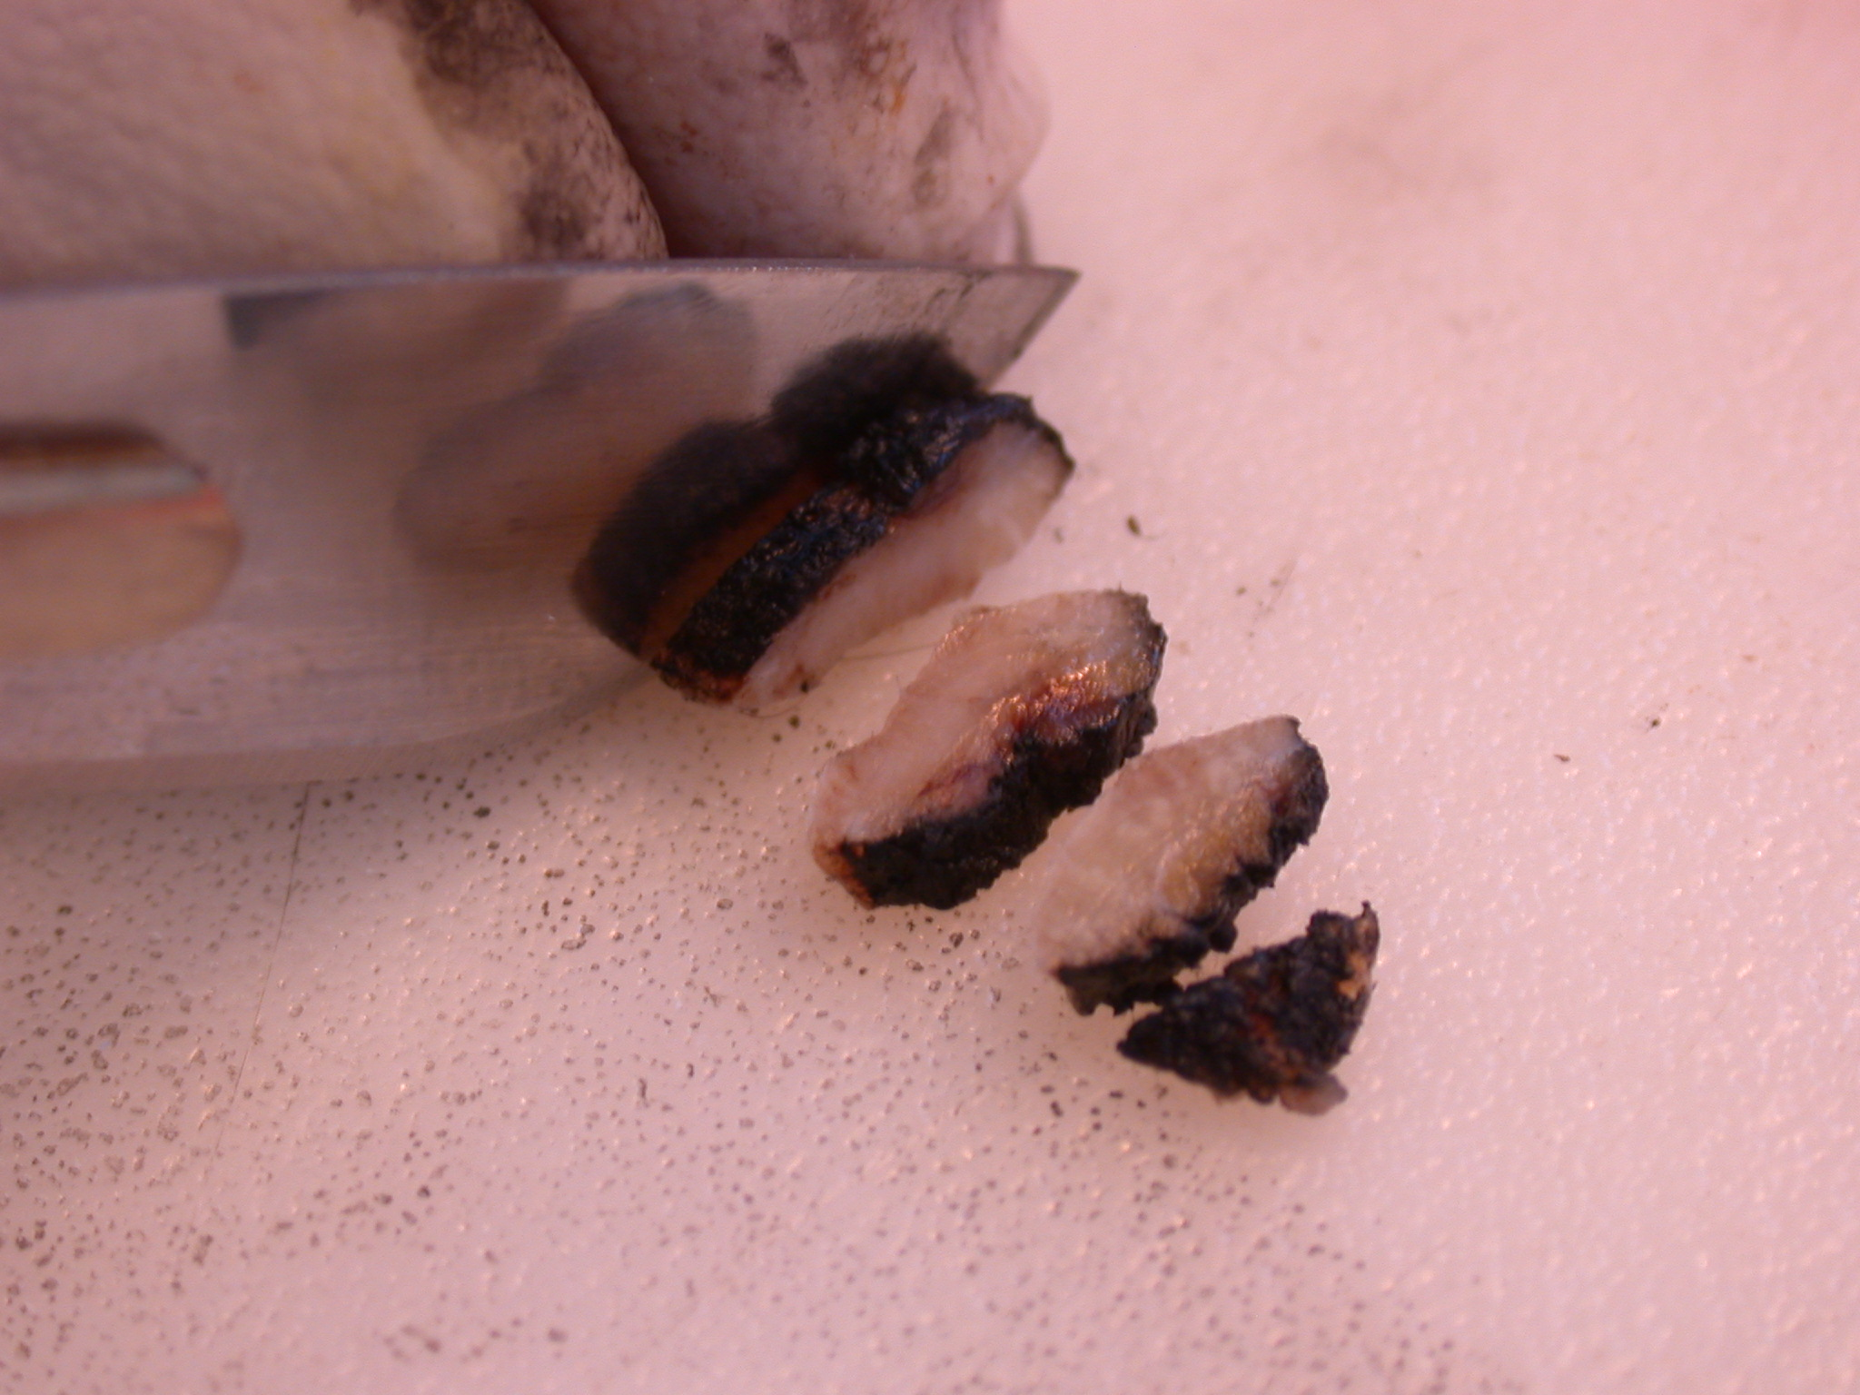

Slide 44
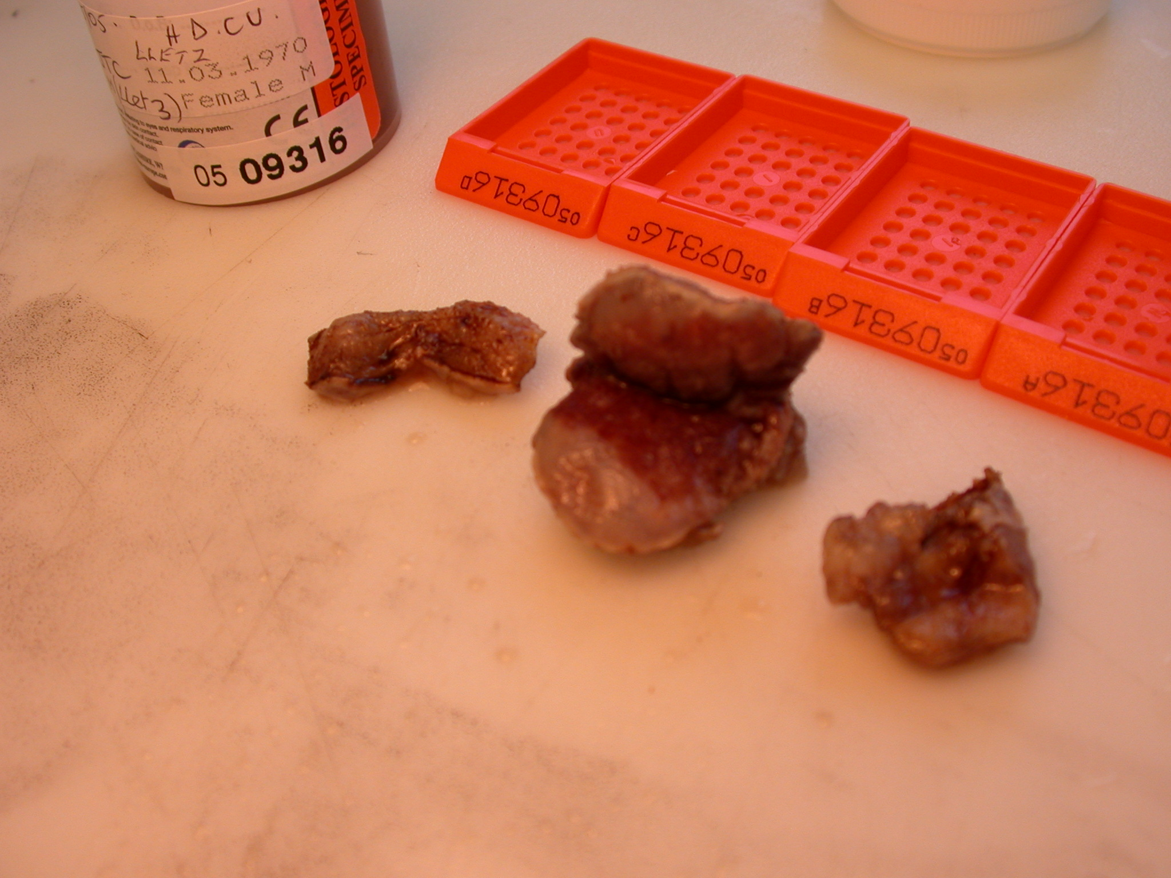
Loop biopsy of cervix

Slide 45
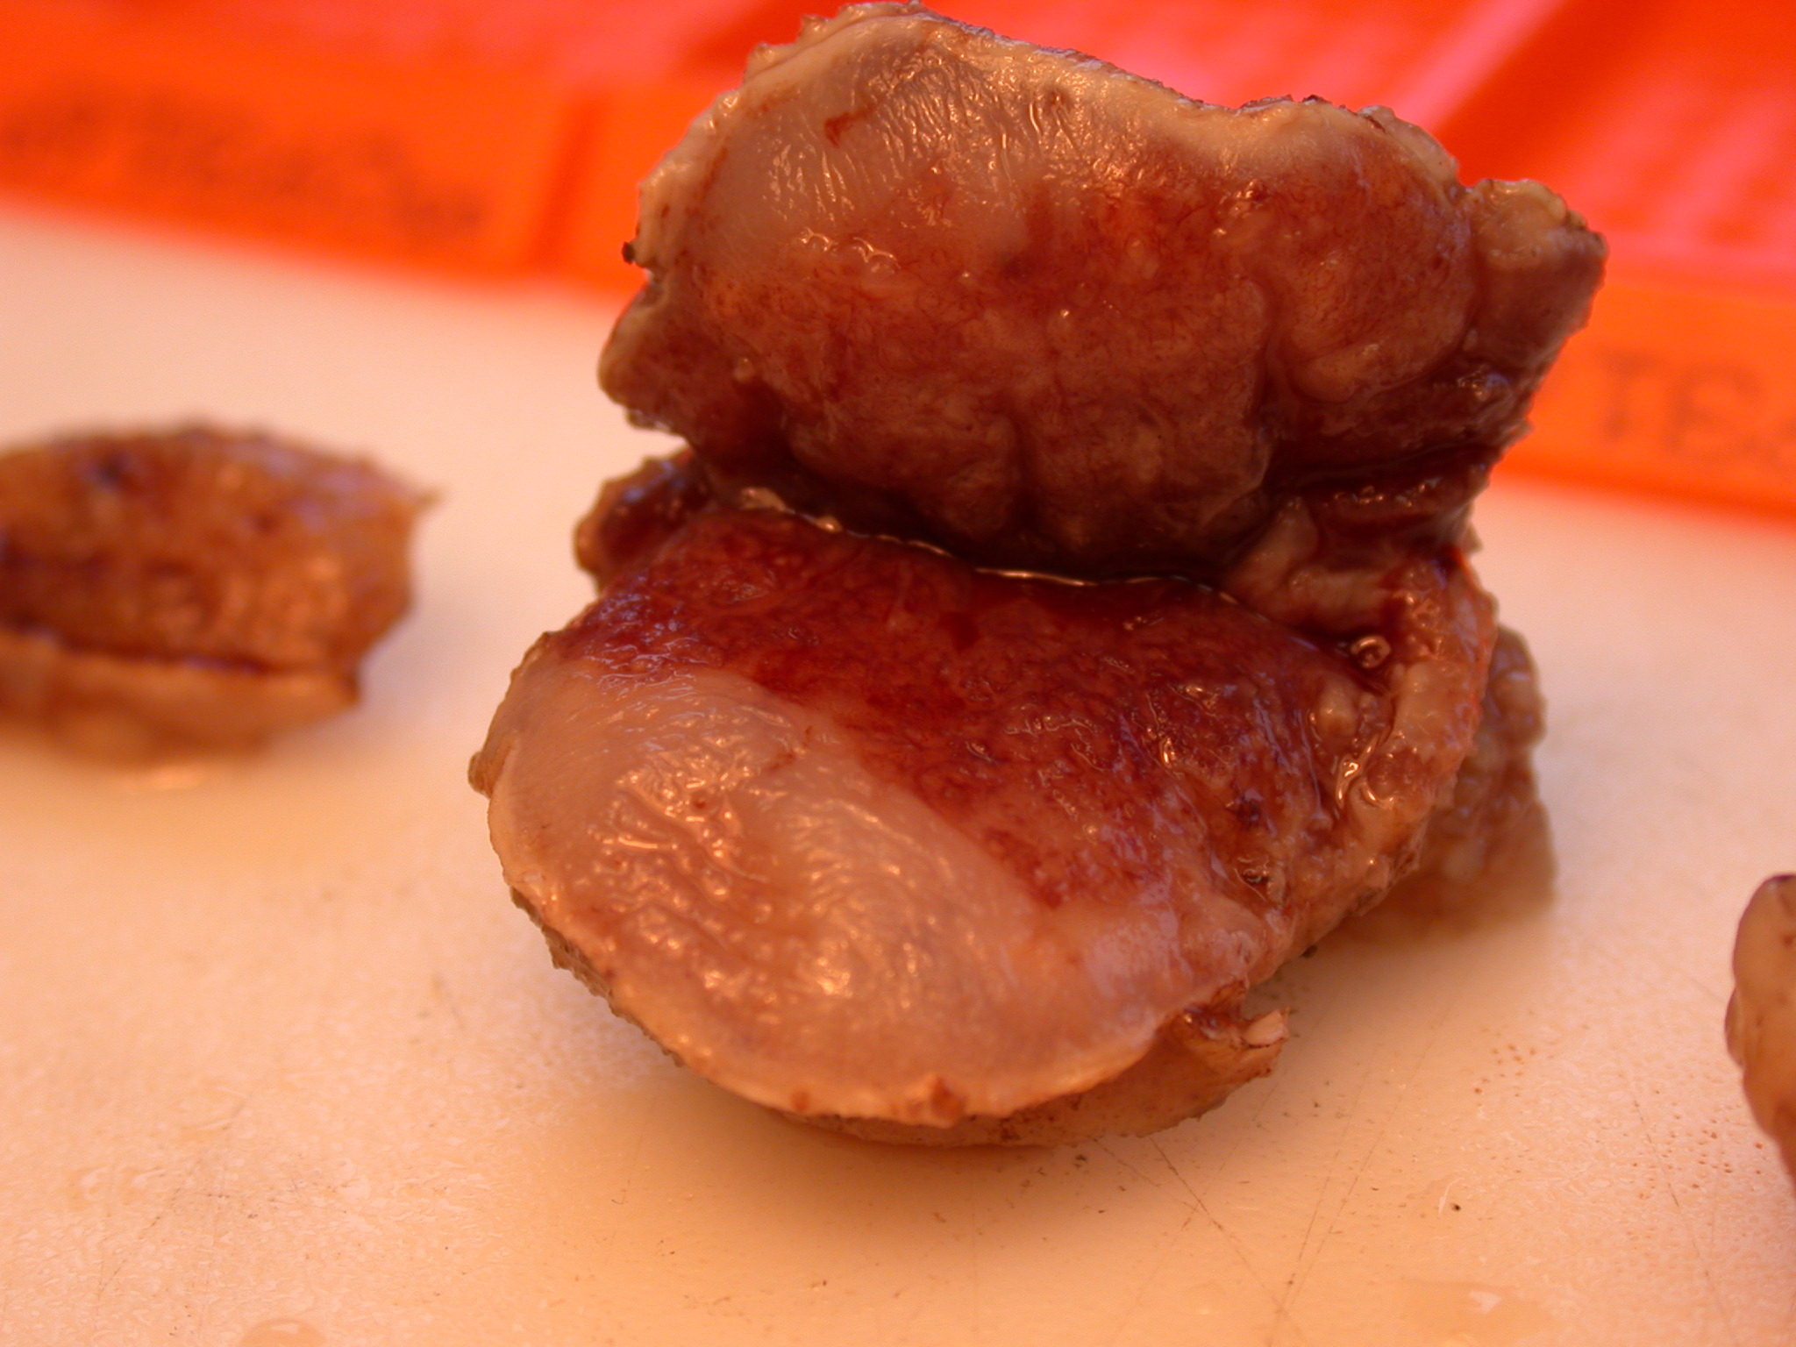
CIN 3

Slide 46
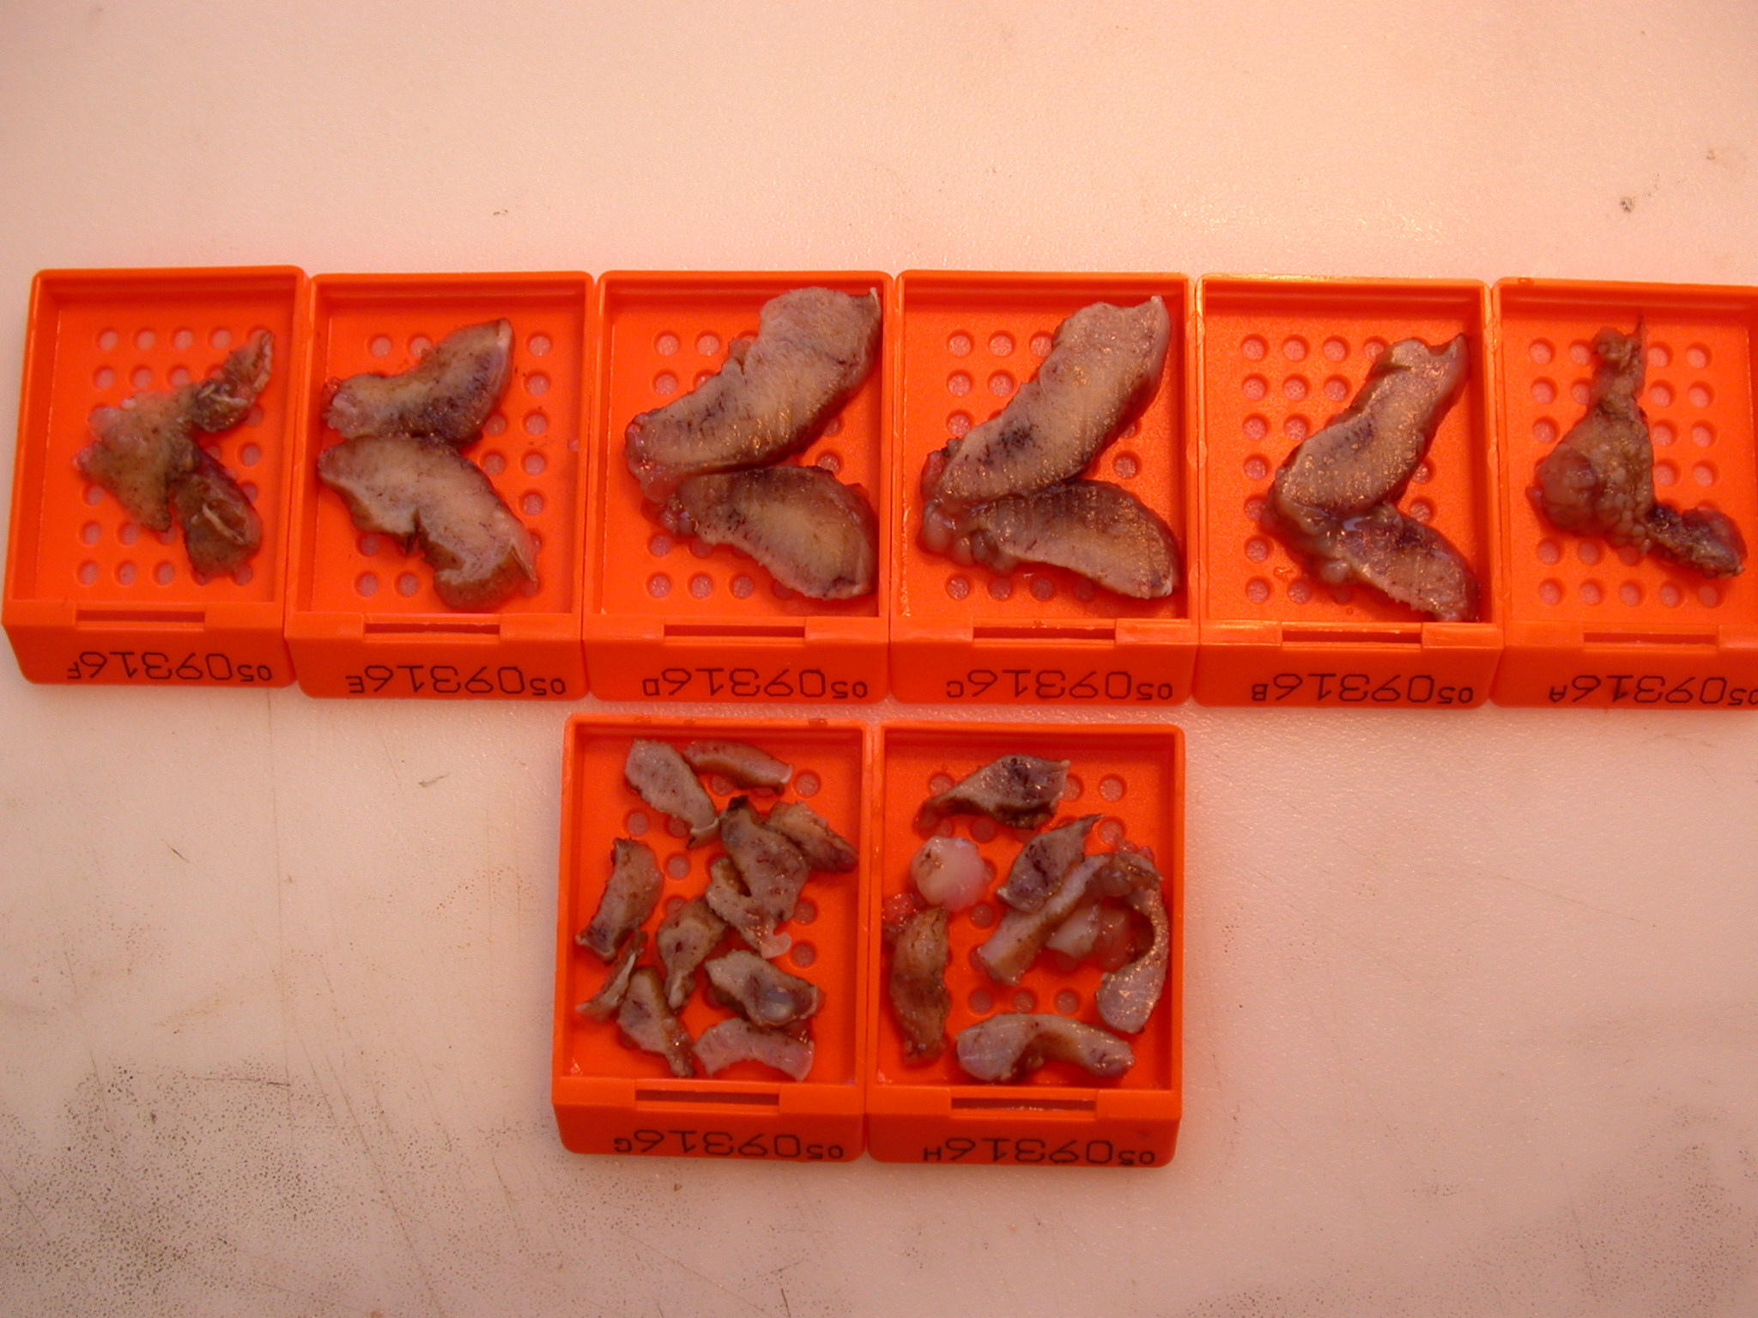

Slide 47
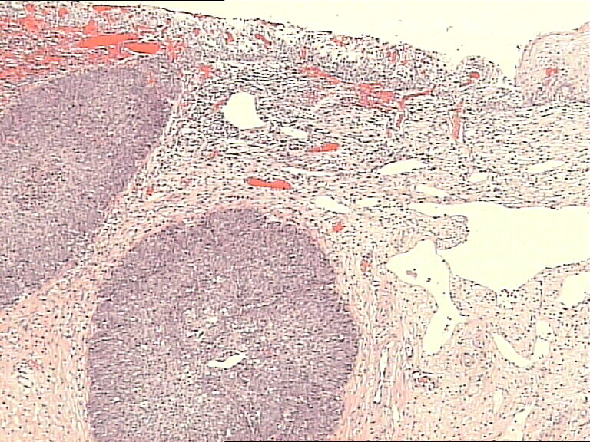

Slide 49
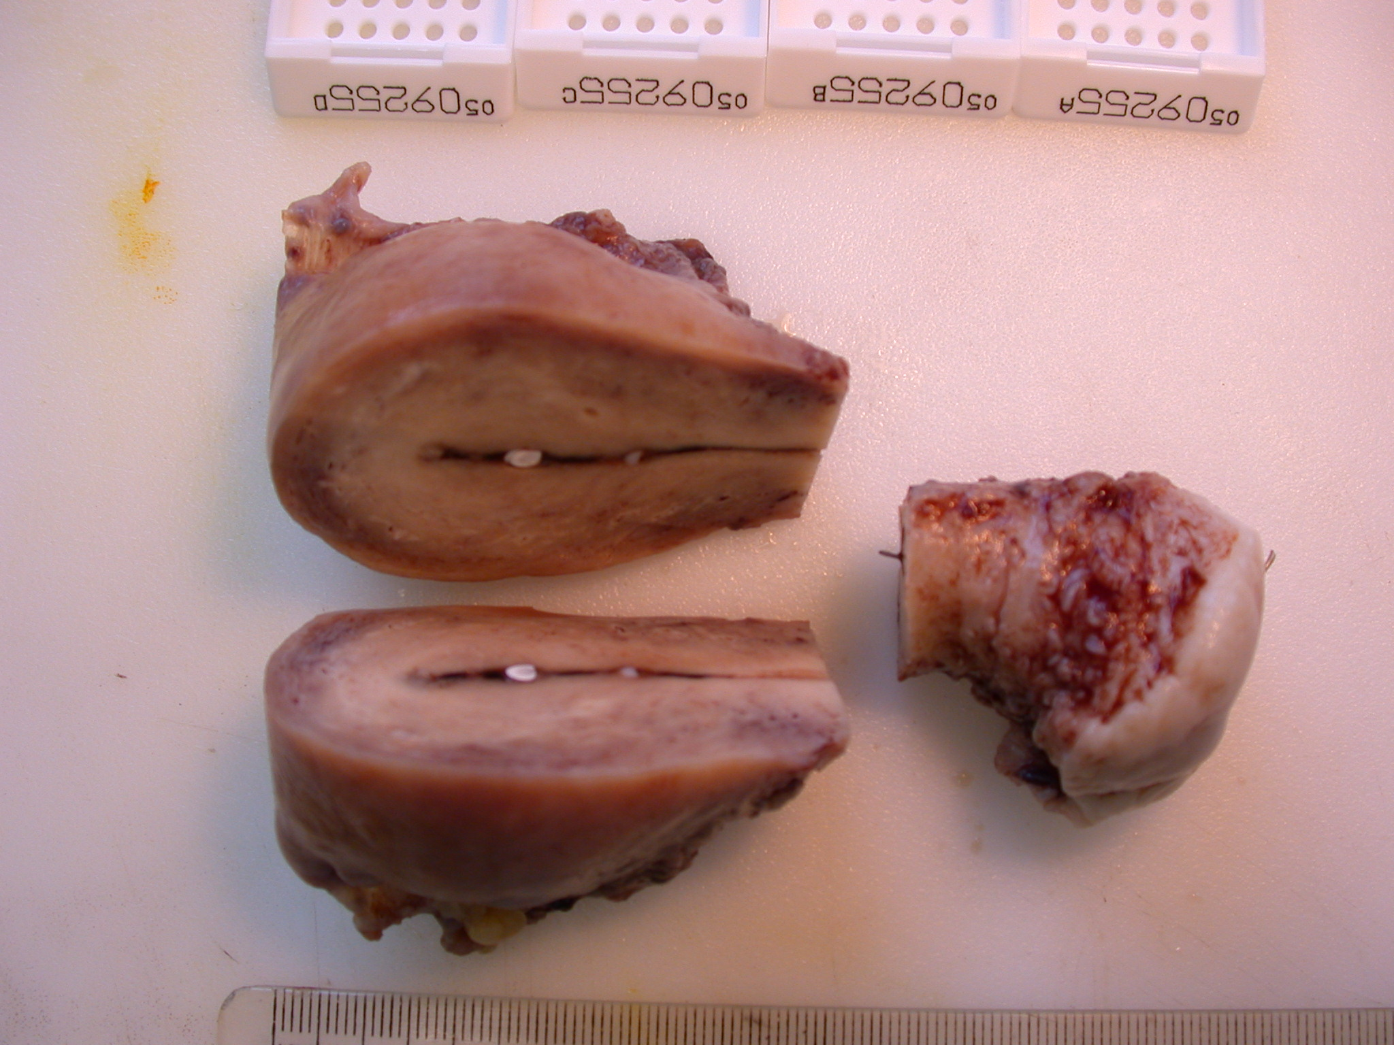

Slide 50
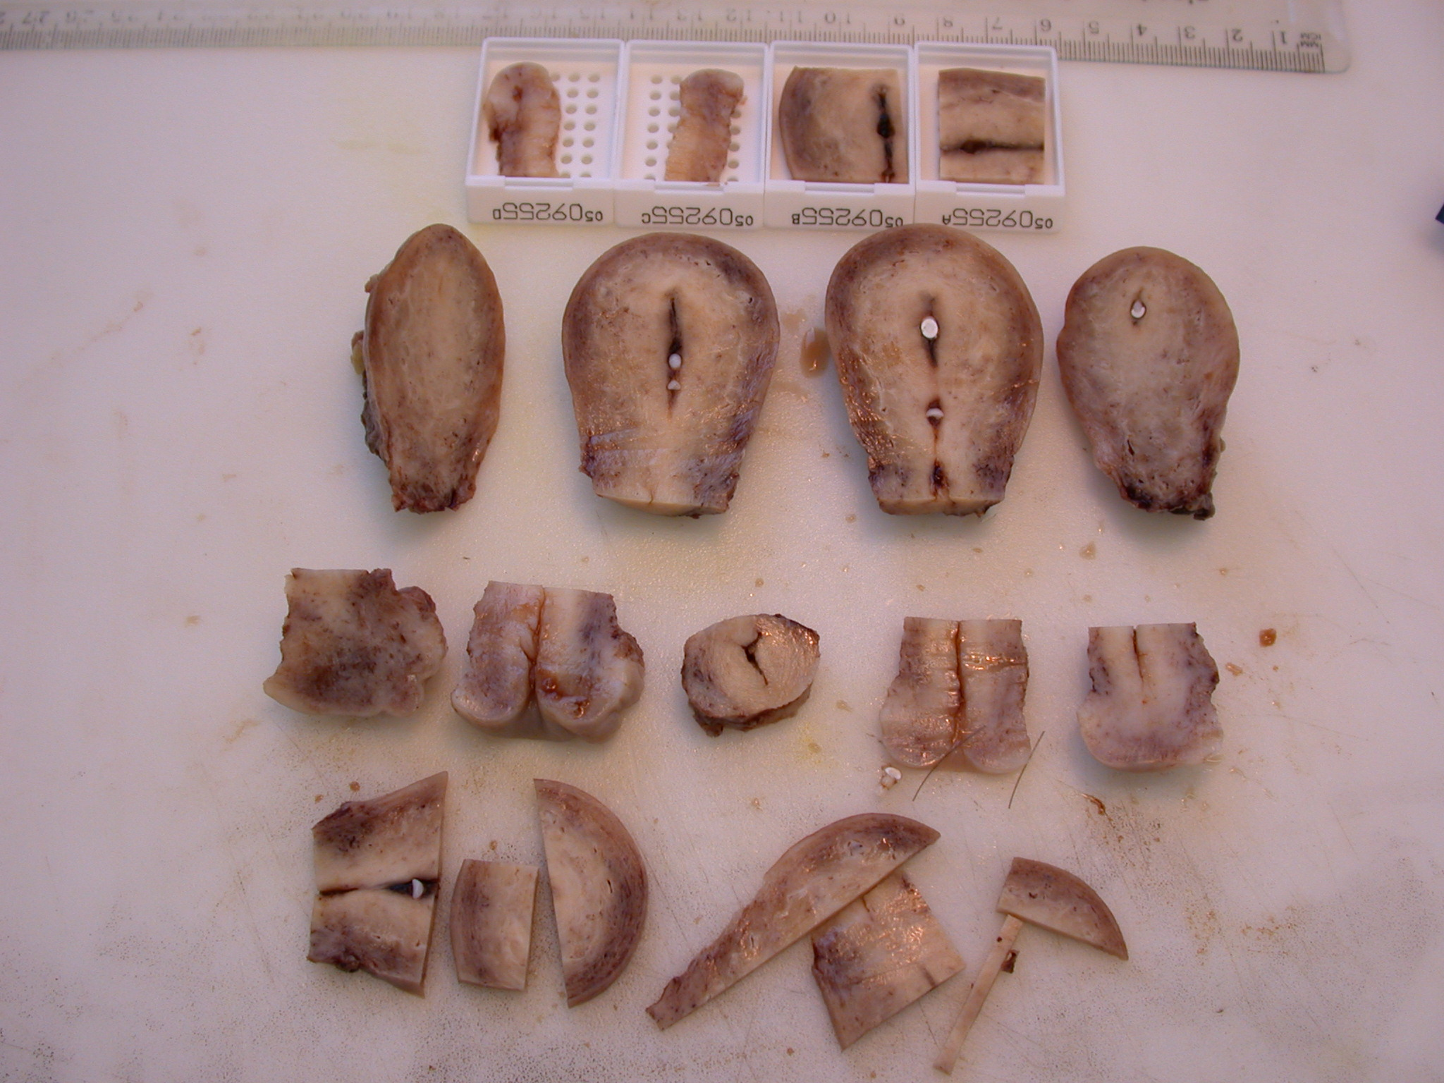

Slide 51
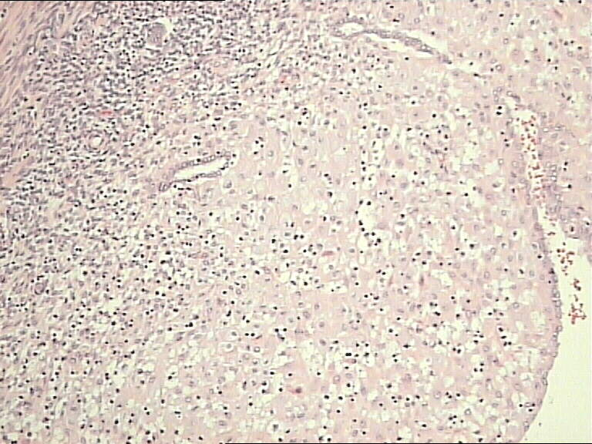

Slide 52
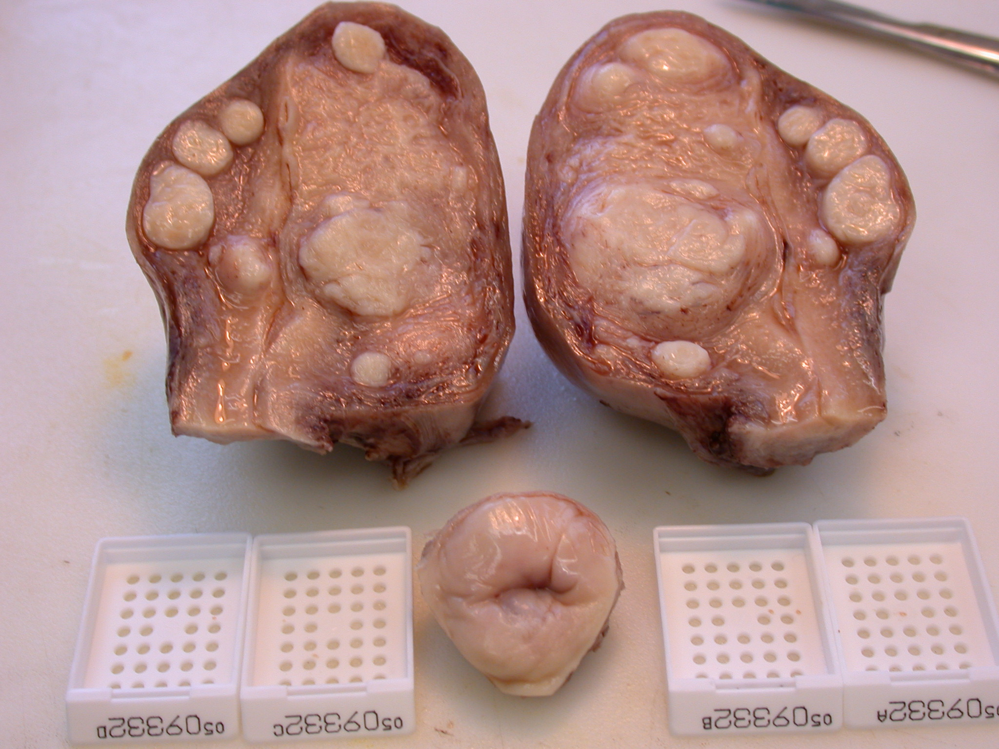

Slide 53
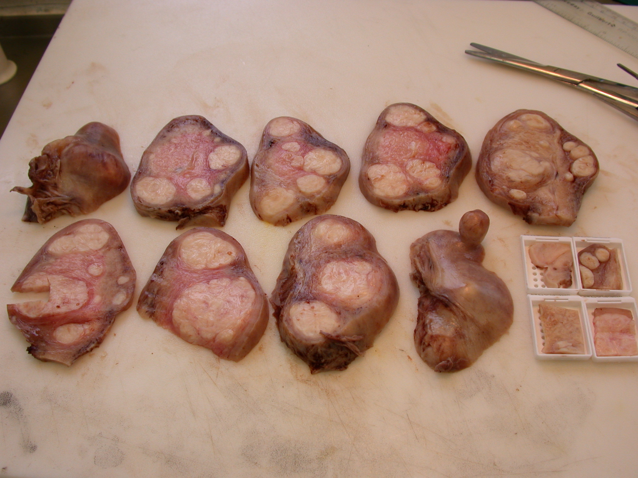

Slide 54
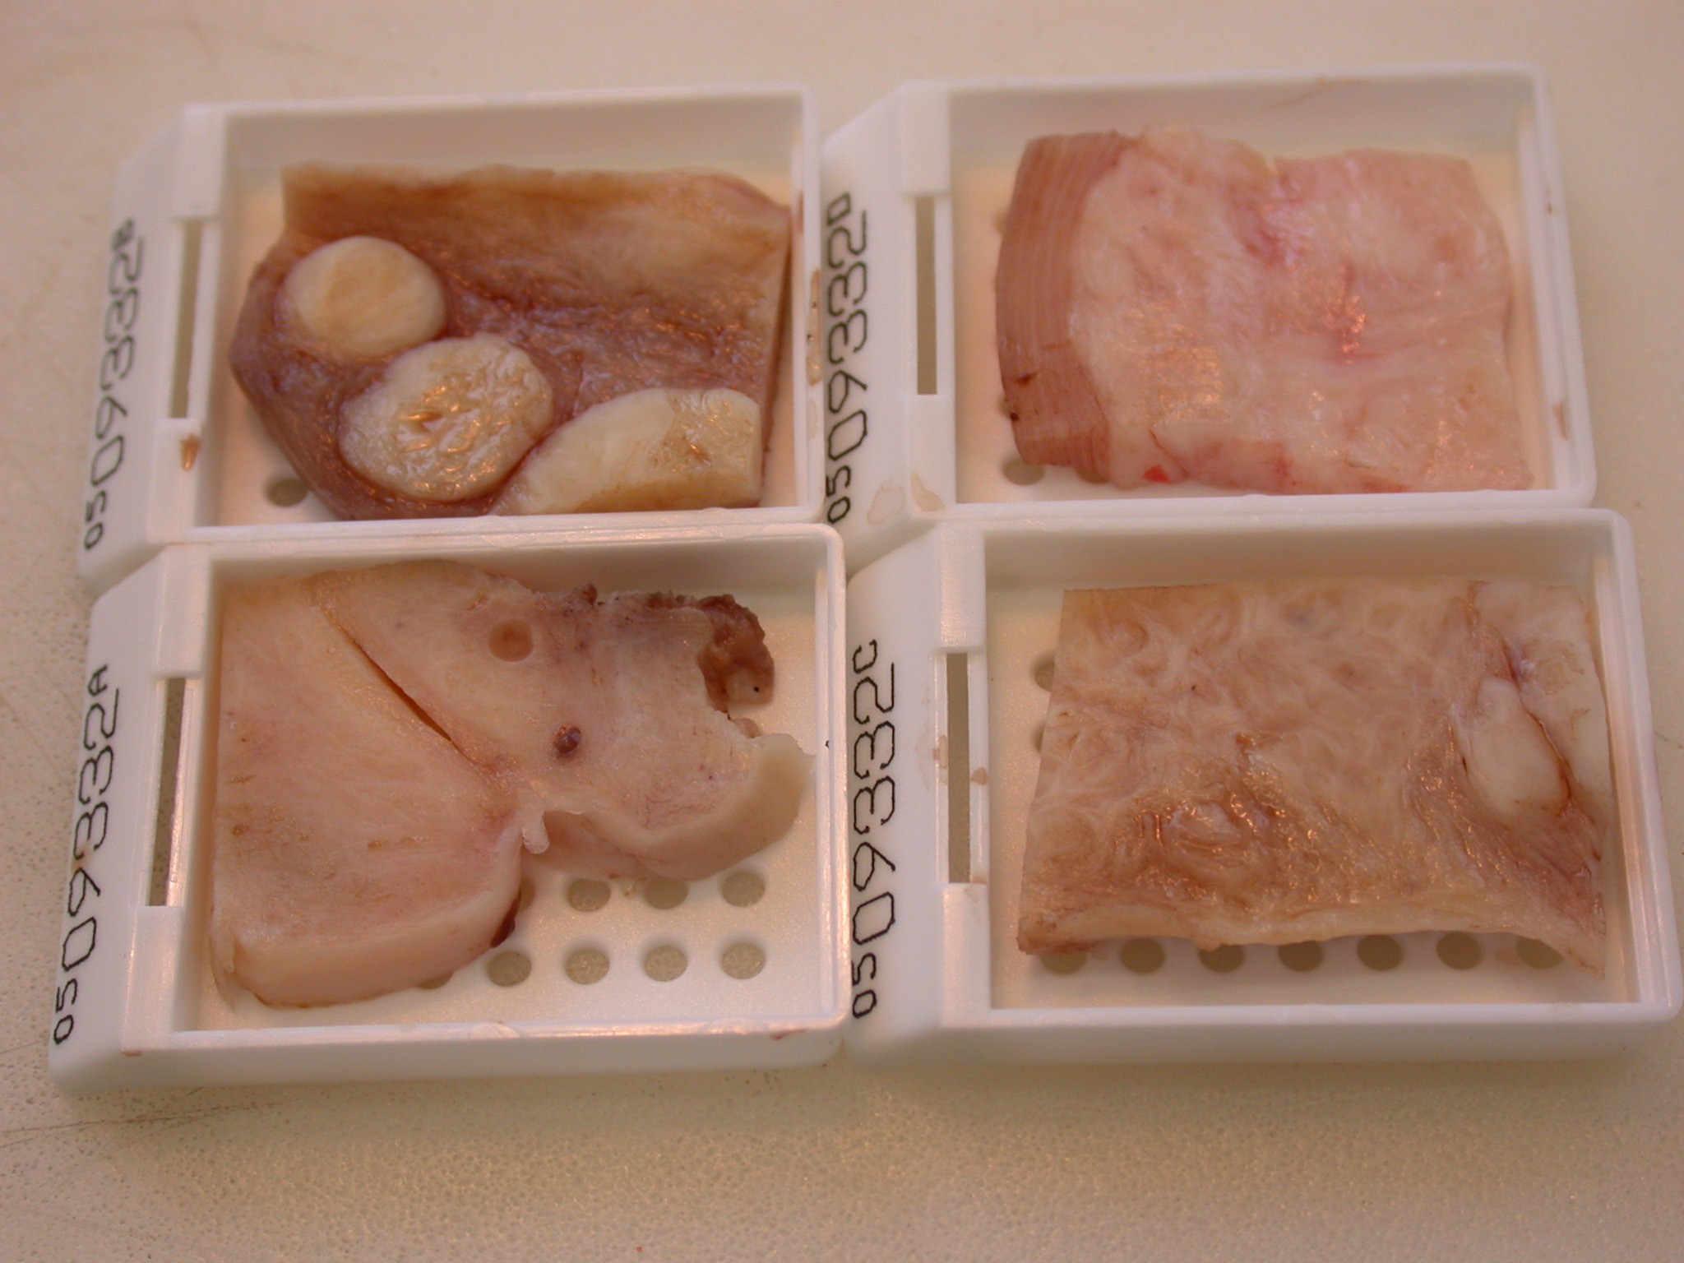

Slide 55
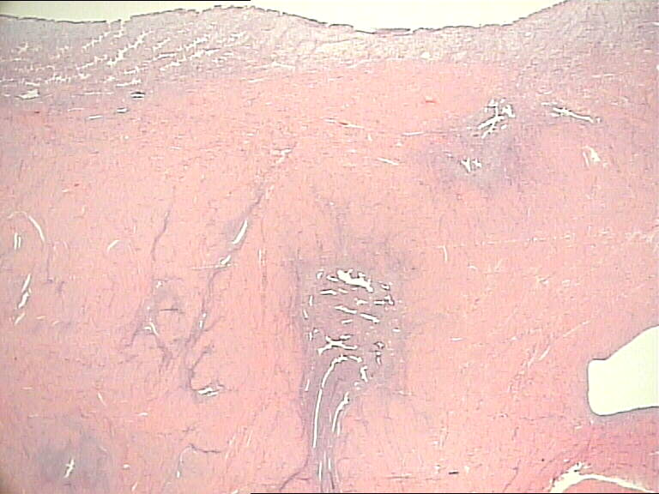

Slide 57
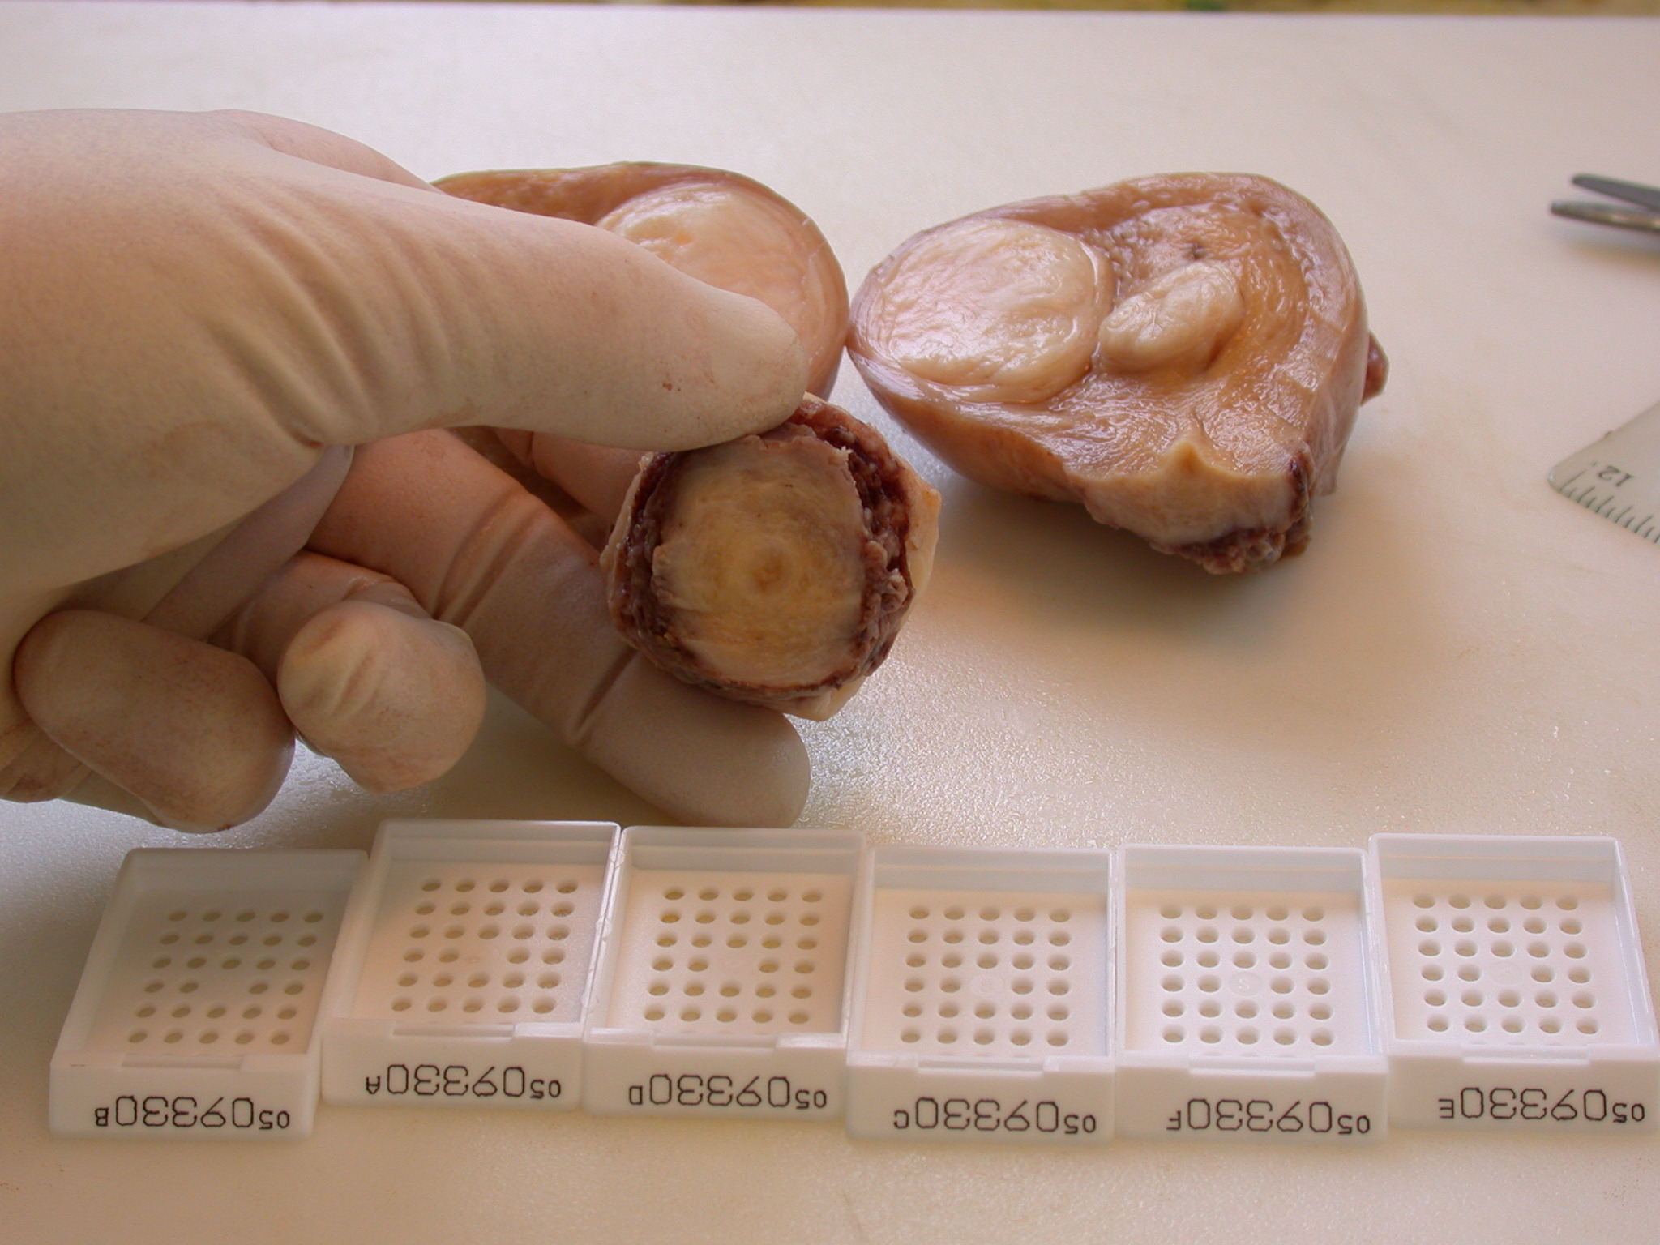

Slide 58
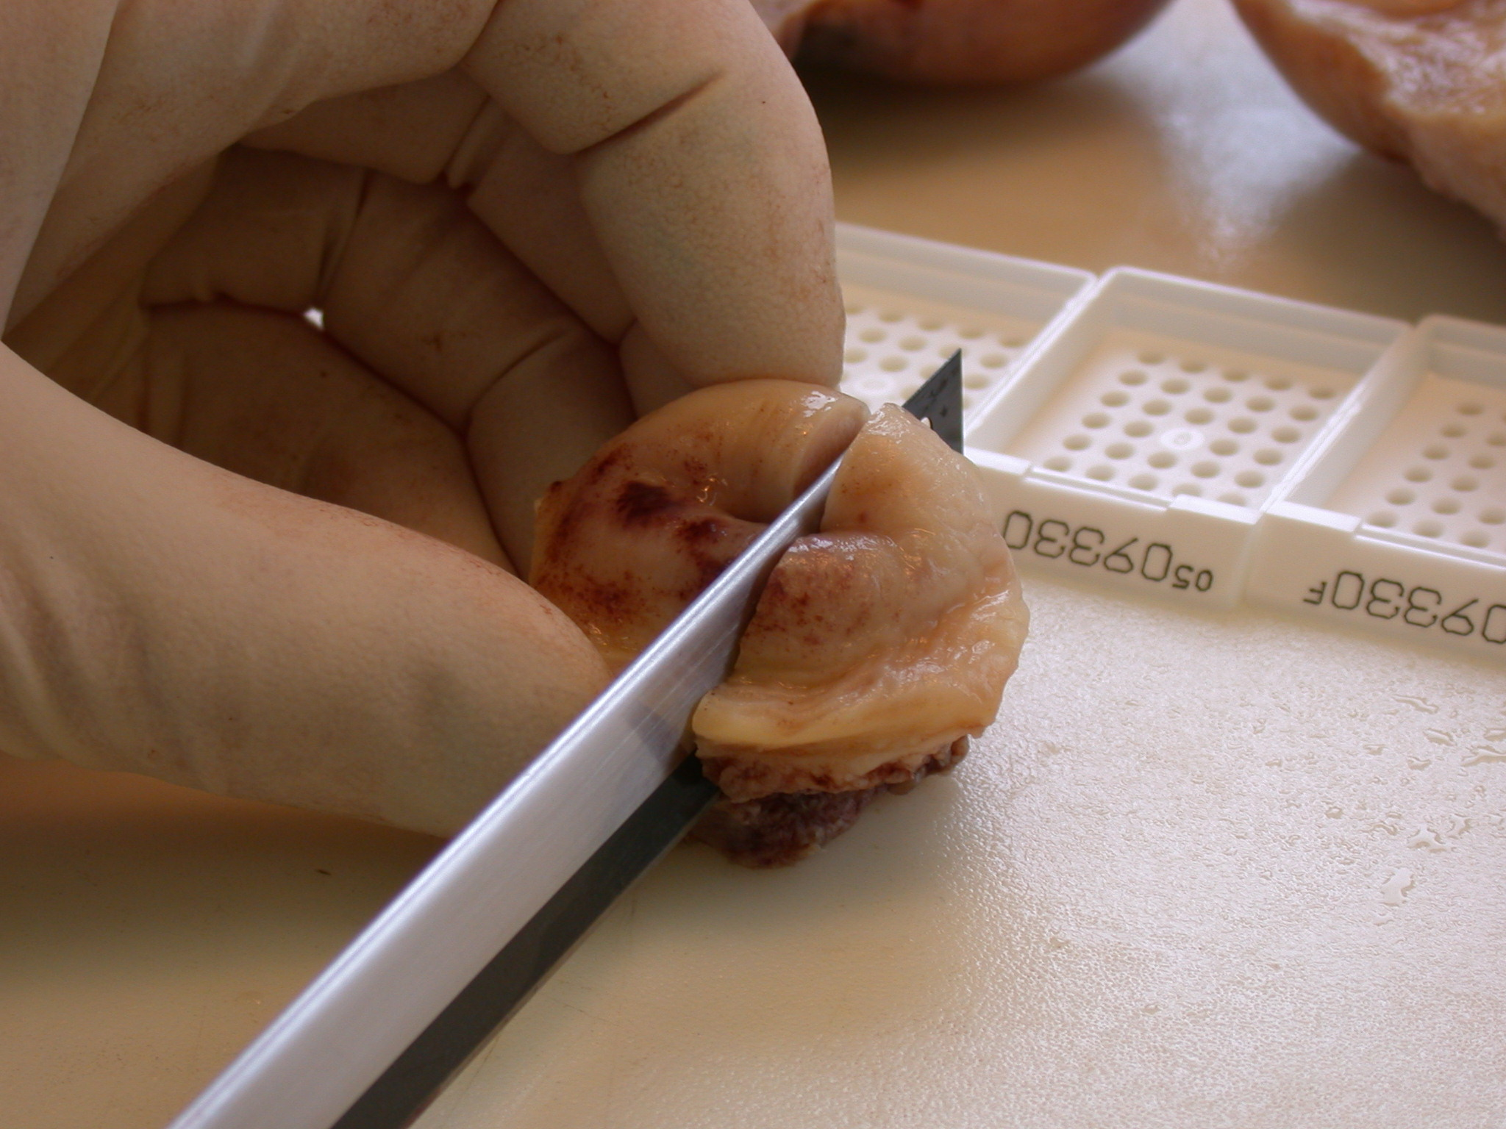

Slide 71
Processes involved in reporting a histology case
Cut Up Room
Check identity of specimen
Dictate gross examination
Dissect specimen
Dictate further as required
Select and cut blocks
Recheck identity and cassette blocks
Microscope / computer
Receive slides
Check identity
Examine slides
Make preliminary assessment – dictate or write report if possible at this stage
Request special stains, deepers etc as appropriate
Communicate with clinicians in charge of the case if required
Discuss with colleagues etc
Receive specials etc
Check identity
Review all slides and information gathered
Dictate/write final report
Receive transcribed report
Check identity
Review transcribed report, amending as appropriate
Assign Codes (SNOMED)
Sign/authorise

Slide 72
REPORT WRITING
Who is the report for?
CLINICIAN
COLLEAGUE
YOURSELF
REVIEWER
CORONER
PATIENT
Good reports are good for everyone

Slide 73
REPORT WRITING
“You only get one shot to make a first impression”
Your report is the first impression many will have of you
It should READ WELL and LOOK GOOD.
Try not to make silly mistakes

Slide 74
FREE TEXT REPORT
Clinical Details
Macroscopic
Microscopic
Conclusion / Comment

Slide 75
CLINICAL DETAILS
Verbatim or summarised?
It’s not your job to reiterate the patient’s clinical notes
But you should provide the information that you have used in diagnosis

Slide 76
MACROSCOPIC
Specimen type(s)
Measurements
Description of findings
Block key
Perhaps diagram / photo

Slide 77
MICROSCOPIC
What is on the slide?
Pathological changes
Special stains
Margins – NB Terminology
The peripheral margin is clear by …..mm (PRM)
The deep margin is clear by …..mm (DRM)
Relevant negatives

Slide 78
PROFORMA REPORT
Content
Only essential information
Minimum Datasets – Cancer Standards
Tissue pathways – best practice
Accuracy
Demographics / Labelling / Pitfalls /Transpositions / Voice recognition

Slide 79
COMMENT, CONCLUSION OR DIAGNOSIS?
Pathological vs. Clinicopathological
Gold Standard vs. Shades of Grey
Degrees of Certainty
Try to answer the question the clinician poses (frequently unstated)

Slide 80
COMPOSE WHILST LOOKING
Selecting descriptive phrases
Dataset checklist
Classical features checklist
Degrees of certainty
DESCRIBE first, CONCLUDE after

Slide 81
DIAGNOSTIC CONFIDENCE 100%
“The appearances are……………..XYZ”
diagnostic of….
those of….
represent….
indicative of….

Slide 82
Confidence 80-90%
“The appearances………XYZ”
Almost certainly represent…
Highly suggestive of…..
Most suggestive of….
Consistent with…

Slide 83
Confidence approximately 75%
“The appearances………”
Most likely represent….
Most suggestive of…
Likely to be….
Favour….

Slide 84
Confidence 50% or less
“The appearances ……………..”
Could represent…
Are consistent with…
Are suggestive of…
Might be consistent with… (40%)
Beware weasel words

Slide 85
Give Differential Diagnosis plus advice
The appearances could be due to mucosal prolapse, ischaemic colitis or clostridium difficile infection.
Have you checked the microbiology or radiology reports?
In the correct clinical context the features are of coeliac disease.
Have you checked the TTG?

Slide 86
Expressing Uncertainty
If the sample is non-diagnostic or inadequate, clearly state why
No tissue present
Too superficial
Artefact (e.g. thermal or crush)
Imperfectly oriented (and can’t be fixed)
Does not explain what they saw (e.g. no explanation for a polyp)
Too inflamed

Slide 87
What do you need or will help the patient?
Please consider (repeat) (larger) (deeper) biopsy
(with more tissue I will be more certain)
Wide excision (with a margin of normal tissue)
(uncertainty over margins – which one?)
MDT discussion / Clinicopathological correlation
(interpretation in clinical context)

Slide 88
Dos and Don’ts
You are a doctor, you answer to the GMC (via consultant / TPD / Trust etc)
Know your abilities don’t go beyond them
If in doubt ask : lab staff or seniors usually know
Admit your mistakes immediately and learn from them

Slide 89
GO FOR IT!

