Slide 1
Gastrointestinal Pathology: Small and Large Intestine
Dr Adrian C. Bateman
Southampton

Slide 2
OVERVIEW
Intestinal crypt – physiology and histology
Variations in normal small and large intestinal morphology
Metaplasia/heterotopia
Inflammatory pathology
    Coeliac disease
    Inflammatory bowel disease
Polyps
Adenocarcinoma

Slide 3
GI Mucosa
Squamous
Glandular

Slide 4
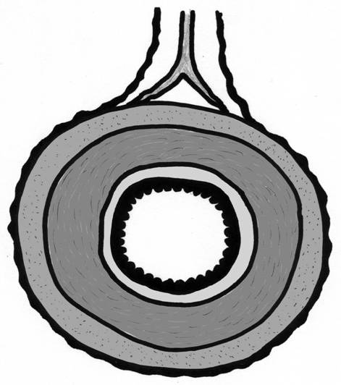
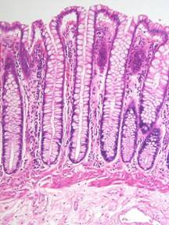
Vascular pedicle/mesentery
Serosa
Circular muscle
Muscularis
propria
Longitudinal muscle
Epithelium
Lamina
propria
Muscularis
mucosae
Mucosa
Submucosa

Slide 5
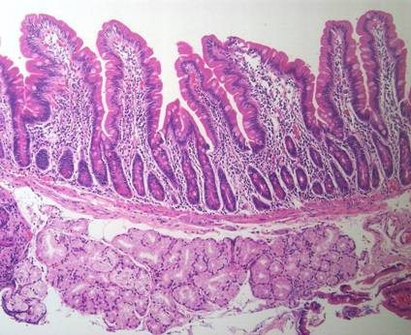
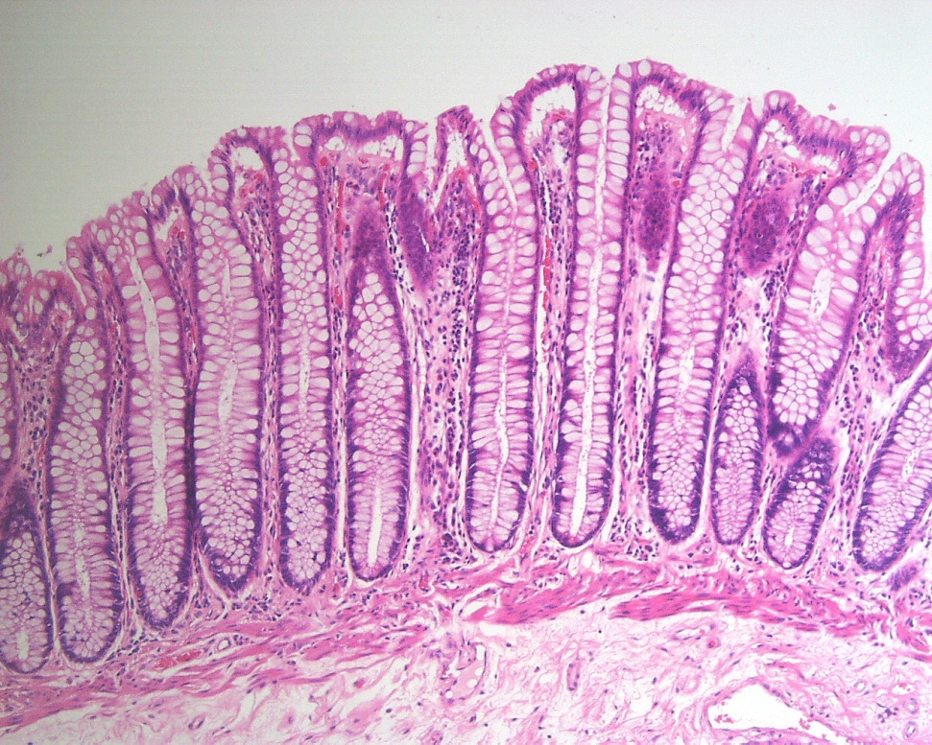
Duodenal mucosa
Colonic mucosa

Slide 6

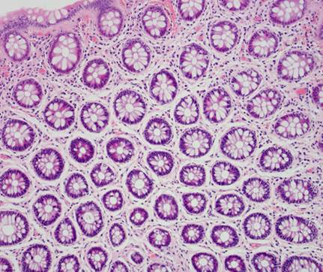
Normal crypt architecture

Slide 7
Intestinal crypt – physiology and histology

Slide 8
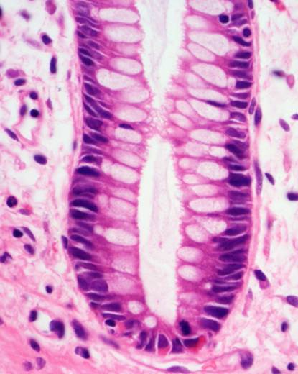
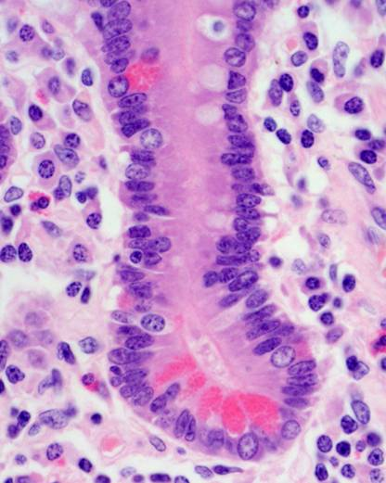
Intestinal crypt
Large intestine Small intestine

Slide 9
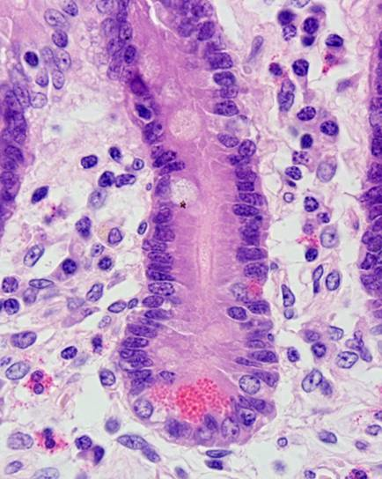
Crypt cell types – small intestine
Goblet cells
Secrete mucous granules by exocytosis
Absorptive cells
Absorption and terminal digestive processes
(brush border)

Slide 10
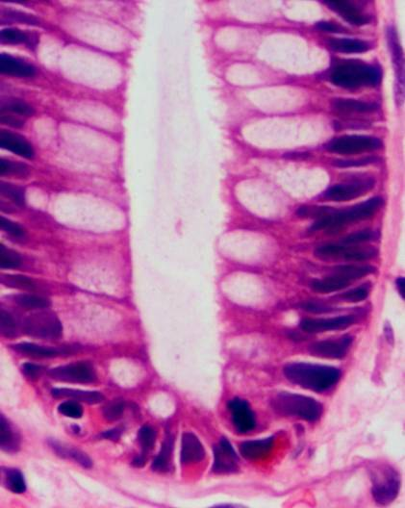
Crypt cell types – large intestine
Absorptive cells
Colonic ion and water transport
Goblet cells
Secrete mucous granules by exocytosis

Slide 11
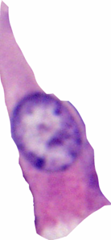
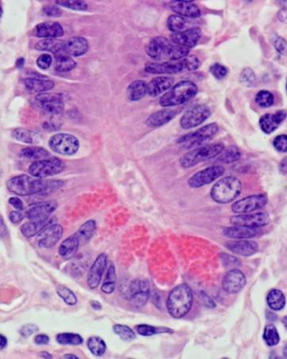
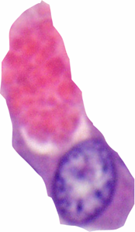
Endocrine cells
Basally located small granules.
Endocrine secretion – into blood
Crypt cell types
Paneth cells
Apically located large granules.
Exocrine secretion – into lumen.
Thought to regulate crypt microbial flora

Slide 12
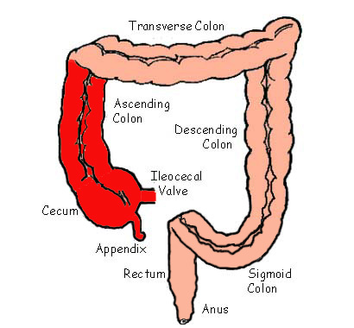
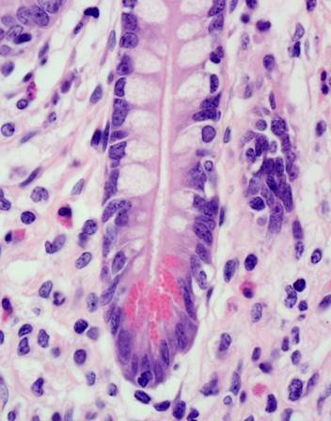
Large intestine: Paneth cells
Paneth cells normally present only in the caecum and proximal right colon

Slide 13
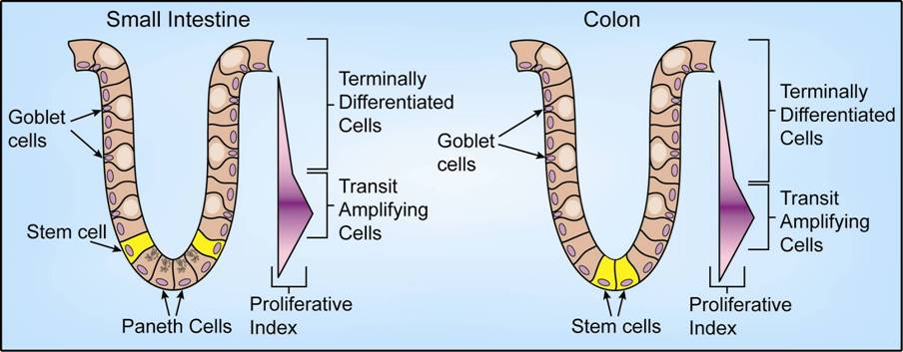
Stem cells and proliferation
Stem cells lie at crypt bases
Most cells migrate up crypt, differentiate and finally die by apoptosis at villous tips or in colonic surface epithelium.
Paneth cells + stem cells remain at crypt base.
Transit times:
      Colonic crypt - 2-7 days.
      Small intestinal crypt to villus tip - 5-6 days.

Slide 14
How and why do we make new crypts?
During growth
Following damage

Slide 15

Crypt fission

Slide 16
Crypt cycle:
Mouse colon (neonate)
17 days
Human colon (adult)
9-18 years.

Slide 17
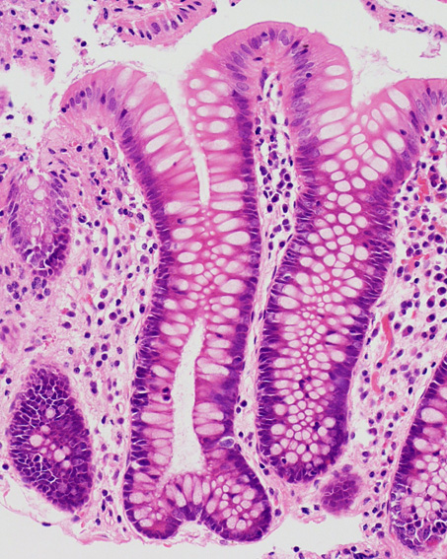
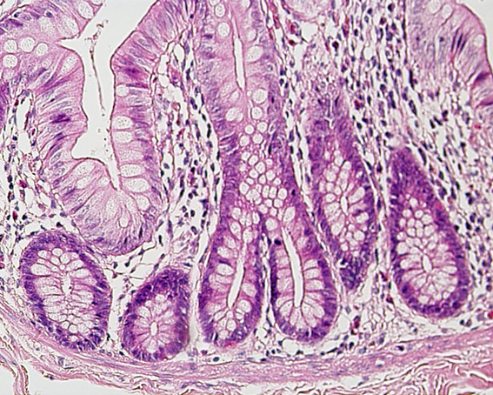

Slide 18
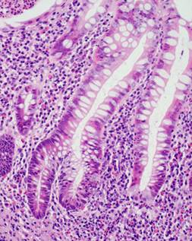
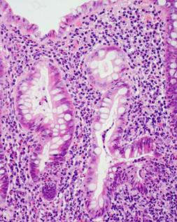
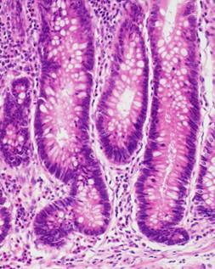
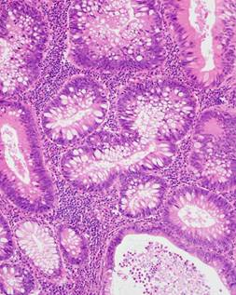
Crypt fission in inflammation (ulcerative colitis)
Crypt fission in neoplasia (tubular adenoma)

Slide 19
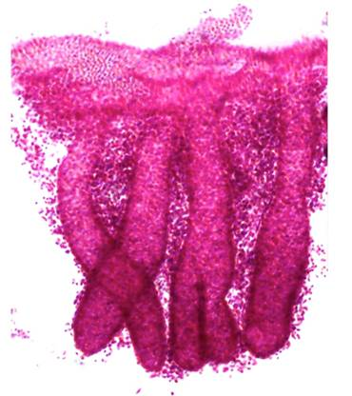
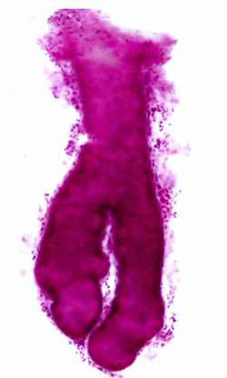
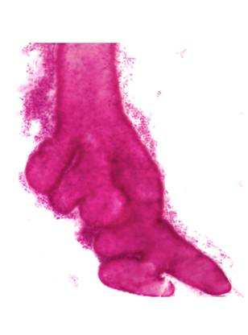
Crypt fission – whole mounts
Normal crypts:
Symmetrical fission
Adenomatous crypt:
Asymmetrical branching
Adenomatous crypt:
Multiple budding

Slide 20
Is the crypt architecture normal?
Allowed one branched crypt per 1mm (approx 1 per x 20 field).
Slightly more crypt distortion in the distal rectum

Slide 21
Mucosa Associated lymphoid tissue (MALT)
Present throughout small and large intestine
Concentration varies at different sites

Slide 22
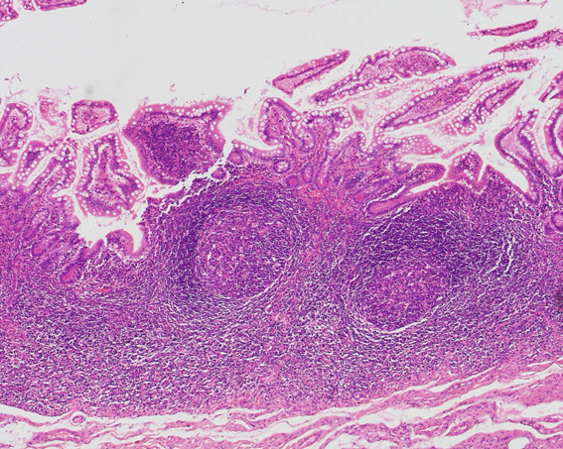
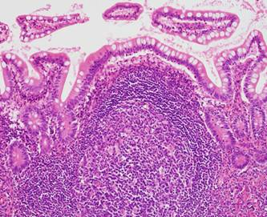
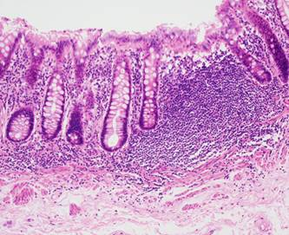
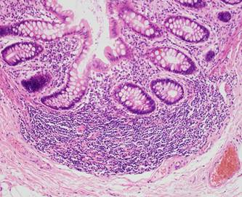
Terminal ileum
Right colon

Slide 23
Variations in normal small intestinal morphology

Slide 24
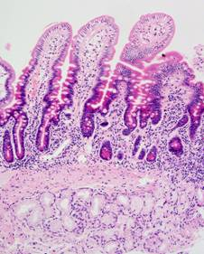
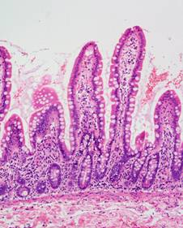
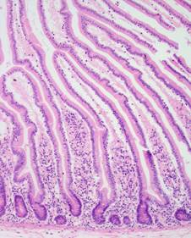
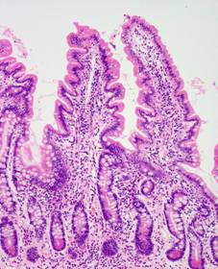
D1 D2 Jejunum
Distal ileum Terminal ileum

Slide 25
Variations in normal large intestinal morphology

Slide 26
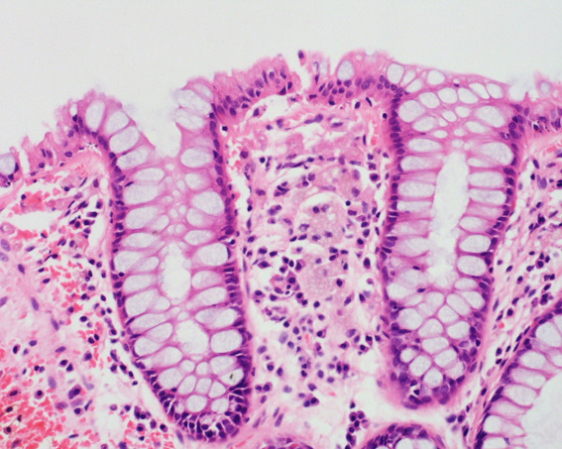
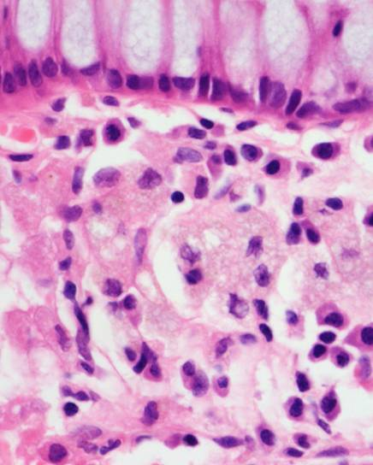
Muciphages
Normally present in distal colon/rectum

Slide 27
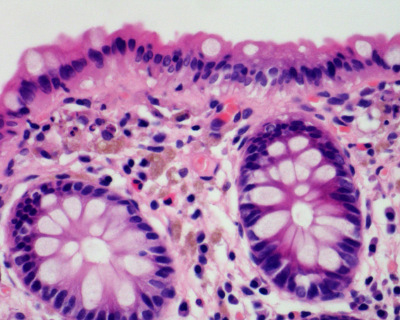
Melanosis coli
Not normal, but very common
No major clinical significance
Long term use of anthraquinoid laxatives
Lipofuscin not melanin

Slide 28
Metaplasia/heterotopia

Slide 29
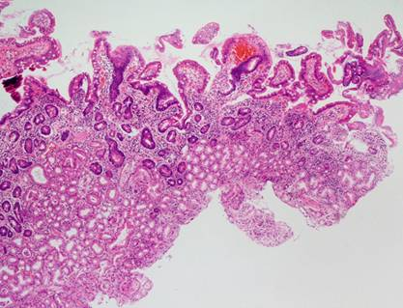
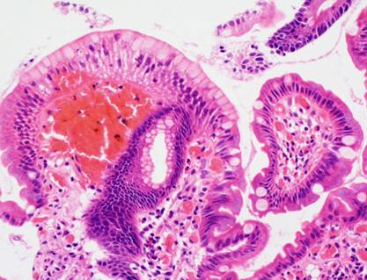
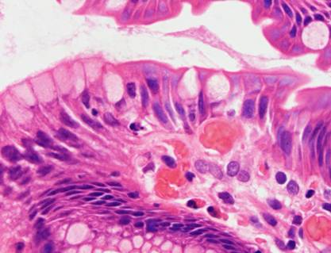
Gastric metaplasia
Change from small intestinal to
gastric foveolar type surface
epithelium
Due to high acidity
Common in D1
(probably physiological)
Abnormal in D2

Slide 30
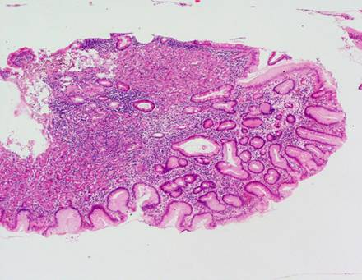
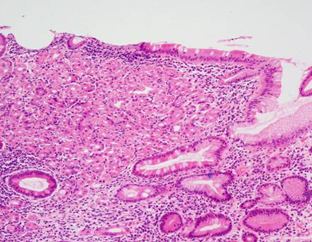
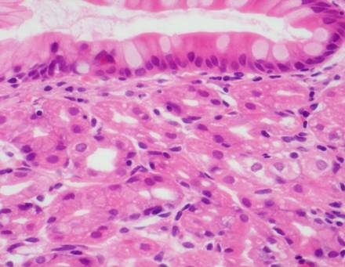
Gastric heterotopia
Collections of body/specialised
type gastric mucosa
- Need to see parietal + chief cells
Not related to acidity
Commonly biopsied
“duodenal nodule”

Slide 31
Inflammatory pathology

Slide 32
Patterns of inflammation

Slide 33
Chronic inflammation
Chronic inflammatory cell infiltrate in normal colonic mucosa varies both within and between patients
How can we tell if a biopsy is inflamed?

Slide 34
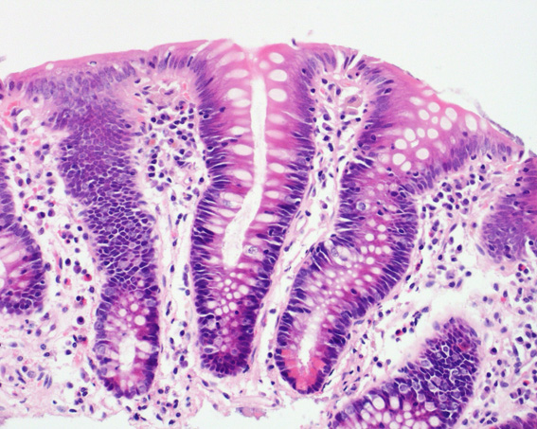
Luminal contents ≡ antigen
Chronic inflammatory cell gradient
Normal colonic mucosa

Slide 35
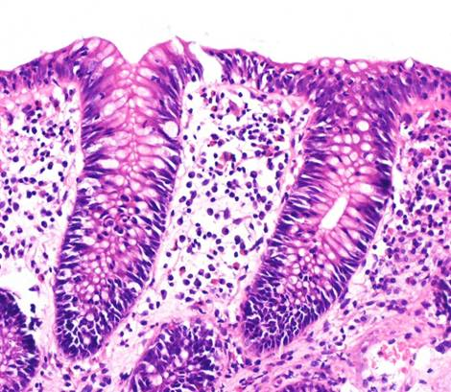
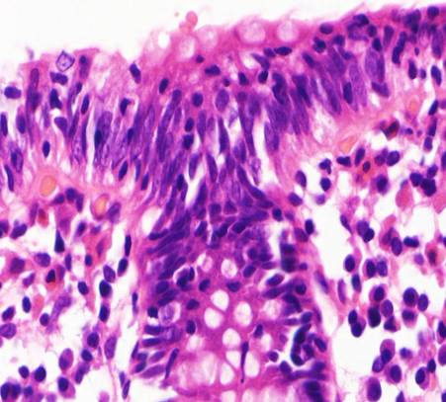
Lymphocytic colitis

Slide 36
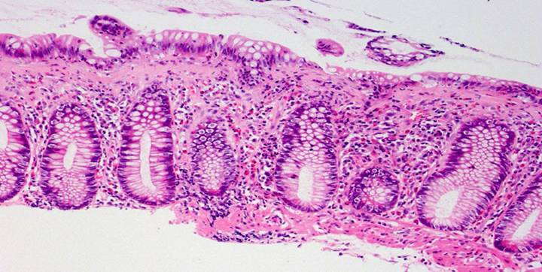
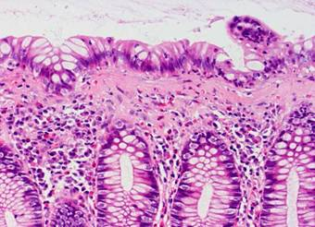
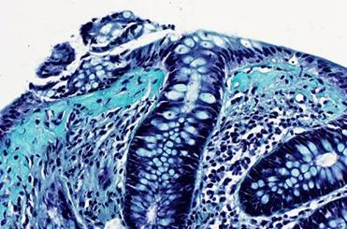
Collagenous colitis

Slide 37
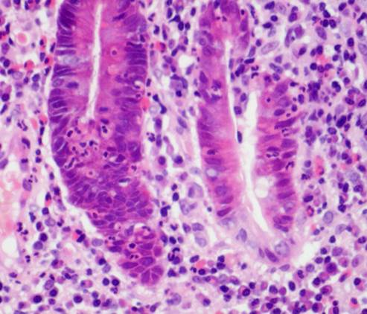
Cryptitis
Active inflammation
Non-specific:
  Infective colitis
  Ischaemic colitis
  Ulcerative colitis
  Crohn’s disease

Slide 38
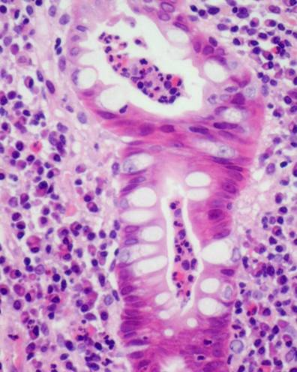
Crypt abscess formation
End point of cryptitis
Non-specific

Slide 39
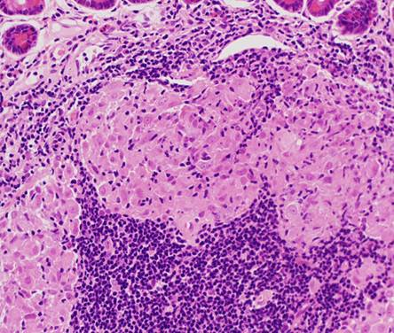

Granulomas
Collection of epithelioid macrophages +/- macrophage multinucleate giant cells
Raise possibility of Crohn’s disease, but many other causes

Slide 40
Coeliac disease
Gluten sensitivity enteropathy (Gliadin)
Predominantly a disease of whites
(Irish 1:100)
Genetic susceptibility (HLA DQ2 + DQ8)
Immune-mediated intestinal injury

Slide 41


Normal
Coeliac

Slide 42


Coeliac disease
Normal
Villous atrophy
Crypt hyperplasia
Intra-epithelial lymphocytosis
Chronic inflammation
Coeliac
Crypt-hyperplastic
villous-atrophy

Slide 43

Assessment of duodenal biopsies
Crypt/villous architecture (normal height ratio 1:3 – 1:5)
Intraepithelial lymphocytes. Normal < 1 lymphocyte per 4 epithelial cells
Gradient of lymphocytes along villus (more at base)

Slide 44


Mild intra-epithelial lymphocytosis

Slide 45


Subtotal villous atrophy

Slide 46


Total villous atrophy

Slide 47
Chronic Inflammatory Bowel Disease
Idiopathic
Crohn’s Disease
(Indeterminate colitis)
- Ulcerative Colitis

Slide 48
Crohn’s disease - Macroscopic
Fat wrapping
Thickened bowel wall
Skip lesions
Stricture formation
Cobblestoned mucosa
Ulceration

Slide 49

Fat wrapping
Normal Crohn’s Crohn’s
Courtesy of Dr Bryan Warren

Slide 50

Skip lesions and stenoses

Slide 51

Linear ulcers

Slide 52

Cobblestone mucosa

Slide 53
Crohn’s disease - Microscopic
Cryptitis and crypt abscesses
Transmural inflammation
  Lymphoid aggregates +/- granulomas
  “Crohn’s rosary”
Fissuring
Neuromuscular hyperplasia

Slide 54

Transmural inflammation

Slide 55

Fissuring ulcers

Slide 56

Mucosal inflammation
Crypt abscess
Withered crypt

Slide 57

Mucosal inflammation with granuloma

Slide 58

Crohn’s – ‘withered’ crypt

Slide 59
Ulcerative colitis - Macroscopic
Normal serosa
Bowel normal thickness
Continuous disease
Confluent mucosal ulceration
Pseudopolyp formation

Slide 60

UC - proctitis

Slide 61

Confluent inflammation - distal to proximal

Slide 62

Skip lesions in UC
Caecal patch
Isolated appendiceal involvement and caecal patch are well described in UC

Slide 63
Ulcerative colitis - Microscopic
Crypt distortion + shortening
Paneth cell metaplasia
Diffuse mucosal inflammation
Crypt abscesses
Mucin depletion
Mucosal ulceration

Slide 64

Diffuse inflammation limited to mucosa

Slide 65

Villiform change, crypt architectural distortion and crypt shortening

Slide 66


Paneth cell metaplasia (rectum)

Slide 67

Diffuse mucosal chronic inflammation with cryptitis

Slide 68


Slide 69
IBD vs infective colitis
IBD
Crypt architectural distortion.
Paneth cell metaplasia.
Villous surface epithelium
Deep and superficial inflammation
Basal lymphoid aggregates
Granulomas
Infective colitis
Preserved crypt architecture.
No Paneth cell metaplasia.
Flat surface epithelium
Predominantly superficial inflammation
No basal lymphoid aggregates
No granulomas

Slide 70

Other types of colitis
Ischaemic
Diverticular
Medication-related
Microscopic
Radiation
Eosinophilic
GVHD
Diverticular colitis
(mimics Crohn’s)

Slide 71
Assessment of gastrointestinal biopsies
Clinical history
Endoscopic findings
Sites of biopsies
Know normal histological variants
Previous histology reports
Endoscopy report very useful

Slide 72
When to talk to your clinicians
No clinical history
BEFORE cutting up a specimen that you are unhappy with:
    Orientation?
    Previous surgery?
    Unsure of reason for surgery?
Clinical history does not match histological findings
Unexpected result (e.g. cancer in small polyp)
New clinician you have not reported for before
  (what will the outcome of your report be?)

Slide 73
Polyps

Slide 74
Intestinal polyps
Inflammatory
(Pseudopolyp)
Hyperplastic
Sessile serrated lesion
Adenomatous
Hamartomatous

Slide 75


Inflammatory polyp
Dilated glands
Inflammatory stroma
Endpoint of many inflammatory processes in bowel.
Often seen in IBD

Slide 76

Pseudopolyp
Island of surviving mucosa in a ‘sea’ of ulceration
Typically seen in UC.

Slide 77


Hyperplastic polyp
Usually < 5mm diameter.
Usually left-sided (sigmoid + rectum).
Usually middle to old age ( mean 62 years)

Slide 78

Sessile serrated lesion
Usually right-sided
Large (typically > 10mm)

Slide 79

Sessile serrated lesion

Slide 80
Sessile serrated lesion
Risk of developing high grade dysplasia and carcinoma within the polyp.
  → should be removed where possible.
Sessile serrated polyps/adenomas are said to be associated with synchronous advanced colorectal neoplasia.
Sessile serrated polyps/adenomas raise the possibility of hyperplastic polyposis.

Slide 81



Adenomatous polyps
3 main types:
  Tubular, tubulovillous + villous (75% cut off).
  Graded: mild/moderate/severe or low/high grade dysplasia.

Slide 82
Hamartomatous polyps
Juvenile polyp
Peutz-Jegher’s polyp

Slide 83


Juvenile polyp
Look very similar to inflammatory polyps.
If multiple in young patient - ? Juvenile polyposis.

Slide 84


Juvenile polyposis
Diagnostic criteria:
● > 3-5 Juvenile polyps in colorectum.
or
● Juvenile polyps throughout GI tract.
or
● Juvenile polyp + family history.

Slide 85
Juvenile Polyposis Syndrome (JPS)
Autosomal dominant.
Hamartomatous polyps of the GI tract.
Colorectal, gastric, duodenal and pancreatic carcinomas
Up to 70% lifetime risk CRC
Median age diagnosis CRC 42 years
SMAD4 – ≈ 20% (TGFβ signalling)
BMPR1A – ≈ 20% (TGFβ signalling)
Notes:
85

Slide 86




Peutz-Jegher’s polyps
Notes:
86

Slide 87



Peutz-Jegher’s polyp
Arborising architecture.

Slide 88

Peutz-Jeghers syndrome
Autosomal dominant inheritance.
Gene LKB1 (p53-mediated apoptosis).
39% lifetime risk CRC.
93% risk of developing malignancy by age 65.
  Carcinomas of colorectum, pancreas, stomach, small intestine, oesophagus.
  Breast, ovary, endometrium and lung cancers.
  Melanoma and sex cord tumours.

Slide 89
Adenocarcinoma

Slide 90
Intestinal malignancy
Large bowel
  97% adenocarcinomas
Small bowel
  Rare
  Approx 50% adenocarcinomas
  Gastrointestinal stromal tumours
  Lymphomas
  Carcinoids

Slide 91
Colorectal adenocarcinoma

Slide 92
Staging of tumours
How far has the tumour spread?

Slide 93



Slide 94


Slide 95


Slide 96
TNM 8 staging
T - Primary tumour
  T1 Tumour invades submucosa
  T2 Tumour invades into muscularis propria
  T3 Tumour invades perirectal/pericolic connective tissue
  T4 Tumour involves peritoneum or other organs
  (T4a & T4b)

Slide 97
TNM 8 staging
N – Regional lymph nodes
  N0 No LN metastases
  N1 1-3 regional LN metastases
  (N1a, N1b, N1c)
  N2 4 or more regional LN mets
M – Distal metastasis
  M0 No distant metastases
  M1 Distant metastases

Slide 98
Grading of tumours

Slide 99
Grading of tumours
How similar are the tumour cells to the normal colonic epithelium?

Slide 100

Normal colonic mucosa

Slide 101

Well differentiated
adenocarcinoma

Slide 102

Moderately differentiated adenocarcinoma

Slide 103

Moderately differentiated adenocarcinoma

Slide 104

Poorly differentiated adenocarcinoma

Slide 105

Poorly differentiated adenocarcinoma

Slide 106

Mucinous adenocarcinoma

Slide 107

Poorly differentiated mucinous adenocarcinoma

Slide 108
Prognostic factors
Completeness of excision
Staging
Grading

Slide 109
Handling of colorectal specimens

Slide 110
Handling of colorectal specimens
Fixation.
Examination.
Photography.
Histological sampling (cut up).
Processing and staining.
Histology

Slide 111
Fixation
Specimen should be opened and bowel contents removed.
Specimen fixed in a large volume of formalin-based fixative.
Fixation for 48-72 hours.

Slide 112
Histological sampling (cut up)
Average tumour approx 4cm diameter
Paraffin block 4-5mm thick
H&E section 4μm thick
    → 1 x H&E section sampling approx 1/10,000 tumour
RCPath guidelines – 4 tumour blocks

Slide 113


Colectomy specimens
Specimen opened anteriorly up to 1cm from tumour and fixed.
- Bowel then bread-sliced through tumour.

Slide 114
Sampling colectomy specimens
Proximal margin
Proximal and distal margins (if < 3cm from tumour)
Lymph nodes
(apical separately)
4 blocks tumour
Distal margin

Slide 115


Slide 116



Slide 117




Slide 118

Proximal margin
Low anterior resections and AP resections – mesorectal margin
Serosal surface
Mesorectal margin
(circumferential)
Distal margin

Slide 119



Low anterior resections and AP resections – mesorectal margin

Slide 120


Slide 121


Slide 122


Distance of tumour to mesorectal margin (CRM)
3mm

Slide 123
Local recurrence and CRM positivity
CRM +ve – 38.2 % recurrence rate
CRM –ve – 10.0 % recurrence rate
Rates of circumferential resection margin involvement vary between surgeons and predict outcomes in rectal cancer surgery.
Birbeck KF, Macklin CP, Tiffin NJ, Parsons W, Dixon MF, Mapstone NP, Abbott CR, Scott N, Finan PJ, Johnston D, Quirke P.
Ann Surg. 2002 Apr;235(4):449-57.

Slide 124


Slide 125
Plane of surgical excision
Notes:
cision

Slide 126
Non-peritonealised (‘circumferential’) resection margin
Caecum and ascending colon
“Mesenteric margin”

Slide 127

Distance of extramural spread beyond
the muscularis propria

Slide 128


Slide 129


Slide 130
References
General GI
Morson and Dawson’s Gastrointestinal Pathology Shepherd et al. 5th Edition. Wiley-Blackwell
Biopsy interpretation guidelines
Inflammatory bowel disease biopsies: updated British Society of Gastroenterology reporting guidelines 2013
Colorectal cancer specimen reporting
Dataset for histopathological reporting of colorectal cancer 2018 – download from www.rcpath.org

