Slide 1
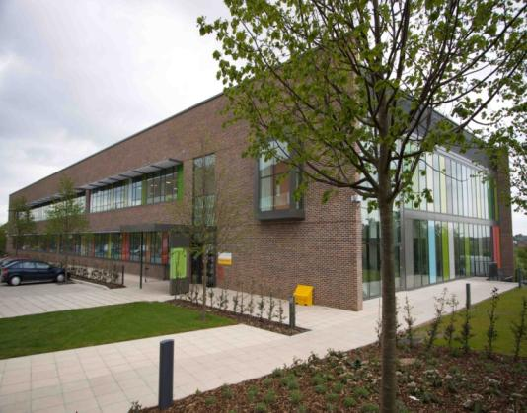

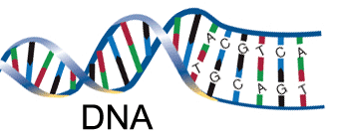
Molecular analysis of solid tumours:
Clinically relevant genetic mutations: current practice and future directions
Claire Faulkner PhD
Clinical Scientist, Bristol Genetics Laboratory
September 2019

Slide 2
Talk outline
Current techniques used in molecular analysis of tumour samples – testing pathway, DNA extraction, PCR, NGS
MAPK pathway alterations
BRAF mutations in melanoma
EGFR, ALK and ROS1 mutations in lung cancer
RAS mutations in colorectal cancer
HER2 testing in breast cancer
Future directions

Slide 3
Service Provision
7 national Genomic Laboratory Hubs provide genetic testing for England
National genomic test directories https://www.england.nhs.uk/publication/national-genomic-test-directories/
Oncology Genomics (solid tumour, haemato-oncology, inherited cancers, oncology monitoring)
Constitutional Genomics (neuromuscular, developmental, reproductive medicine, newborn screening )
Genetics laboratory staff:
Medical Laboratory Assistants
Genetic Technologists
Clinical / Healthcare Scientists
Bioinformaticians
Administrators

Slide 4
Testing pathway
Formalin fixation, paraffin embedding (FFPE)
Extract DNA (RNA)
Fluorescent in situ hybridisation (FISH)
Mutation detection
PCR
Pyrosequencing
Fragment analysis
Sanger sequencing
NGS
Histopathologist diagnosis
Tumour biopsy or resection
Request for molecular analysis
Cut sections and mark tumour region for molecular analysis
Analysis
Histopathology
Clinical team – oncologists, surgeons, specialist nurses etc.
Report
Genetics

Slide 5
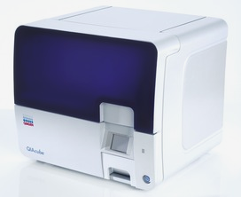
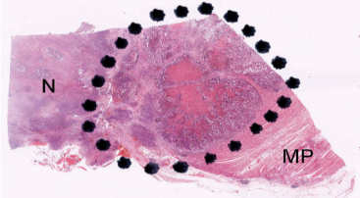
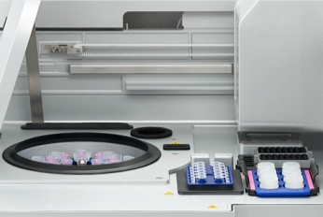
DNA extraction
FFPE sections deparaffinised
Tumour region macrodissected
Tissue digested overnight to digest proteins
Formalin bonds broken: 90°C 1 hour
Sample cleaned-up using spin column and automated on Qiacube
- negatively charged DNA binds to silica-gel membrane in column
  DNA washed, digested proteins and impurities pass through membrane and are discarded
  DNA eluted with low-salt buffer
  Results in pure but fragmented DNA sample

Slide 6
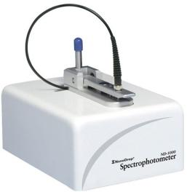
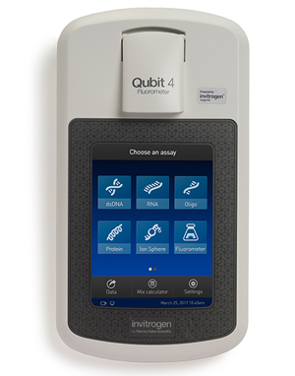
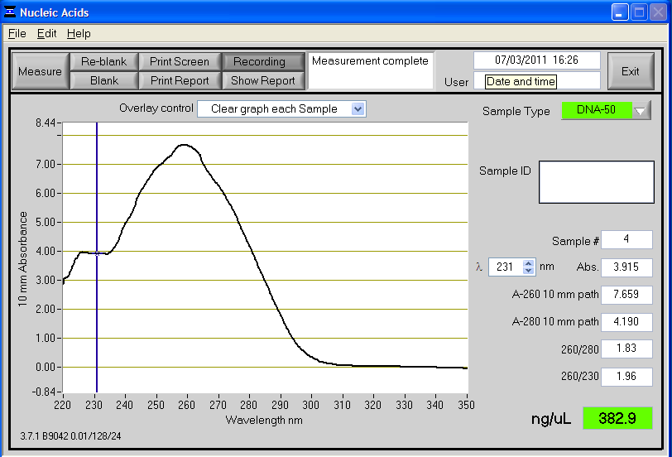
DNA Quantification
Spectrophotometer measures
Optical density
Total nucleic acid concentration
Sample quality (protein/reagent contamination)
Fluorometer
fluorescent dye that only binds to DNA
more sensitive and accurate quantification

Slide 7

PCR (Polymerase Chain Reaction)
Method for amplifying very small amounts of DNA
Key technique – revolutionised molecular biology
Quick, inexpensive, simple and powerful
Invented 1983 by Kary Mullis
- nobel prize 1993
"Beginning with a single molecule of the genetic material DNA, the PCR can generate 100 billion similar molecules in an afternoon. The reaction is easy to execute. It requires no more than a test tube, a few simple reagents, and a source of heat."
Used to amplify specific region of DNA (100bp-1kb)
DNA primers used to define region to be amplified
- short single stranded pieces of DNA (18-30bp)
- complementary to ends of region to be amplified

Slide 8
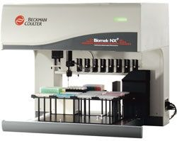
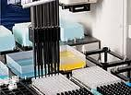
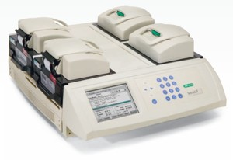
Setting up PCR
Liquid handling
Thermocycler
Automation
High throughput
Faster turn around times
Minimising errors
Assay consistency

Slide 9
Considerations for solid tumour testing
FFPE (formalin-fixed paraffin embedded)
- highly fragmented DNA
- decalcification
- artefacts: C>T mutations
Tumour content (>30% tumour)
Low DNA concentration (resections/biopsy/FNA/cytology)
Heterogeneity (which sample to test?)
Reporting times (<2 weeks)
When/ who should request testing?
e.g. Reflex: BRAF testing for malignant melanoma stage pT3b +
On-demand: RAS testing in metastatic CRC

Slide 10
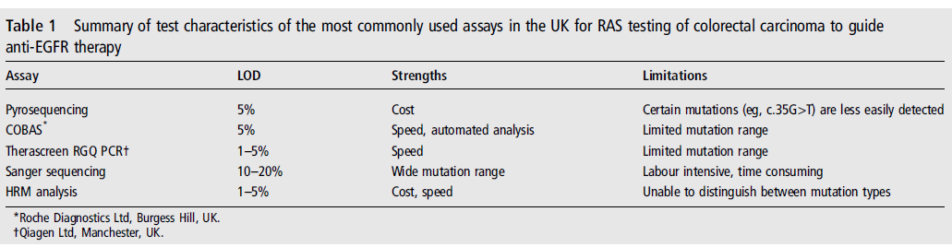
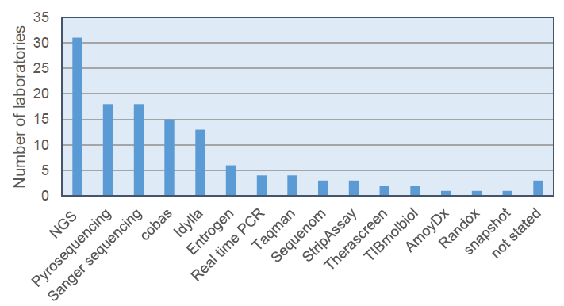
Molecular pathology testing methods
Variety of testing methods in use across the UK – NGS used in Bristol
Wong et al 2014 J Clin Pathol 2014;0:1–7.
RAS testing methods used by labs participating in 2017-18 RAS EQA scheme

Slide 11
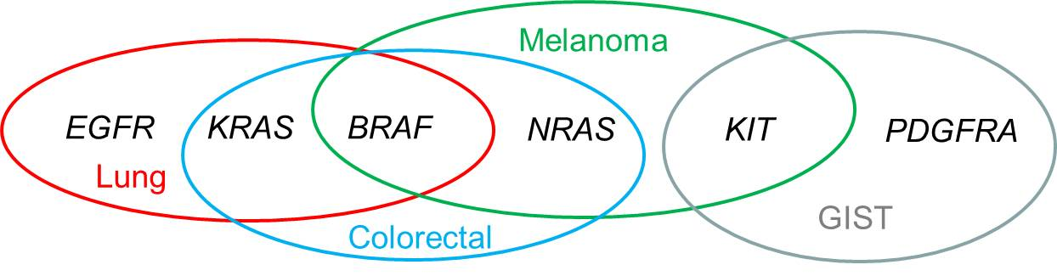
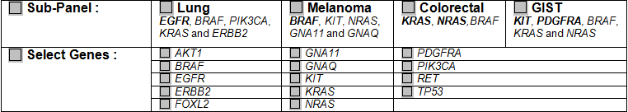
Next Generation Sequencing (NGS)
Single panel test for all of the important clinically actionable genes in solid tumours
TruSight Tumour 15 assay – panel of 15 genes with tumour specific sub-panels applied
Low DNA input and high sensitivity (5% mutant DNA in a background of wild type DNA)

Slide 12
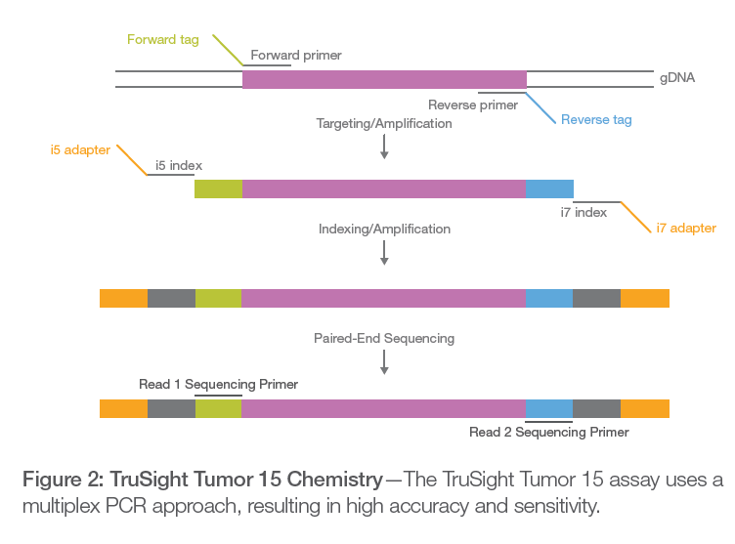
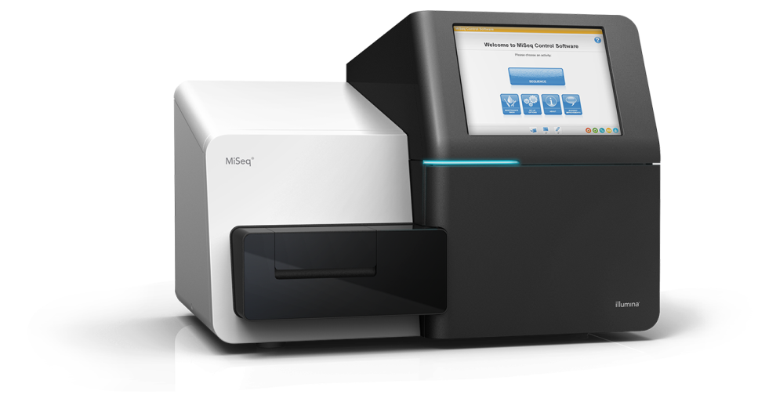
Next Generation Sequencing (NGS)
DNA is PCR’d with specific primers to regions of interest
Adapters and indexes are added to the DNA fragments
Indexes act as patient specific identifier and adapters bind the DNA molecules to the flow cell
DNA library then loaded into flow cell and run on MiSeq which sequences the DNA

Slide 13
Next Generation Sequencing (NGS)
Lots of data is produced
Specific somatic bioinformatics pipeline to process the data
- map to genome
- identify variants
- remove artefacts
- annotate data
Variants analysed using AMP framework for variant interpretation to determine whether variant is a ‘driver’ or ‘passenger’ and if it is clinically actionable
Only clinically relevant variants reported (approved therapy, clinical trial eligibility or diagnostic/prognostic significance)

Slide 14
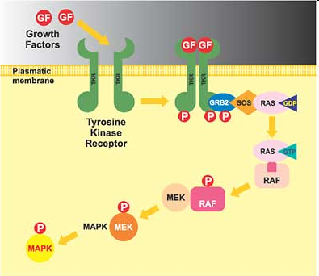
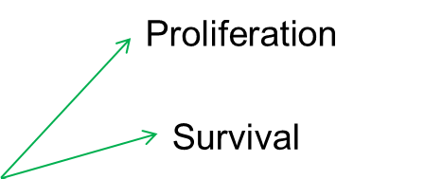

MAPK pathway, mutations & targeted therapies
EGFR monoclonal antibodies e.g. cetuximab
.
EGFR-TKI e.g. gefitinib
MEKi e.g. trametinib
BRAFi e.g.
vemurafenib

Slide 15
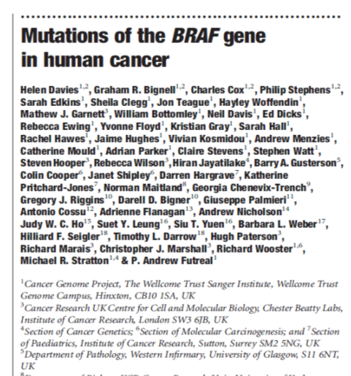

BRAF mutations in melanoma
Identified BRAF as an oncogene in human cancer in 2002
Mutations found in:
- 66% melanoma
- 40% thyroid
- 18% colorectal cancers
- 11% gliomas
- 9% lung cancers
- plus a wide range of other cancers
Cytoplasmic serine/threonine kinase which is part of MAPK pathway that regulates cell growth
All mutations within kinase domain of the protein
Most common (80% overall, 90% melanoma): c.1799T>A (p.Val600Glu or V600E)
Mutated BRAF: 500x increased activation and activates in the absence of any growth factors

Slide 16
BRAF mutations in melanoma
BRAF mutation associated with:
- younger age (OR = 1.734; P < .001)
- trunk location (OR = 2.272; P < .001)
- non-chronically sun damaged skin (OR = 2.833; P < .001)
- superficial spreading melanoma (OR = 2.081; P < .001)
- advanced melanoma stage (OR = 1.551; P = .003)
Kim et al 2015 – BRAF metaanalysis, J Am Acad Dermatol.
Population differences:
    Irish melanoma cases 24% mutant BRAF
    Belgian melanoma cases 43% mutant BRAF
Van de Huurk et al 2015 Melanoma Res. 2015 Jun;25(3):189-99.

Slide 17
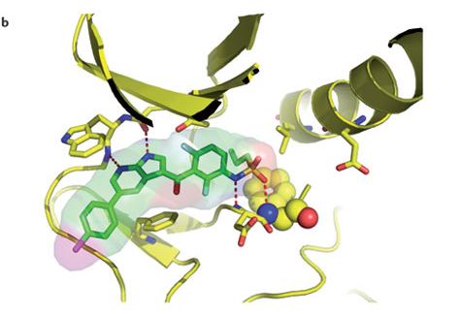
BRAF in melanoma
Vemurafenib (Zelboraf, PLX4032, Roche) inhibitor of mutated BRAF
- designed specifically to bind active site of V600E mutated BRAF
FDA approval for use in unresectable or metastatic melanoma with the V600E mutation in August 2011
European (EMA) approval for use in unresectable or metastatic melanoma with any codon 600 mutation in December 2011
NICE approved in December 2012
Dabrafenib (GSK) – NICE approved December 2014
Trametinib (MEK inhibitor) approved in combination with dabrafenib – NICE June 2016
Bollag et al 2012 Nature Reviews Drug Discovery 11, 873-88

Slide 18
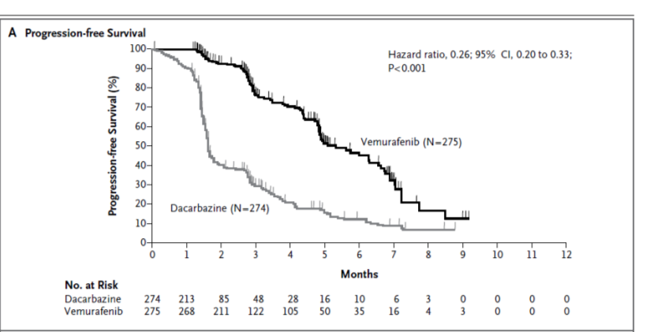
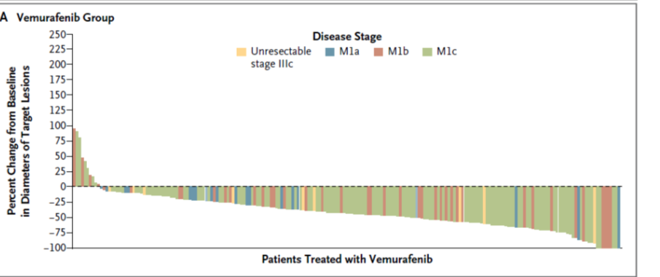
BRAF in melanoma
In patients with codon 600 mutations, vemurafenib improves:
- progression-free survival (PFS) 5.3 months for vemurafenib vs. 1.6 months for dacarbazine
- overall survival (OS) 13.2 months for vemurafenib vs. 9.9 months for dacarbazine
Phase III BRIM trial: Chapman et al 2011 (30 June) NEJM 364;26: 2507-2516

Slide 19
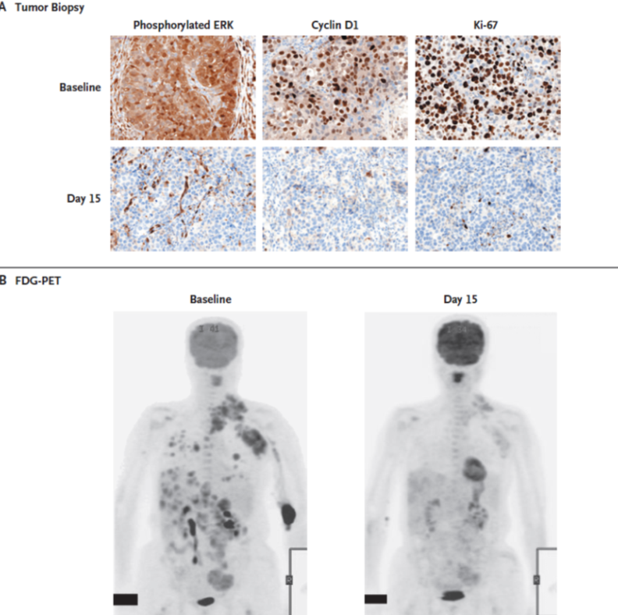
BRAF in melanoma
Flaherty et al 2010 NEJM 363 9: 809-819 (phase I BRIM trial)

Slide 20
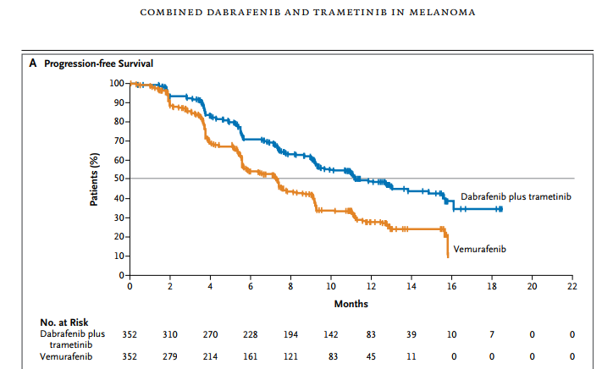
BRAF + MEK inhibition
Phase III study dabrafenib + trametinib (704 pts, Roberts et al 2015):
- OS at 12 months 72% combination vs. 65% vemurafenib.
- PFS 11.4 months combination vs. 7.3months vemurafenib.
Cutaneous squamous-cell carcinoma and keratoacanthoma in 1% of combination- therapy group and 18% of vemurafenib group.

Slide 21
BRAF in melanoma: case study
47 year old male
0.8 mm thick superficial spreading melanoma (26 x 22mm) excised right temple. Wide local excision and full thickness skin graft May 2010.
2 years later: severe lower back pain. CT showed multiple metastases: liver, bone and paravertebral muscles.
Commenced CVD (cisplatin, vinblastine and dacarbazine) chemotherapy with partial response after 3 cycles but then progression with brain metastases.
BRAF mutation status requested.
c.1799T>A (V600E) mutation detected in original tumour sample (~5% mutation).
Good response to vemurafenib treatment

Slide 22
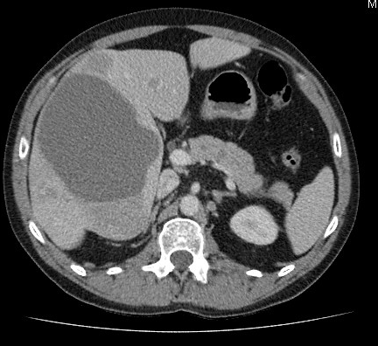
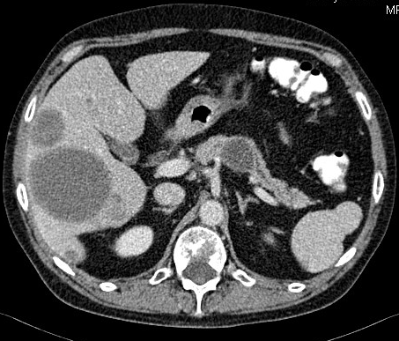
BRAF in melanoma: case study
Pre-treatment
vemurafenib treatment
Liver metastasis
Tumour shrinkage

Slide 23
BRAF in melanoma
Results (444 patients) | Number | %
No mutation | 280 | 63%
Total mutation positive | 164 | 37%
c.1799T>A; p.(Val600Glu) (V600E) | 121 | 74%
c.1798_1799delGTinsAA; p.(Val600Lys) (V600K) | 27 | 13%
c.1799_1800delTGinsAA; p.(Val600Glu) (V600E) | 5 | 3%
c.1798_1799delGTinsAG ; p.(Val600Arg) (V600R) | 4 | 3%
c.1801A>G; p.(Lys601Glu) (K601E) | 4 | 3%
c.1799_1800delTGinsAC; p.(Val600Asp) (V600D) | 1 | 0.6%
c.1799T>A and c.1801A>G (V600E & K601E) | 1 | 0.6%
c.1799_1802delinsAAAT (V600E & K601E) | 1 | 0.6%

Slide 24
BRAF in melanoma: resistance & side-effects
~50% response rate of BRAF mutation positive melanoma to treatment
Side-effects can include other benign forms of skin cancer: keratoacanthoma & squamous cell carcinoma – minimised with trametinib treatment
Of those that do respond, resistance to therapy inevitably occurs (6-12 months)
Why?
- MAPK-independent and MAPK-dependent pathways
- intrinsic and acquired
- signalling pathways function as a network rather than linear pathway
- tumour heterogeneity
Notes:
MAPK independent e.g. activation of other signalling pathways such as PI3-kinase, upregulation of other growth factor receptors e.g. MET
MAPK dependent e.g. NRAS mutations, MEK mutations
Intrinsic – present in the tumour before treatment started
Acquired – evolve as a response to treatment
Heterogeneity – high in melanoma between primary & mets and between different mets

Slide 25
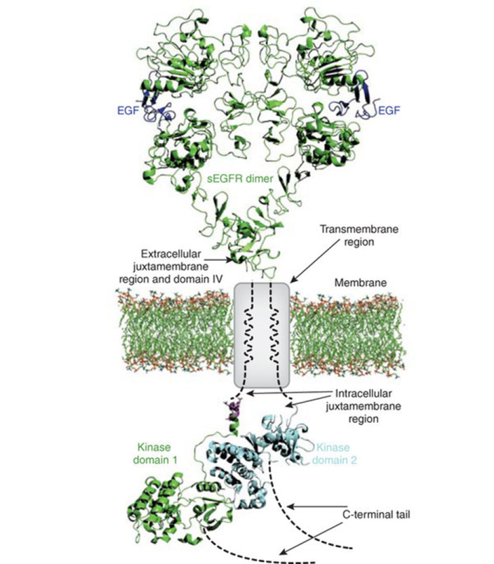
Lung adenocarcinoma
Lung cancer is a leading cause of death worldwide
- > 1.3 million deaths per year
- > 40% lung adenocarcinoma
Tumours often discovered as locally advanced or metastatic disease
Average 5 year survival rate for lung adenocarcinoma is ~15%
Molecular genotyping now routinely used to guide clinical care
Superior efficacy of targeted kinase inhibitors compared to standard chemotherapy in patients with EGFR mutations or ALK translocations (~15% patients)
Bessman et al 2012 Nature Structural & Molecular Biology
19:1-3

Slide 26
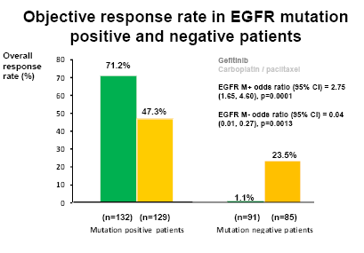
EGFR testing in NSCLC
The tyrosine kinase inhibitors (TKIs) gefitinib and erlotinib are beneficial in around 10% Caucasian NSCLC patients
  Adenocarcinoma
  Non-smokers
  Female
The 2008 IPASS trial demonstrated that a mutation in the EGFR gene is associated with response to gefitinib
NICE 2010 guidelines recommend gefitinib as a 1st line treatment option for locally advanced/metastatic NSCLC patients with an EGFR mutation

Slide 27
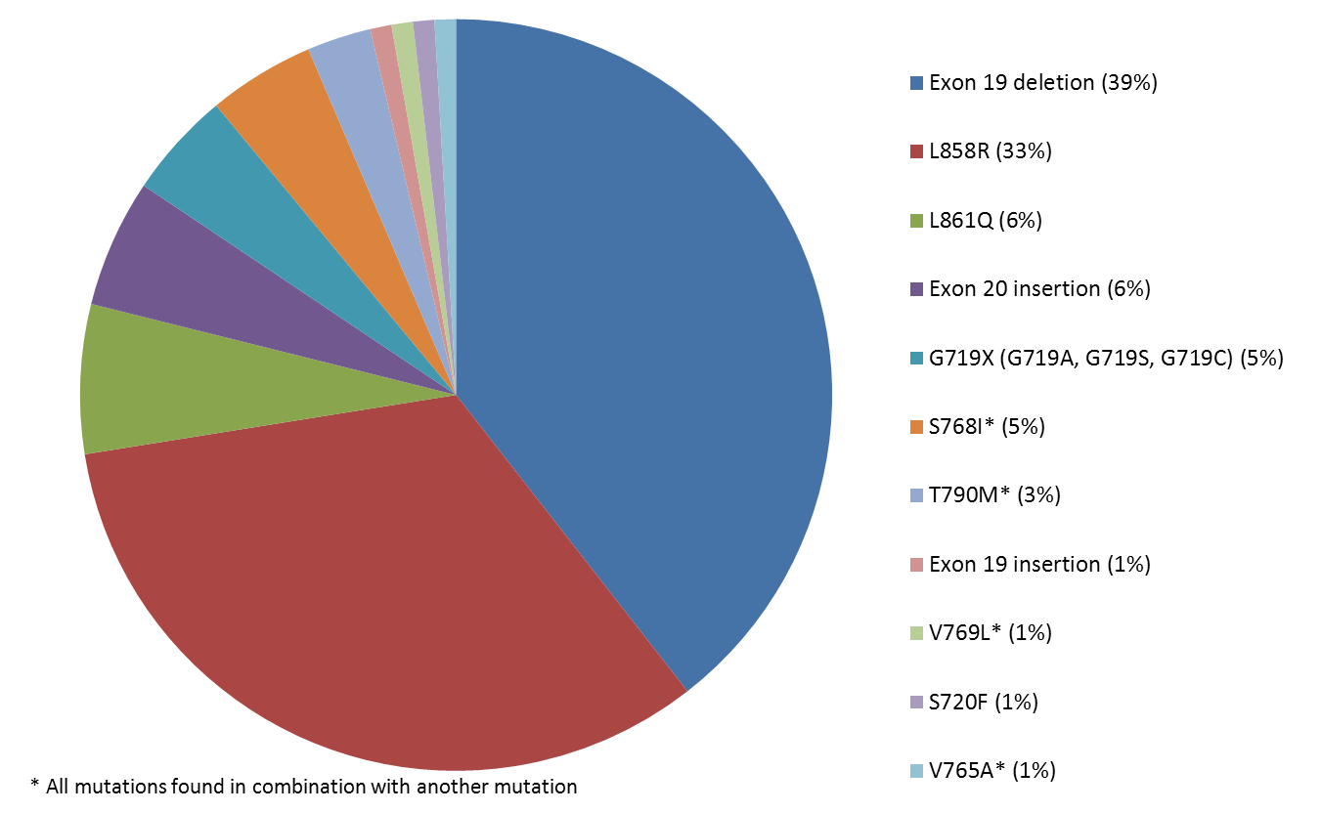
EGFR testing in NSCLC

Slide 28
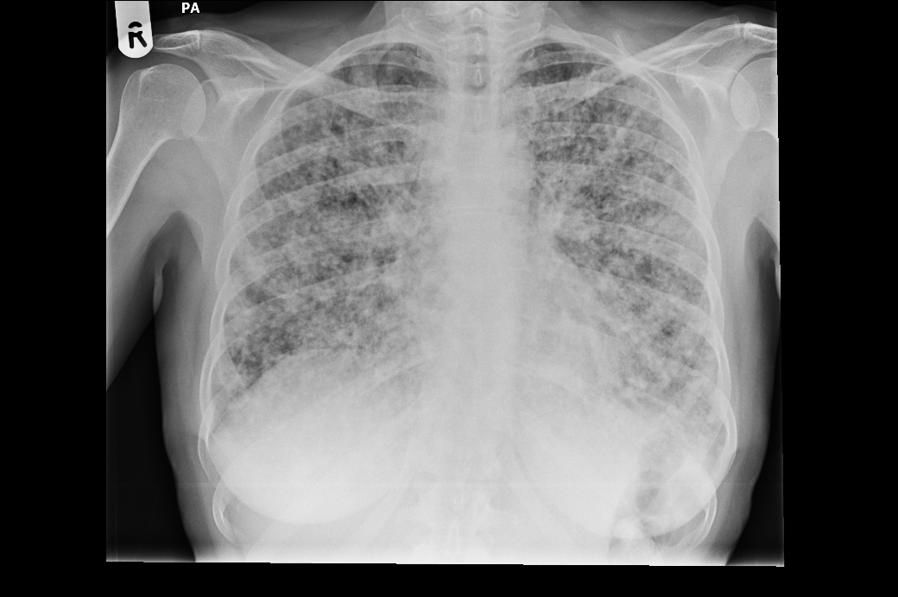
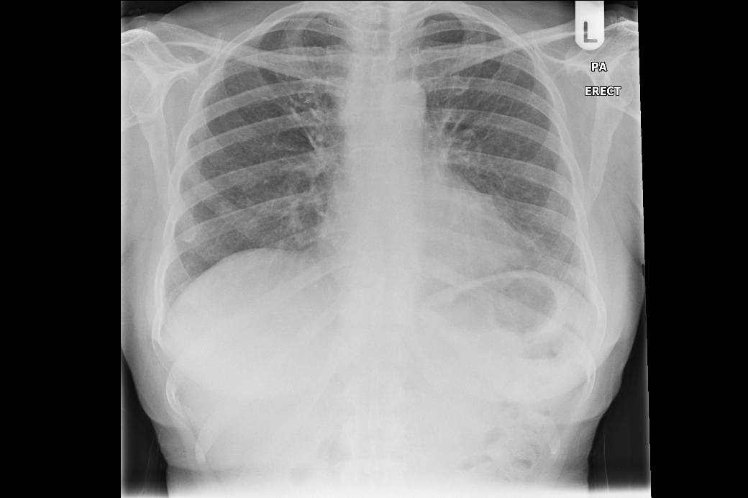
Case Study – 15 bp deletion
Chest X-ray at diagnosis showed extensive miliary pulmonary metastases from lung adenocarcinoma
57 year old female never smoker
Chest X ray showing complete radiological response following 4 weeks gefitinib treatment
Grade I dermatitis only toxicity

Slide 29
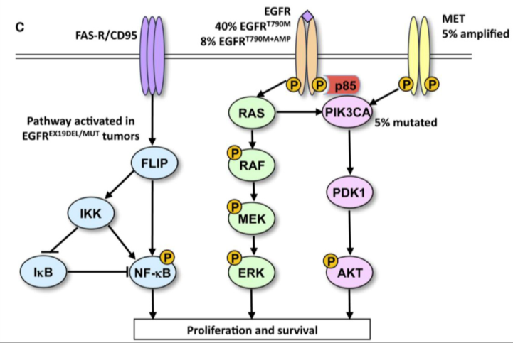
Resistance to therapy (EGFR)
Response rate: 52% to 82% to EGFR TKI in mutation positive patients
Of those that do initially respond, the tumour inevitably relapses and becomes TKI resistant
Intrinsic and acquired resistance mechanisms:
T790M mutation
Osimertinib 3rd generation TKI approved Oct 2016
-> C797S, G796D
BRAF or KRAS mutation
PIK3CA mutation
MET amplification
Fas/NFкB activation
Intratumoural heterogeneity
(~30% Bai et al 2013)
Antonicelli et al 2013 Int J Med Sci. 2013; 10(3): 320–330

Slide 30
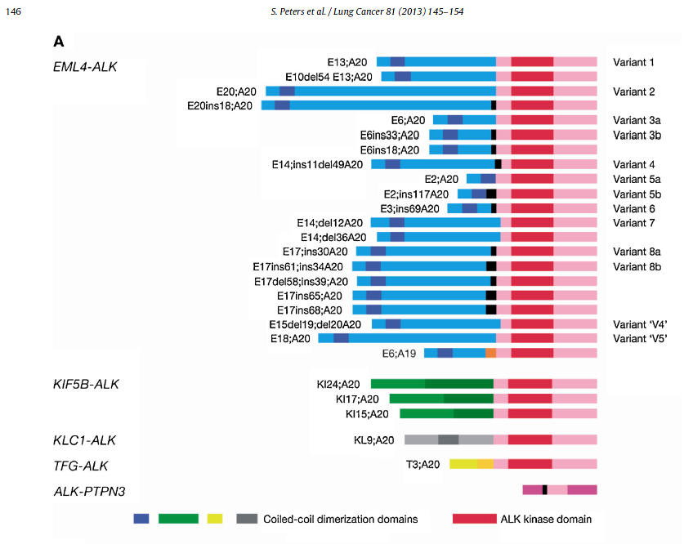
ALK and ROS1 testing in NSCLC
ALK and ROS1 are transmembrane receptor tyrosine kinases
ALK and ROS1 activation: chromosomal rearrangement leading to fusion of ALK or ROS1 with the promoter region of a different gene e.g. EML4-ALK rearrangement: amino-terminal half of EML4 fused to the intracellular catalytic domain of ALK leading to constitutive dimerization of ALK kinase domain and aberrant activation of downstream signalling
Testing strategy is IHC for ALK and ROS1 expression – equivocal or +ve cases confirmed by FISH
ALK rearrangements in 2-5% and ROS1 rearrangements in ~ 1% lung adenocarcinomas
Mutually exclusive with EGFR mutations

Slide 31
ALK and ROS1 testing in NSCLC
Crizotinib (Xalkori, Pfizer) is a small-molecule inhibitor of ALK. Also has additional MET, ROS1 and RON kinase inhibitory activity.
Response rate ~60%
Phase III trial (PROFILE 1007) median PFS 3.0 months chemotherapy vs. 7.7 months crizotinib
NICE approved for NSCLC patients with either ALK rearrangements or ROS1 rearrangements

Slide 32
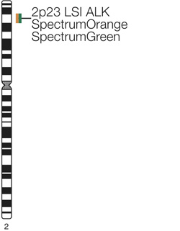
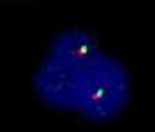
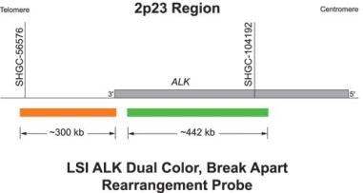
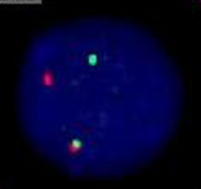
ALK and ROS1 testing in NSCLC
Normal cell –two probes overlap in a fused or yellow signal
ALK rearranged - spatial separation of the green and red probes
Fluorescent in situ hybridisation (FISH) is undertaken using a dual colour breakapart probe which detects ALK rearrangements at chromosome band 2p23. (FDA ‘gold standard’)
ROS1 rearrangements use a dual colour breakapart probe binding at 6q22.1
IHC also available – now used as
first line screen, with FISH for equivocal cases

Slide 33
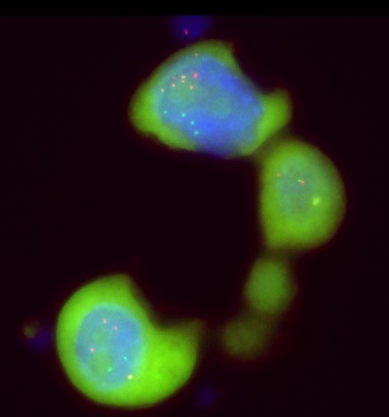
ALK positive
Normal cell:
2 fusions
ALK rearranged cells with extra copies

Slide 34
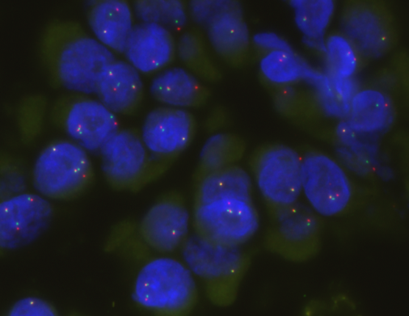
ALK and ROS1 testing in NSCLC
Requires single-slide of FFPE tissue for each test
Analysis can be complicated by extra copies (*) and in 30% of positive cases a single red (3’) signal is observed (>)
Criteria for positive case:
- at least 15% of cells counted are positive
- separation of the green and red signals by at least 2 signal diameters
- at least 100 cells counted (50 by two separate analysts)
*
*
>
*
*

Slide 35
Resistance to therapy (ALK)
ALK tyrosine kinase domain mutations (28% patients) e.g. L1196M ‘gatekeeper’ mutation reduces crizotinib binding
KRAS mutations
EGFR mutations
ALK copy number gain
RANPB2-ALK translocation

Slide 36

RAS mutations in colorectal cancer
cetuximab
Monoclonal antibodies that target and inhibit EGFR e.g. cetuximab, bevacizumab and panitumumab
However anti-EGFR therapy is ineffective in CRC with RAS mutations
NICE recommend use of cetuximab/panitumumab in combination with chemotherapy for previously untreated metastatic colorectal carcinoma if RAS wild-type only (TA176).
Inferior, progression-free survival, and objective response rates have been shown in patients with RAS mutations (at exons 2, 3, and 4 of KRAS and NRAS) who received cetuximab in combination with FOLFOX4 (oxaliplatin-containing) chemotherapy versus FOLFOX4 alone (OPUS trial)

Slide 37
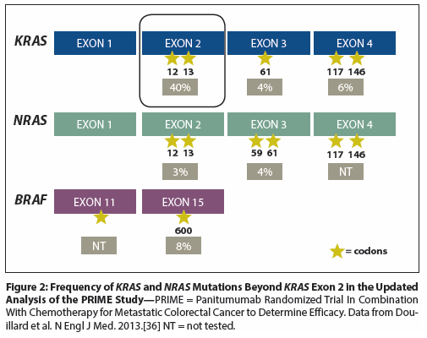
RAS mutations in colorectal cancer
RAS analysis identifies who will benefit from anti-EGFR therapy and prevents potential survival detriment (particularly if combined with oxaliplatin)
Gene | Exon | Codon | Example Mutations
KRAS & NRAS | 2 | 12 | c.34G>A; p.(Gly12Ser) G12S c.34G>T; p.(Gly12Cys) G12C c.35G>A; p.(Gly12Asp) G12D
 |  | 13 | c.37G>T; p.(Gly13Cys) G13S c.38G>A; p.(Gly13Asp) G13D
 | 3 | 59 | c.175G>A; p.(Ala59Thr) A59T
 |  | 61 | c.182A>T; p.(Gln61Leu) Q61L c.183A>C; p.(Gln61His) Q61H
 | 4 | 117 | c.351A>C; p.(Lys117Asp) K117N
 |  | 146 | c.436G>A; p.(Ala146Thr) A146T

Slide 38
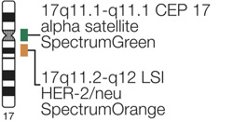
HER2 testing in breast cancer
Human epidermal growth factor receptor 2 (HER2) overexpression in ~15% early invasive breast cancers
Amplification and/or overexpression of HER2 has been shown to be both a prognostic and predictive marker in breast cancer.
Studies have confirmed the efficacy of Herceptin (trastuzumab) as adjuvant therapy for patients with overexpression of HER2.
FISH on FFPE breast tissue sections that have been identified as 2+ (borderline) by immunohistochemical stains for HER2 protein expression .
Ratio of HER2 copy number relative to the 17 centromere plus average HER2 copy number categorises patients into non-amplified, borderline, amplified.

Slide 39
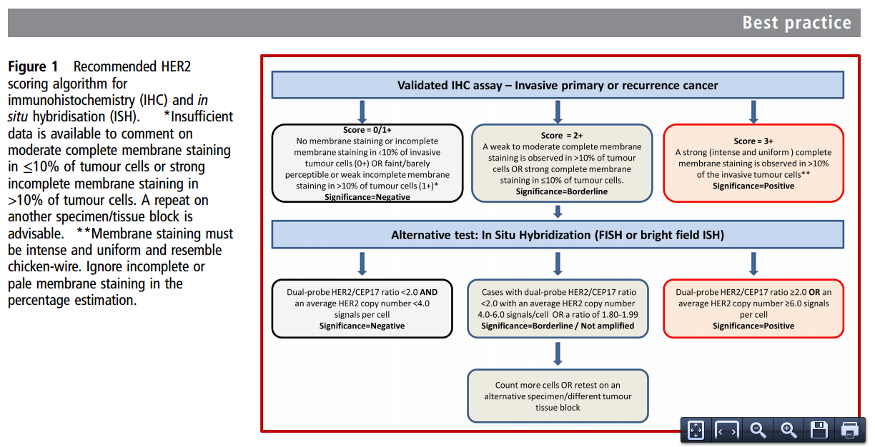
HER2 testing in breast cancer
Rakha EA, et al. J Clin Pathol 2014;0:1–7.

Slide 40
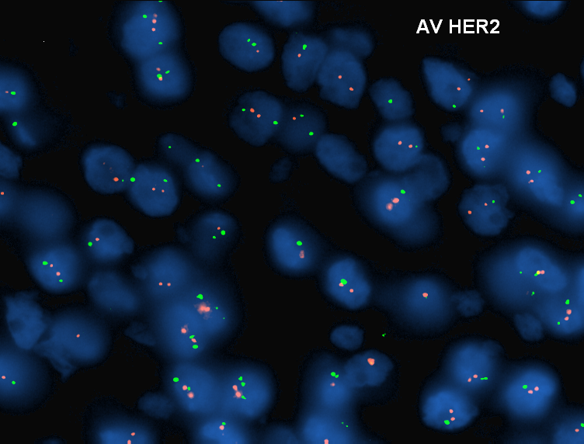
HER2 testing in breast cancer
HER2 not amplified

Slide 41
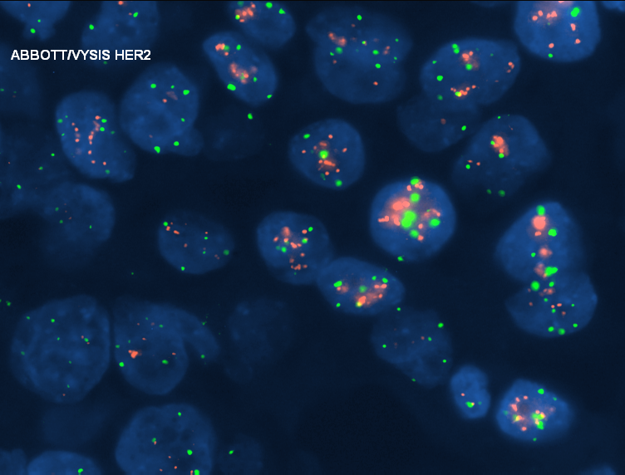
HER2 testing in breast cancer
HER2 amplified

Slide 42
Future Directions
~10 yrs ago: single mutation/gene tests
Now: small gene panels (~15 genes) in routine clinical use plus FISH assays for gene fusions
In development: larger panels: 60 genes/500 genes to include SNVs, fusions and copy number variants all in one assay. Also TMB for large panels.
100, 000 Genomes project – launched in 2012, now nearing completion, whole genome sequenced and cancer specific panels analysed: breast, colorectal, brain tumours (fresh/frozen tissue)
Aim: to bring benefits of genomic medicine into mainstream NHS
Whole genome sequencing due to be rolled out for sarcomas and paediatric cancers by the end of the year
1990s: 13 years to sequence first human genome ($2.7 billion)
Today: 26 hrs (<$1,000 genome) (+ time needed for analysis!)

Slide 43
Conclusions
Molecular analysis of solid tumours for clinically actionable mutations has become part of the routine clinical care and treatment for patients with melanoma, NSCLC, colorectal cancer and other tumour types.
This ‘personalised’ or ‘stratified’ medicine approach enables patients to be treated with the most effective therapy for their particular tumour.
Next generation sequencing technology more comprehensively profiles tumours enabling access to a wider range of clinical trials and therapies targeted to particular mutations.
Please feel free to contact me if you have any questions of would like any further information: claire.faulkner@nbt.nhs.uk

