Slide 1
Gynaecological pathology
September 2019 Bristol

Slide 2
Female genital tract Development 1 Ovary- Indifferent stage- Germ cells from yolk sac at 4th week of gestation 2 Uterus and fallopian tubes from Mullerian ducts at 6th week of gestation in absence of Mullerian Inhibiting substances. 3 Lower genital tract from urogenital sinus

Slide 3
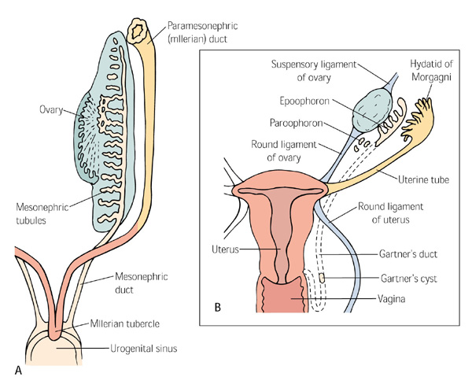

Slide 4
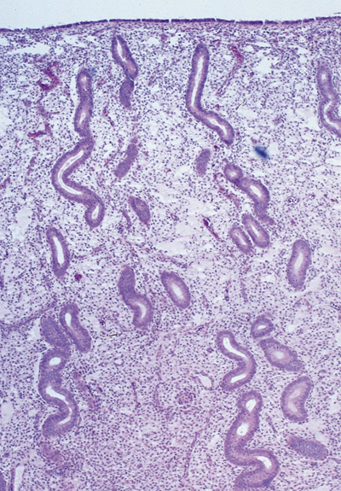
Endometrium
Normal Structure
Surface epithelium
Glands
Stroma and blood vessels
Inflammatory cells
Endometrioid Epithelium

Slide 5
Endometrium
Functional
Incorporates surface epithelium
Superficial part
Undergoes cyclical changes
Fine blood vessels
Shed in menstruation
Basal
Deep component
Does not show cyclical changes
Thick walled blood vessels
Retained post menstruation

Slide 6
Menstrual Cycle
0-4 menstrual phase
4-14 proliferative phase- Oestrogen driven
Early
Mid
late
14-28 secretory phase- Progesterone modulated- date specific features

Slide 8
Features for Endometrial Dating
Glandular changes
Structure
Mitotic activity
Nuclear features
Cytoplasmic vacuolation
Luminal secretions
Apoptosis
Stromal changes
Oedema
Mitotic activity
Decidua
Inflammatory cells

Slide 9
Proliferative endometrium
Growth of endometrium form 0.5 to 4 mm in thickness
Glands and stroma show brisk mitotic activity
Glands change from small tubular to tortuous
Pseudo stratified , oval nuclei
Stromal oedema
Fine blood vessels

Slide 10
Secretory Endometrium
Thickness up to 7 to 8 mm
Day 16 to day 28 orderly sequence of changes in glands (first half) and stroma(second half)
36 to 48 hours after ovulation
Ovarian luteal phase
At least 50% cells and gland should show vacuolation

Slide 11
Secretory endometrium
Stromal changes are characterised by predecidualisation, days 23 to 28
Granular lymphocytes or NK cells, CD56 positive
Apoptosis and nuclear dust appears at the base of glands
Fibrin thrombi in blood vessels

Slide 12
Menstrual Endometrium
Fibrin thrombi in small vessels
Glandular and stromal breakdown
Stromal Crumbling
Haemorrhagic background

Slide 13
Indications for Biopsy
Determining the cause of abnormal bleeding, intermenstrual bleeding and post menopausal bleeding
Status of endometrium in infertility analysis
Products of conception
Assessment of response to hormonal treatment

Slide 14
Variations- Physiological
Regional variations between Isthmic and corpus and functionalis and basalis
Recognition of metaplastic epithelium such as ciliated cells, pink cells , papillary and squamous cells
Cyclical
Age related changes such as atrophic or inactive

Slide 15
Clinical history
Any nonphysiological uterine bleeding
Dysfunctional/nonorganic abnormality
Pregnancy related
Organic lesion
Age and menstrual/menopausal status important for interpretation
Dysfunctional disorders seen in young patients
Polyp- 2 to 24%, in our study of PMB polyps accounted for 25%.
Hyperplasia- in peri or post menopausal patients up to 16% .
Malignancy in 10% of women

Slide 16
Endometritis
Disorder of reproductive years
Features include Presence of plasma cells and eosinophils, lymphoid cells, neutrophil and lack of normal glandular development
Infective aetiology includes Chlamydia and gonococcus infection
Follows pelvic inflammatory disease, recent gestation, instrumentation

Slide 17
Endometrial Polyp
Common cause of post menopausal bleeding
Focus of hyperplasia/ true neoplasia/focus lacking in hormonal receptors
Low proliferative potential
Cystic glands, Fibrous stroma incorporating blood vessels
Increased incidence following HRT usage

Slide 18
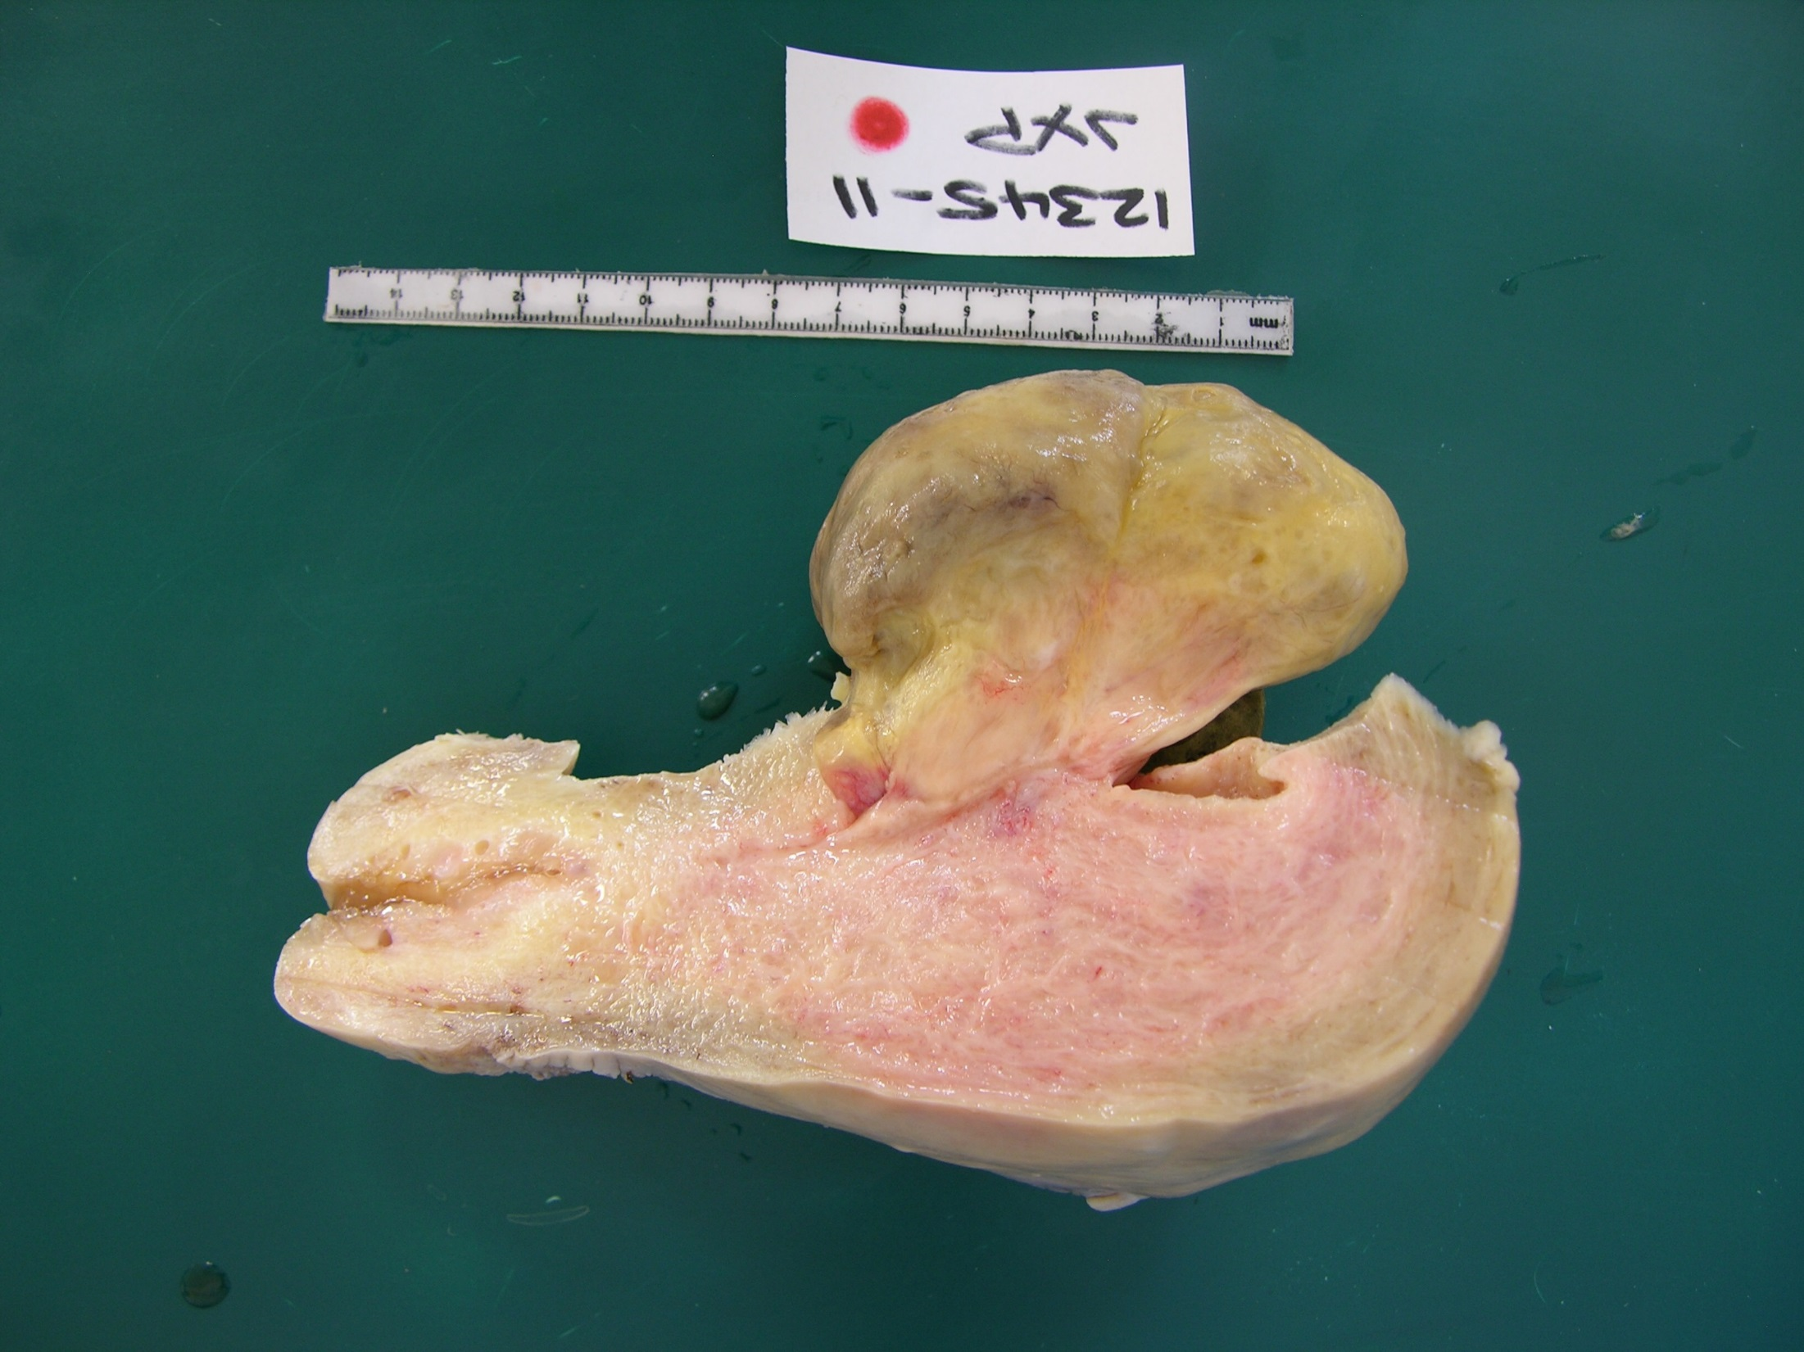

Slide 19
Endometrial Polyp
Histological features
Glands- tubular /cystic and metaplastic
Stroma- fibrous
Proliferative activity, mostly low
Inflammatory component
Architectural abnormality
Cytological abnormality
Therapy related features i.e. Tamoxifen

Slide 20
Pregnancy related changes
Miscarriage before 16th week of gestation
Approximately 15% to 20% early pregnancies result in loss
Spontaneous abortion before 12 weeks and at least half are due to chromosomal abnormalities
Incomplete abortion- conceptus is incompletely passed
Missed abortion- retained products without bleeding after death of foetus

Slide 21
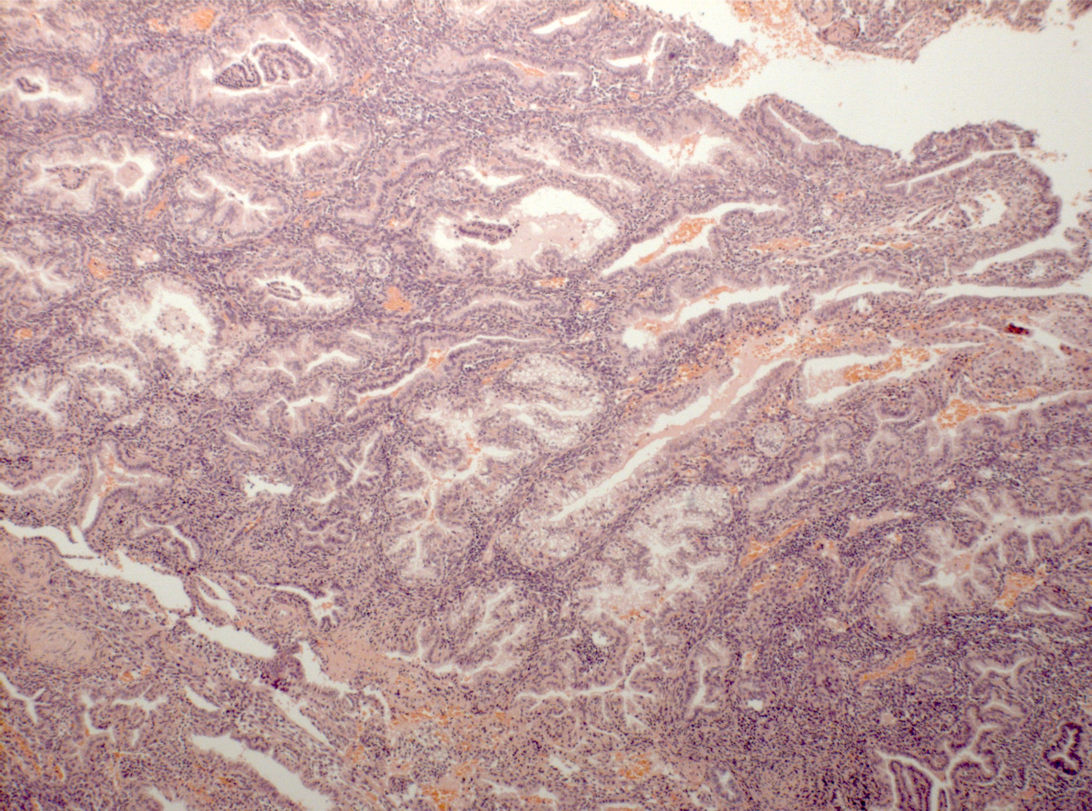

Slide 22
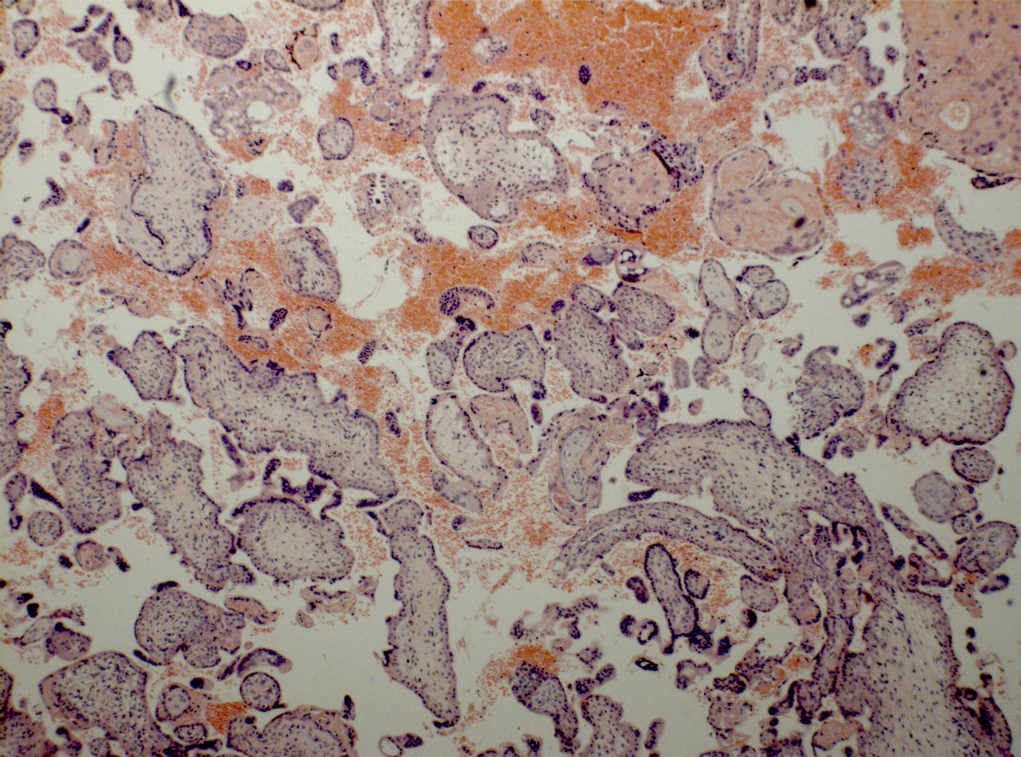

Slide 23
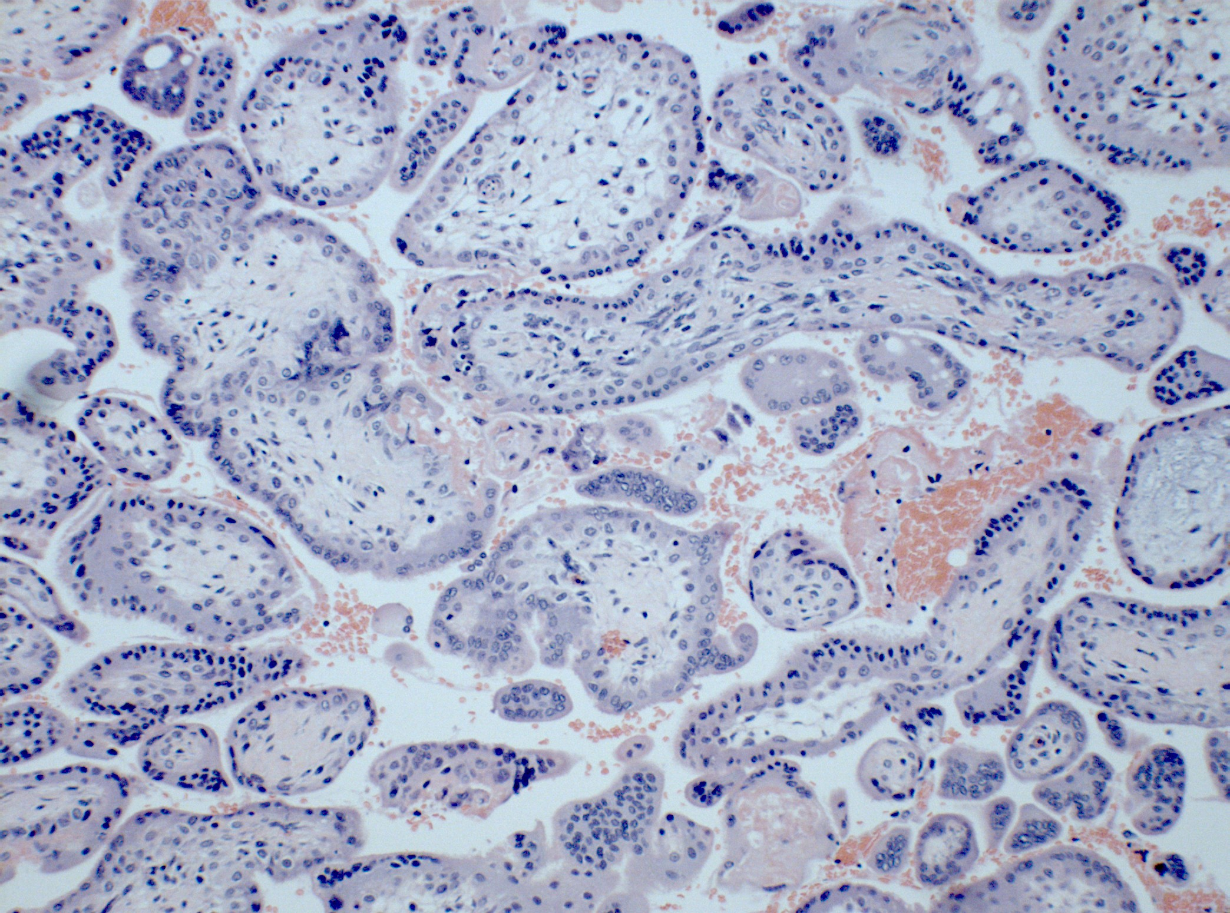

Slide 24
Abnormal uterine bleeding
Atrophy
Deficient proliferation
Follicular phase defect
Disordered proliferation
prolonged proliferation
Luteal phase defect
Anovulatory cycles

Slide 25
Endometrial Hyperplasia
Disease of perimenopausal women
Reflection of Anovulatory cycle
May result in menorrhagia
Ultra sound examination shows thickened endometrium
Subtypes
Simple- Cystic Hyperplasia
Complex Hyperplasia
Atypical Hyperplasia- EIN

Slide 26
Endometrial hyperplasia
Causes of Hyperplasia
Anovulatory cycles
Prolonged exposure to oestrogen
Polycystic ovary disease
Functioning ovarian or adrenal tumours

Slide 27
Simple Cystic Hyperplasia
Increased number of glands
Increased amount of stroma
Anovulatory cycles
Causes irregular bleeding
High levels of oestrogens

Slide 28
Atypical Hyperplasia
EIN- Endometrial Intraepithelial Neoplasia
Presence of cytological abnormality
Risk of progression to Adenocarcinoma is 25 %
May regress in a proportion of patients with Progesterone therapy

Slide 29
Myometrium
Smooth muscle cells supported by collagen
Respond to progesterone
Undergoes hypertrophy in pregnancy

Slide 30
Myometrial pathology
Leiomyoma
Adenomyosis
Stromal tumours
Leiomyosarcoma

Slide 31
Cervix
Transformation Zone
HPV
Definitions
Concepts of early invasive carcinoma
Screening programme
Vaccination programme

Slide 32
Transformation Zone
Site of active remodeling, proliferation and metaplasia of epithelium with reserve cells
Cells are vulnerable and a target for latent or active infections
Secondary factors contribute to progression of infection to neoplasia

Slide 33
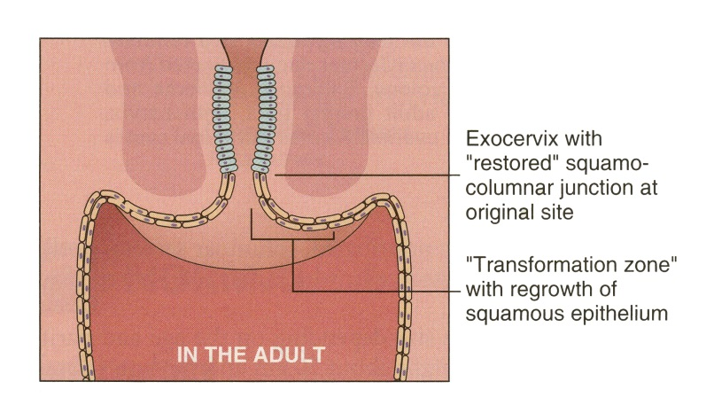
Structure of Cervix
Composed of 2 parts
Ectocervix – Squamous epithelium
Endocervix – Mucin secreting glandular epithelium
Transformation zone
Zone between original and functional Squamo- columnar junction
Reserve cells

Slide 34
Human Papilloma Virus
Non enveloped Double stranded DNA virus
8 kb circular genome
118 different genotypes
Epitheliotropic

Slide 35
Precursor lesions of cervical malignancy
CIN
SIL
Cervical intra epithelial neoplasia CIN I, II and III
Squamous intraepithelial lesions, low and high grade

Slide 36
Glandular precursor lesion
High grade Cervical glandular intra epithelial neoplasia
Adenocarcinoma in situ

Slide 37
Cervical smear

Slide 38
Cervical carcinoma
Squamous cell carcinoma
Adenocarcinoma
Neuroendocrine carcinoma
Adenosquamous carcinoma

Slide 39
Ovary
Normal structure
Endometriosis
Neoplasms

Slide 40
Normal structure

Slide 41
Normal Folliculogenesis
When FSH causes follicles to grow and develop and produce estradiol, activin and inhibin
provide a feedback mechanism to control the hypothalamus-pituitary-ovarian axis.
follicular cells develop LH receptors, which prepare the follicle for ovulation
After ovulation the granulosa and theca cells differentiate into luteal cells to produce progesterone
Notes:
After ovulation in normal cycles, the granulosa and theca cells of the ovulated follicle differentiate into luteal cells. The main function of this transformation is to produce progesterone to prepare the reproductive tract for successful implantation and pregnancy

Slide 43
Ovarian neoplasms
Epithelial neoplasm
Germ cell neoplasm
Sex cord stromal neoplasm
Secondary neoplasm

Slide 44
Epithelial neoplasm
Nature of epithelium
Biological nature of neoplasm
1- Serous
2- Endometrioid
3- Mucinous
4- Transitional
5- Clear cell
Benign
Borderline
Malignant

Slide 45
Endometriosis
Presence of endometrial glandular epithelial and stromal cells growing in the extra-uterine environment
10%–15% in women of reproductive age
Women with a first-degree relative with endometriosis are 5%–8% more likely to have endometriosis
Retrograde menstruation seen in 90%
Symptoms are pain and infertility

Slide 46
Take home message
Mullerian tract incorporates different types of specialised epithelium which are hormone responsive and capable of metaplastic changes.
There is a spectrum of age related, cyclical and regional variations in endometrium.
Ovarian neoplasms correspond to the different cellular constituents of the ovary
Cervical pathology incorporates understanding of relationship of infection with virus and immune system and development of neoplasia

