Slide 1
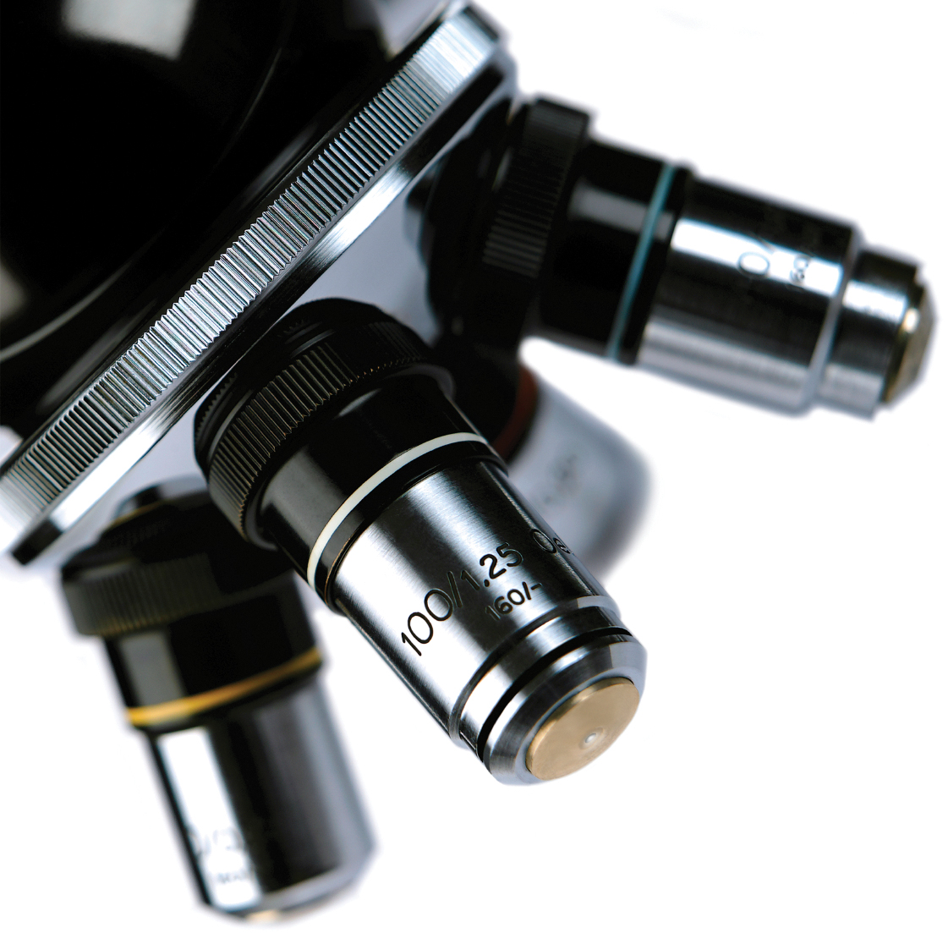
Non Cervical Cytology ST1 Block Teaching Week Bristol
Dr Vipul Foria
University Hospital Southampton

Slide 2
Background
The art and science of cytology has been implemented and recognised as early as the 18thand 19th centuries.
However the progress and the standardisation of this branch of pathology were not founded completely until the later years of the 20th century.
Scandinavian countries were able to utilise this technique even before World War II.

Slide 3
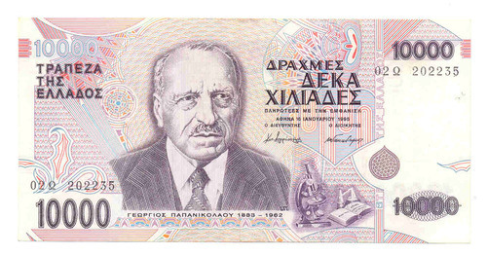
George Papanicolaou, after whom the famous Papanicolaou (Pap) smear and Pap stain were named, was one of the initial pioneers who drove the attention to the science of the ability to make a diagnosis looking at slides with a smear of cells in the period between 1917 and 1928
Papanikolaou’s portrait appeared on the Greek
10,000 drachma note from 1995 – 2001

Slide 4
Differences between Histology and Cytology
 | Histology | Cytology
Material | Tissue | Cells
Cost | More | Less
Anaesthesia | May be required | Not required
Equipment | Extensive | Minimal
Sampling Error | Less common | Possible
Complications | Uncommon | Rare
Scar | Yes | No
Ancillary Studies | Possible | Possible but may be limited

Slide 5
Applications
Provide definitive diagnosis
Screening tool- cervical cancer
Follow-up- disease recurrence
Prognosis- molecular markers eg. Her-2, EGFR, etc.

Slide 6
Advantages
Safe
Simple
Quick
Cost-effective

Slide 7
Types of Cytology Samples
Aspiration- FNA of palpable and non-palpable lesions
Exfoliative- respiratory samples, GI brushings, urine, body fluids
Scrapings- skin

Slide 8
Technical Aspects
Direct smears
Cytospin- prepared using the cytocentrifuge method. Concentrates the material and is especially advantageous when few cells are present in a large amount of fluid, such as pleural or peritoneal fluids.
Monolayer liquid-based cytology- used to prepare Pap smears. The smears are superior to their conventional counterparts and also allow testing for Human Papilloma Virus DNA particles. The cells are laid on the slide in a monolayer fashion and the background is clean
Cell Block- material flushed in ethanol or formalin-based solution after which the material is centrifuged and a mini biopsy is created from the concentrated cellular material at the bottom of the tube that can be used to do special stains including immunohistochemical stains.

Slide 9
Staining techniques
Alcohol Fixed- Material spread and fixed immediately in alcohol
Stain with Papanicolau Stain
Air dried- Material spread and rapidly air dried
Stain with Giemsa Stain

Slide 10
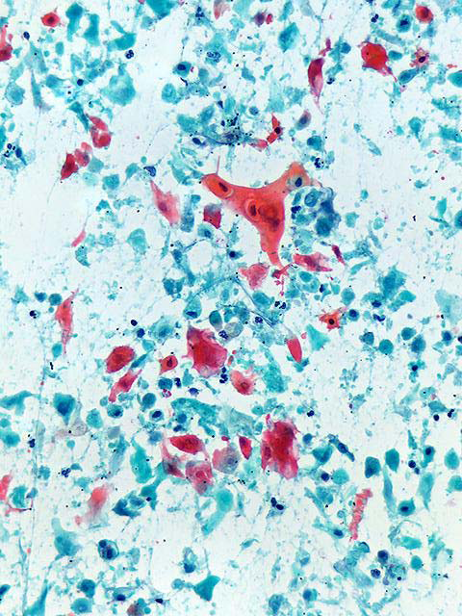
Papanicolaou stain
Nuclear details
Keratin
Extracellular material translucent so does not interfere with cellular details
Urine, respiratory samples, squamous cells
Cells may appear smaller (more benign)

Slide 11
Air dried
Romanowski stains
Diff Quick
MGG
Giemsa

Slide 12
Air dried preps
Good for cytoplasmic features
Extracellular material better seen- colloid, amyloid, mucin, etc
Quick- can be used in one-stop clinic
Thyroid, salivary gland, lymph nodes
Cells appear larger (more malignant)

Slide 13
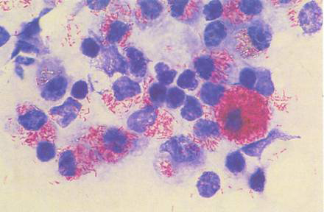
Ancillary techniques
Cell blocks
Immunocytochemistry
Special stains- Perl’s, PAS, ZN, etc
Flow cytometry
Mol. techniques

Slide 14
What to look for in cytology
Overall cellularity
Types of cells
Stromal/extracellular elements
Nucleus
Cytoplasm

Slide 15
Nucleus
N:C ratio
Pleomorphism
Nuclear outline- smooth or irregular
Chromatin pattern- euchromatin and heterochromatin
Anisonucleosis
Nucleoli- size, number

Slide 16
CYTOLOGICAL FEATURES OF MALIGNANCY
No single feature is diagnostic of malignancy
Constellation of findings that vary depending on the tissue aspirated, the collection technique and the smear preparation method.
General features of malignancy include:
high cellularity
cellular enlargement
increased N/C ratio
nuclear hyperchromasia
discohesiveness of cells
prominent and large nucleoli
abnormal distribution of nuclear chromatin
increased mitotic activity and specially the presence of abnormal ones
nuclear membrane abnormalities
cellular and nuclear pleomorphism
background tumour necrosis (tumour diathesis)

Slide 17
Pitfalls
Air drying artifacts (leaving the smears for too long before fixing). This will sometimes give false impressions of enlargement of the cells and nuclei, which in inexperienced hands may increase the incidence of false positive diagnosis.
Marked inflammation. The presence of marked inflammation sometimes obscures diagnostic cellular details, causing a false negative diagnosis. A comment in the report indicating that there is marked inflammation obscuring cellular details may be a necessity.
Too many blood elements- especially red blood cells. Usually seen in sampling of certain organs (such as thyroid and liver). Thorough screening of the slides is mandatory so that abnormal/malignant cells can be detected and interpreted appropriately.
Cellular changes related to radiation and/or chemotherapy: Certain changes are induced by these treatment modalities. The pitfalls can be reduced by detailed clinical history and awareness of the changes by the pathologist.

Slide 18
FALSE NEGATIVE
Desmoplasia: Many tumours can cause fibrosis around the malignant cells. Eg. breast, pancreatic and biliary tree carcinomas, nodular sclerosing Hodgkin's lymphoma. Applying negative pressure and multiple passes during the FNA procedure can help.
Well-differentiated tumour cells: Certain tumours resemble their normal counterparts. Eg. thyroid follicular carcinoma, hepatocellular carcinoma.
Sampling problems: Sometimes the needle is not in lesion of interest.
Inflammation

Slide 19
FALSE POSITIVE
Inflammation, radiation and chemotherapy effects
Haemorrhage and infarction sometimes induce atypical changes in the cells.
Reactive changes

Slide 20
CYTOPATHOLOGY REPORT
Adequacy-critical if the material is inadequate and the final message is to re-evaluate and/or re-investigate
Microscopic description
Diagnosis- a specific diagnosis is always desired when possible. Sometimes the diagnosis is broad, such as “positive for malignant cells” and then this will be followed by descriptive diagnosis and a comment entailing a differential diagnosis to help the clinicians. In some cases, not all the diagnostic criteria are present or the atypical cells are very few; in these circumstances a “suspicious for malignancy” diagnostic category can be used.
Comment- In certain circumstances a comment is needed to clarify or add some information that may be of clinical importance.
Communication- may need to call the clinicians and discuss the case either face to face or over the telephone.

Slide 21
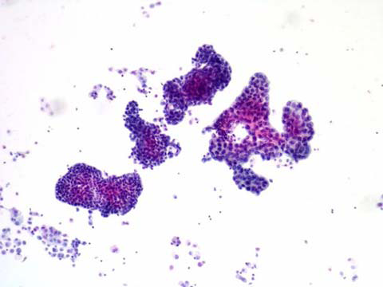
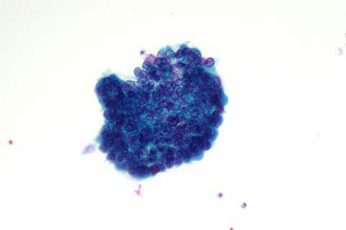
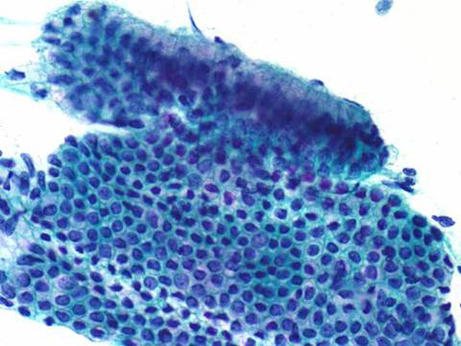
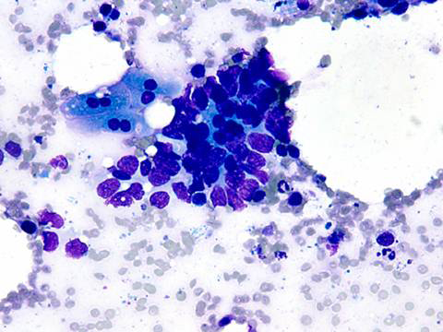
Cell Patterns
Papillary
Cluster
Honey combing
Moulding

Slide 22
Common specimen types
Fluids- ascitic, pleural
Respiratory- sputum, wash, brushings
Breast
Thyroid
Salivary glands
Urine
LNs
EUS, EBUS

Slide 23
Fluids
Pleural fluid
Pericardial fluid
Peritoneal (Ascites) fluid
Pelvic/Peritoneal Washing

Slide 24
Normal Components and Findings
Mesothelial cells in effusions
Nuclei
Single or binucleate
Centrally located but can be eccentric
Round to oval with well-defined, smooth nuclear borders
Fine chromatin
Inconspicuous nucleoli
Cytoplasm
Dense center with pale periphery
Lacy “skirt” cell borders
Blunt cytoplasmic processes due to degeneration

Slide 25
Benign mesothelial cells

Slide 26
In washings

Slide 28
Histiocytes
Usually present in effusion. Prominent in cancer, TB and embolism
Lymphocytes
Some amount usually present. Can be numerous in conditions ranging from congestive heart failure and infections to carcinoma and lymphoma
Eosinophils
Causes include previous tap, pulmonary infarct, pneumonia, trauma, hydatid disease
Neutrophils
Presence can have many causes, particularly infection. Malignant effusions are seldom associated with acute inflammation

Slide 29
Reactive changes
Reactive changes are common and may be due to:
Pulmonary embolism or infarct
Active cirrhosis or hepatitis
Uraemia
Pancreatitis
Long-term dialysis
Radiation and chemotherapy

Slide 30
Reactive changes
Features of reactive mesothelial cells may include:
Varying cell sizes
Increased numbers of mesothelial cells
Enlarged central or paracentral nuclei
Binucleation or multinucleation
Coarsening of chromatin that remains evenly distributed
Nucleoli may become prominent

Slide 31
Tumours causing malignant effusions:
Primary:
Malignant Mesothelioma
Effusion Lymphoma
Metastatic:
Adenocarcinoma
Squamous Cell Carcinoma
Neuroendocrine Tumors
Lymphoma/leukaemia
Melanoma
Other Neoplasms

Slide 32
Mesothelioma
Usually associated with asbestos exposure
Most cases occur in men aged 50 to 70 years
Commonly found in the pleural cavity but can occur in the peritoneal cavity as well

Slide 33
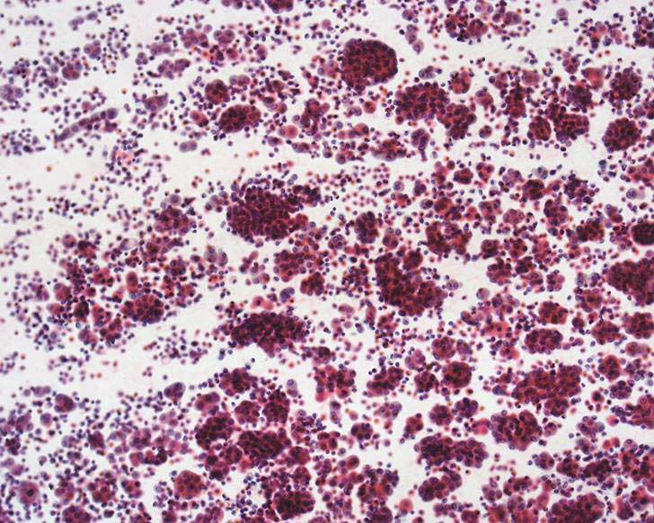
Mesothelioma
Cytologic features:
One cell population of malignant mesothelial cells
Larger clusters with irregular, knobby, flower-like borders
Dense endoplasm with delicate, lacy ectoplasm
“Windows”, “skirts” or blebs of cytoplasm
Central enlarged nucleus with macronucleoli and irregular borders
Abnormal mitotic figures may be seen but are not diagnostic of mesothelioma

Slide 34
Immunochemical Markers
Mesothelioma
Adenocarcinoma
Calretinin +
WT-1 +
CEA -
TTF-1 -
MOC-31 -
Ber-EP4 -
B72.3 -
Calretinin -
WT-1 -
CEA +
TTF-1 +
MOC-31 +
Ber-EP4 +
B72.3 +

Slide 35
Adenocarcinoma
Cytologic features:
Glandular acini, papillae or cell balls
Increased N/C ratios
Irregular nuclear membranes
Abnormal chromatin
Large or irregular nucleoli
Secretory vacuoles with mucin

Slide 36
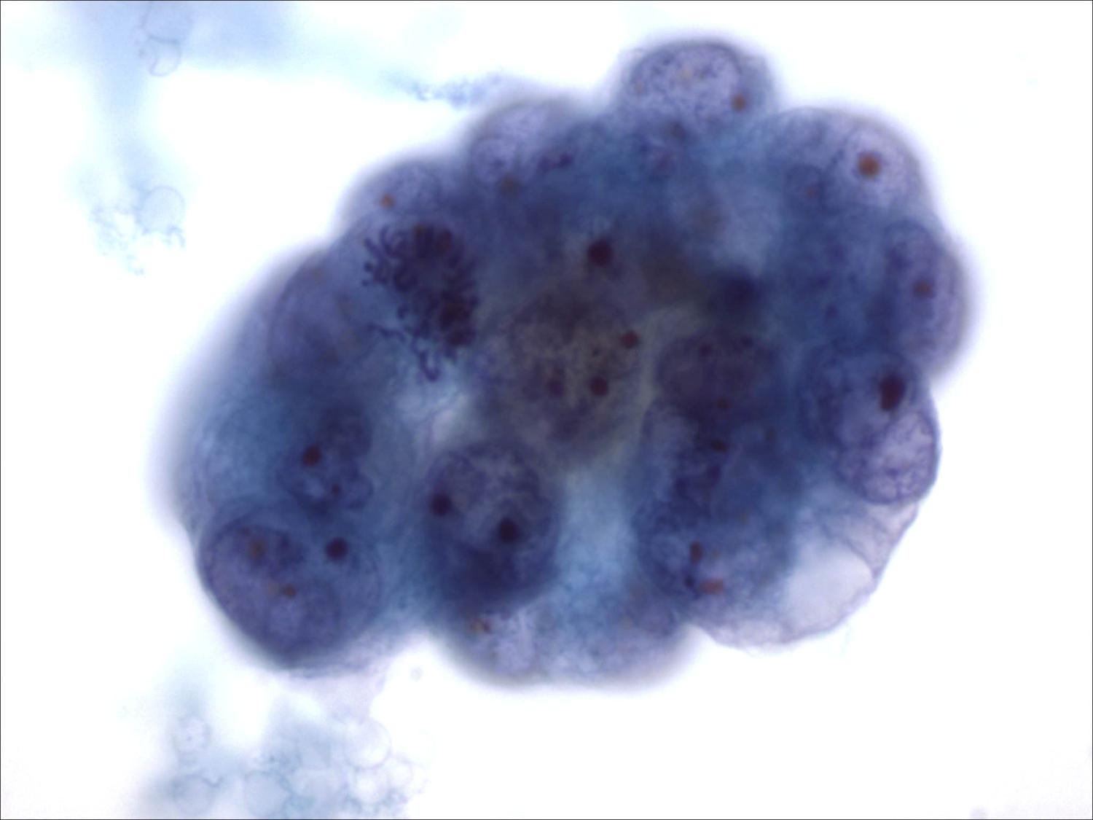

Slide 37
Respiratory Cytology
Exfoliative methods
Sputum cytology
Bronchial cytology (BW and BB)
Bronchoalveolar lavage (BAL)
Fine needle aspiration (FNA)

Slide 38
Sputum
The best sample is an early morning deep cough sample
Alveolar macrophages: lower respiratory tract sampling
Reflect constituents from many regions of lung
Useful for centrally located malignancies (Squamous cell/Small cell CA)
To increase diagnostic yields: induced sputum, 3-5 samples
Chronic inflammations: Asthma, COPD
Respiratory infections

Slide 39
Bronchial cytology
Fibreoptic bronchoscopy
Adequacy: large number of bronchial epithelial cells and alveolar macrophages
Inadequate specimen: heavy oral contamination, obscuring blood, inflammatory process, drying artefact

Slide 40
Bronchial cytology: disadvantages
Limited area of the lung examined by bronchoscopy
Invasive procedure: unpleasant for the patients
Benign tumors, extremely peripheral lesions

Slide 41
Bronchoalveolar lavage
The most distal airspaces
Diffuse disease process
Pulmonary infection: opportunistic infections
Interstitial lung disease
Lymphoproliferative disorders
Malignancy

Slide 42
FNA cytology
Percutaneous transthoracic FNA
Direct lung tap
CT-guided FNAB
Transbronchial FNA
Bronchoscopy
Staging of lung tumors
Hilar nodes
Mediastinal nodes
Subcarinal nodes

Slide 44
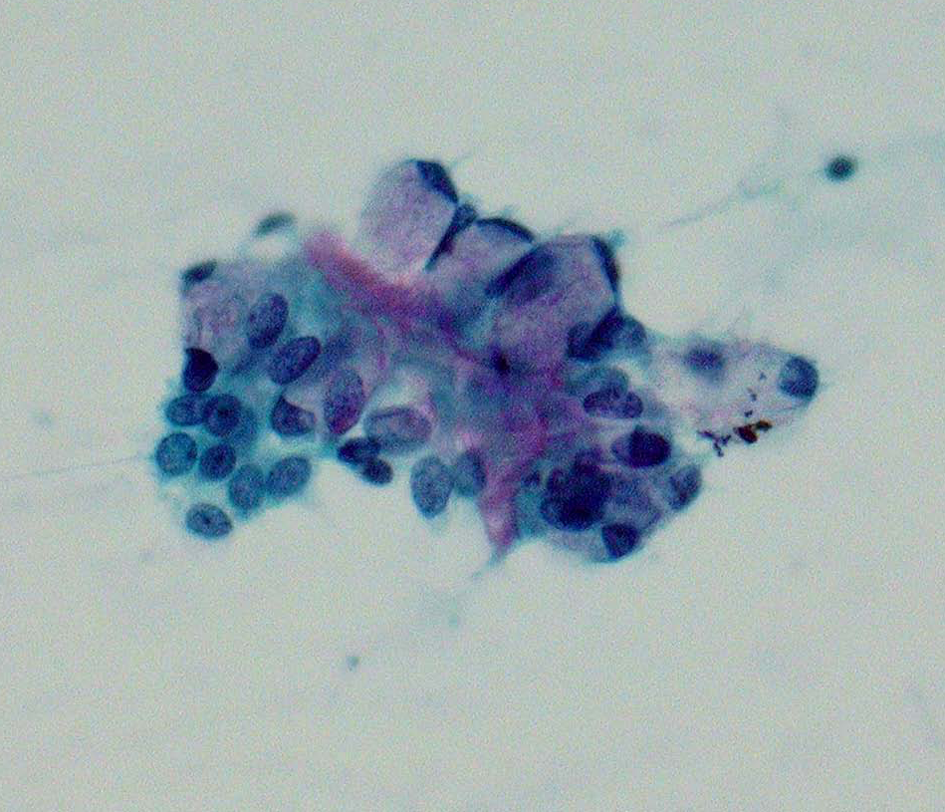

Slide 47
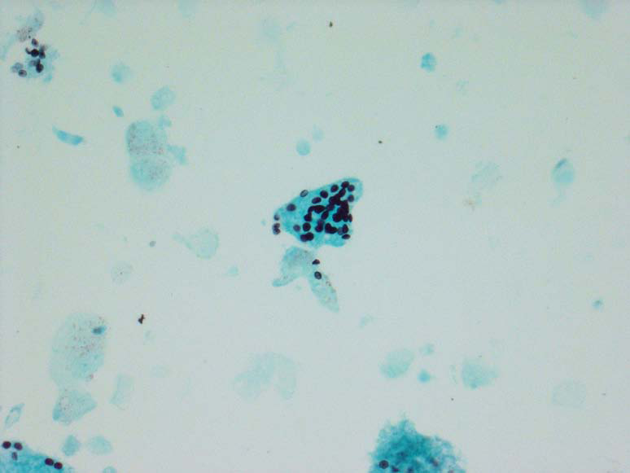

Slide 51
Breast
Triple approach
FNA results
Clinical findings
Radiologic findings
Combining these 3 tests improves false negative and false positive results

Slide 52
Diagnostic categories
C1: Unsatisfactory
C2: Benign lesion
C3: Atypical, probably benign
C4: Suspicious for malignancy
C5: Malignant

Slide 55
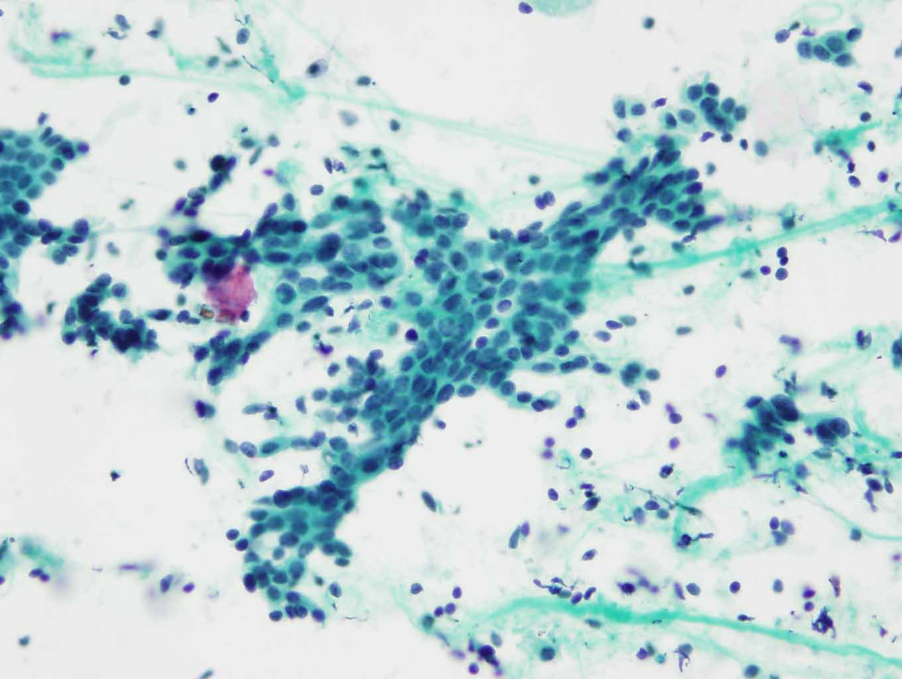
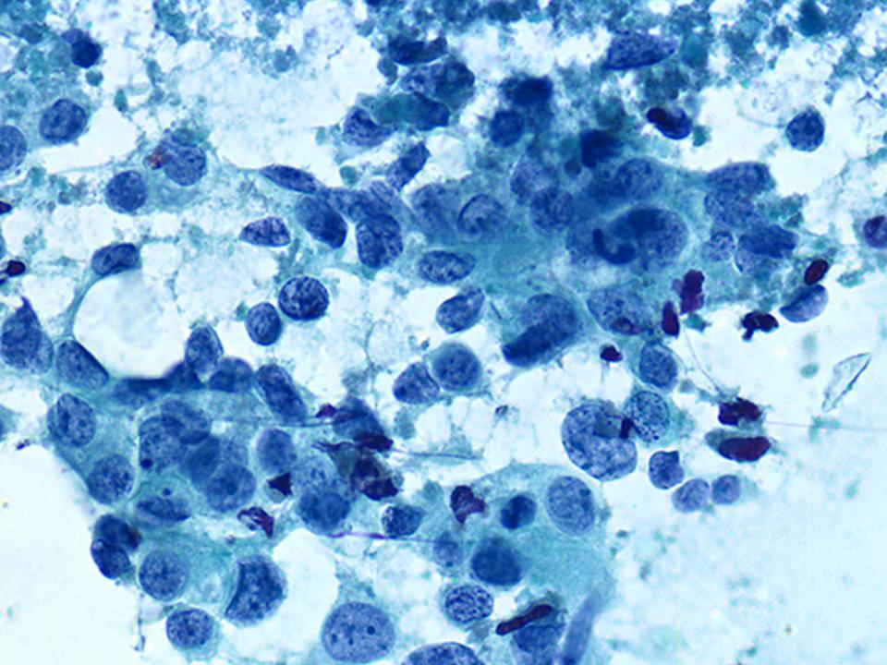
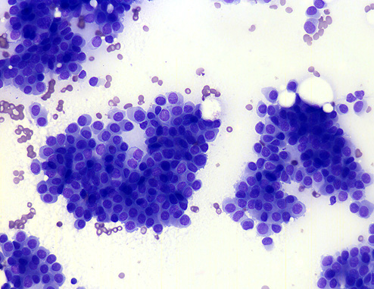
Fibroadenoma
Ductal Carcinoma

Slide 57
Summary
Cytology can be used as a screening or diagnostic test
Sample taking is simple, quick and inexpensive
Can be used in the one-stop clinic for rapid diagnosis.
Little risk to patient, no anaesthesia or scars
Requires good communication with clinicians and correlation with other diagnostic methods (triple approach)

Slide 58
Thank You!

